Slide 1
Structural control of igneous complexes and kimberlites: a new statistical method Dazheng Zhang and Lutz, T., 1989.

Slide 2
Spatial distribution of magmatic activity
transport through the lithosphere
mechanical properties of the lithosphere
zones of weakness
associated with deep crustal fractures
linear outcrop patterns

Slide 3
Monte Carlo simulations
null model
anisotropies
evaluated on a statistical basis

Slide 4
Geologic point features
earthquake epicenters
kimberlites
igneous complexes
distribution random
controlled by geologic structures

Slide 5
Magma transport control
pre-existing zones of weakness
stress fields during ascent
epeirogenic faults
transform fault extensions

Slide 6
Anisotropic point feature distribution
Chapman (1968) alkaline igneous complexes
lattice nodal points
intersecting sets of crustal fractures
grid lines could be constructed
complexes located at nodal positions
Thompson and Hager (1979)
intuitive perceptions

Slide 7
Lutz (1986) Monte Carlo simulations
line azimuth method
spatial anisotropy
shape of the region
azimuths of lines

Slide 8
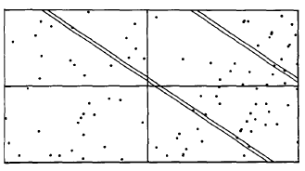
Filtering method (Strip method)
convex bounding polygon
parallel strips
equal number of strips
width of the strips
areal point density
vary the orientation

Slide 9
Filtering method continued
limiting value arbitrary
false positive
false negative
signal to noise ratio

Slide 10
Comparison of methods
should yield same anisotropies
different measures of spatial organization
line azimuth distribution (smaller scale)
point density (regional scale)

Slide 11
Applications
theoretical tectonics
mineral resources location
geologic hazards

Slide 12
Studies
Ring complexes
Kimberlite pipes

Slide 13
Conclusions
In neither case can a convincing connection be shown between the directions of the trends indicated by the analysis and the trends of known geologic structures
located at depth and have no known surface expression
basis for predicting the locations of undiscovered or future events

Slide 14
Thank You

