Slide 1
Pre- Basin and Range Magmetism
Jody Becker
Kelsii Dana
(Team Awesome)

Slide 2
Background
Geologic record in the High Lava Plains:
>19 Ma- intermediate composition volcanism
19-17 Ma- magmatic hiatus
17-14 Ma- bimodal volcanism; Steens, N NV Rift, and CRB basalts, NW B&R rhyolitic activity
13-11 Ma- volcanism focused to High Lava Plains, W Owyhee Plateau
<10 Ma- High Lava Plains/NW B&R basalt and age-progressive rhyolite eruptions

Slide 3
Pre-Basin and Range Magmatism
Intermediate composition magmatism
Shallow subduction, delamination of slab
Extreme extension, low angle faulting
Magma mixing
Ignimbrite
Shallow-slab subduction
Delaminating subducting plate
Region potentially affected by Yellowstone hotspot

Slide 4
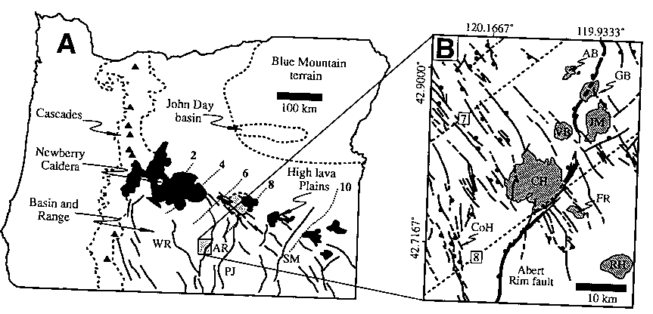
Coleman Hills
22 Ma Composite Volcano heavily eroded, Miocene dikes, sills, volcaniclastic sed. exposed
Mafic dikes vesicular with glassy margins
Irregular contacts between sills and contact breccia
Dunes in lithic tuff containing ash and reworked lithics
Rhyolitic deposits in shallow water-filled basin, injected with mafic dikes.

Slide 5
Simplified Geology of Coleman Hills

