Slide 1
Regional Structure High Lava Plains
-Reviewed by Jody R. Becker-

Slide 2
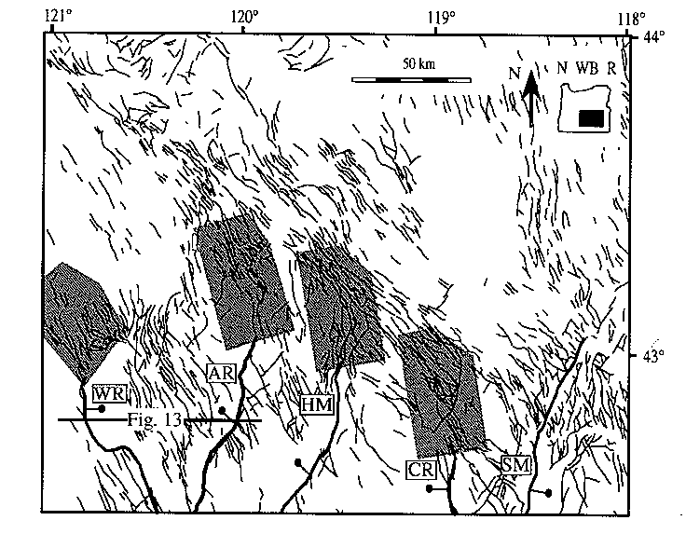
Post Laramide Forces at Work
Some Possible Models for Deformation
Trench pull and Subduction zone rollback
Rotation of the Cascadia Forearc
Development and propagation of San Andreas and Walker Lane fault systems
Collapse of the crust due thickening of Laramide crust

Slide 3
Structurally
Wide diffuse zone of NW striking Faults
Tens of meters long
Strike NW
Brothers Fault Zone (intracontinental transform fault)
Seperates Basin and Range from non extending crust of HLP
Basin and Range
Strike N-NW to N-NE and are tens of kilometers long
Widely spaced, bound to the Grabens
Faults of both trends occur in both provinces

Slide 4
Rotation Point
Central Oregon and Washington Border
GPS data identifies a rotational axis that increases southward into the Basin and Range
Paleomagnetic data suggests that Oregon has been extended by ~17% in the past 15 Mya
N-NW movement of the Pacific Plate has “pulled” continental material with it
Moving at `52mm/year since 8 Mya
Results in extension in the E-W directions and lateral shear

Slide 5
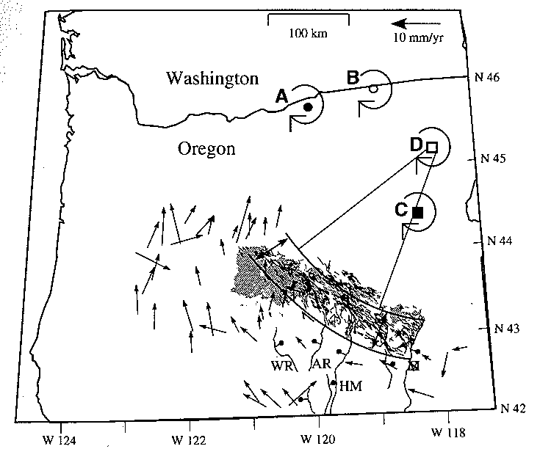
Possible Pivot Points

