Slide 1
Acculturation Psychology and Study Abroad
Dr. Victor Savicki
Western Oregon University

Slide 2
Agenda
Acculturation: What is it? Why it is important?
ABC’s of Acculturation
Affect, disequilibrium and adjustment
Behavioral adaptation
Cognitive identity challenges and changes
Implications for study abroad

Slide 3
Acculturation
Acculturation:
The process of cultural and psychological change that takes place as a result of contact between cultural groups and their individual members (Berry, 2005).
Changes that occur as a result of continuous first-hand contact between individuals of differing cultural origins (Ward, 2001).
Acculturative stress:
Stress reactions in response to life events that are rooted in the experience of acculturation (Berry, 2005).

Slide 4
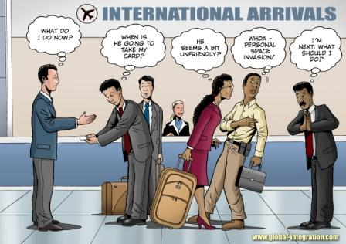
Acculturative Stress Example

Slide 5
Disequilibrium and Satisfaction
for Study Abroad Students Only
Intercultural Adjustment Potential
Satisfaction with Life
T-scores

Slide 6
Ward’s ABC’s of Acculturation
Affect
Stress, coping, adjustment, well-being
Behavior
Adaptation to behavioral demands, “fitting-in”
Cognition
Social identity, self-description/concept
Ward, (2001)

Slide 7
Affect: Stress and Well-being Model
Well-being
Adjustment
Emotion
Antecedent Event
Appraisal
Harm/Loss
Threat
Challenge
Benefit
Coping
Effective
Ineffective
Meaning
Lazarus, 1999

Slide 8
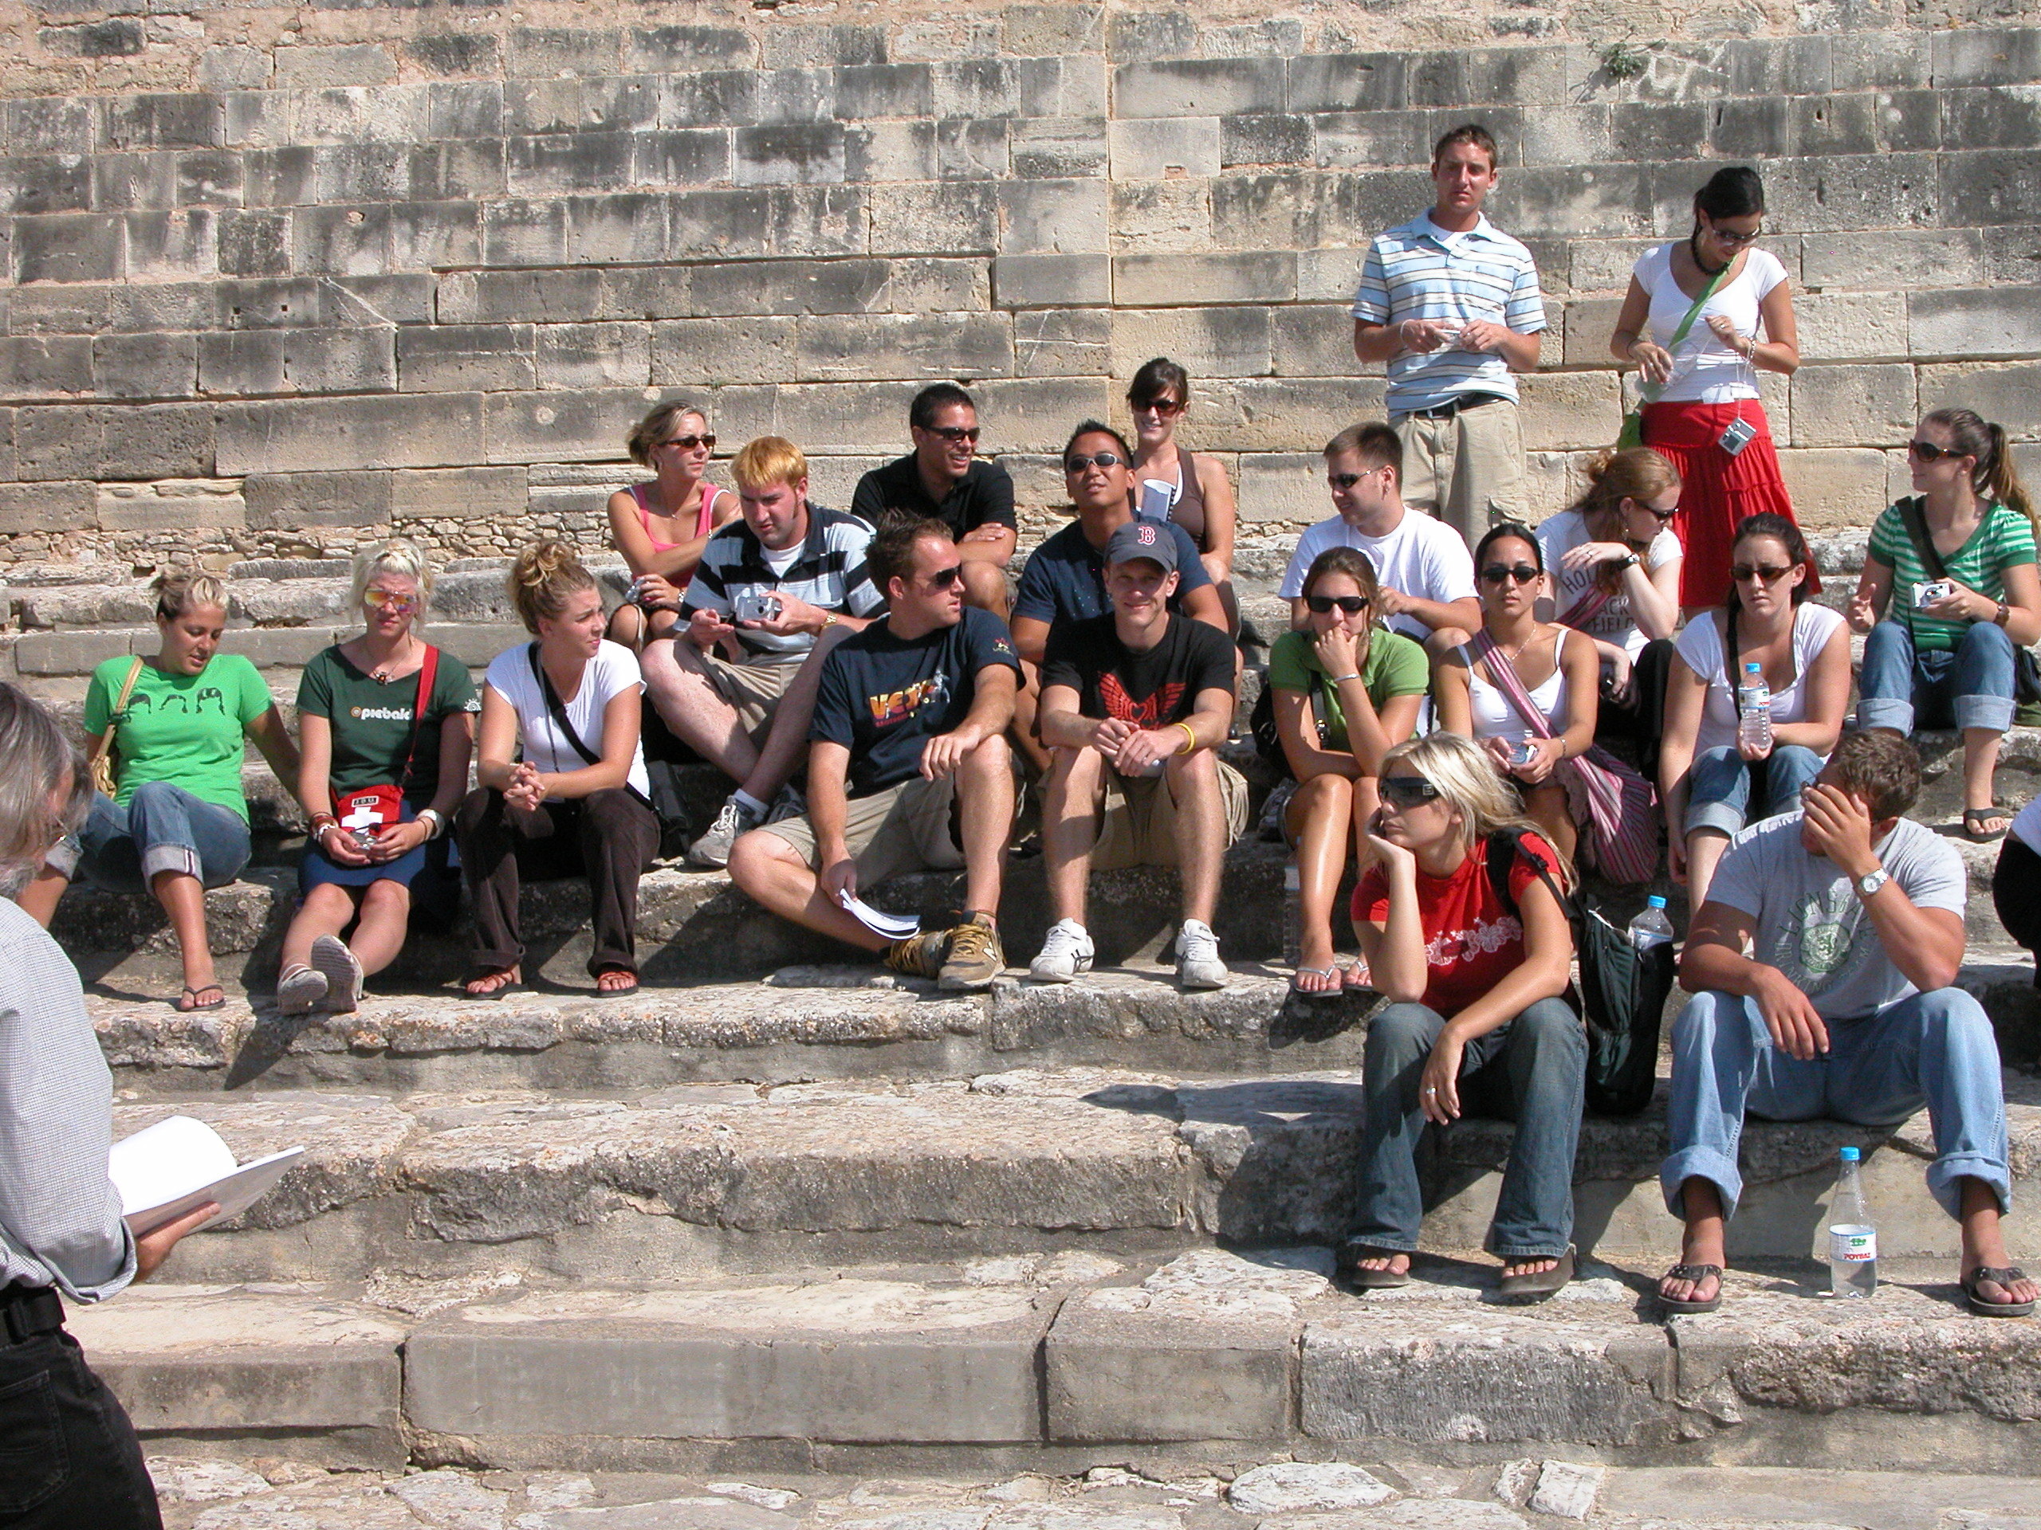
Affect Findings
Stress Appraisal
Higher Wellbeing: Challenge
Lower Wellbeing: Threat, Loss
Effective coping strategies
Active coping
Planning
Acceptance
Positive reinterpretation
Ineffective coping strategies
Behavioral disengagement
Denial
Venting Emotion

Slide 9
Behavior: Socio-cultural Adaptation Factors
Cultural Empathy-Relatedness | Impersonal Endeavors and Perils
Making friends | Dealing with someone who is unpleasant/cross/aggressive
Accepting/understanding the local political system | Getting used to the local food/finding food you enjoy
Understanding the locals’ world view | Dealing with people in authority
Taking a local perspective on the culture | Dealing with the bureaucracy
Understanding the local value system | Getting used to the pace of life
Seeing things from the locals’ point of view | Dealing with unsatisfactory service in stores and restaurants
Understanding cultural differences
Being able to see two sides of an intercultural issue
Ward & Kennedy, 1999

Slide 10
Behavior Findings, No U Curve

Slide 11
Cognition: Identity
Psychological identity refers to a subjective feeling of consistency and continuity of self across situations that provides a sense of stability and serves as a guide for making key life choices. A stable identity develops over time through a process of experimentation, reflection, and observation that peaks in adolescence and may continue into early adulthood.

Slide 12
Identity Components
Gender
Ethnicity
Family roles (son/daughter, mother/father, etc.
Career/work/professional
Ideology
Religion
Culture
National

Slide 13
Identity: Context
Erik Erikson Identity, Youth and Crisis (1968).

Slide 14
Marcia’s Formulation

Slide 15
American Identity: Home vs Abroad

Slide 16
Identity and ABC’s
Pre-Departure Commitment/Affirmation (C) correlated significantly with Post behavioral adaptation difficulties (B).
Pre-Departure Commitment/Affirmation (C) is related to lower Flexibility, higher appraisal of cultural experiences as Threats, stronger Negative Affect and higher Anxiety (A).
Pre-Departure Exploration/Search (C) also correlated significantly with Post behavioral adaptation difficulties (B).
Pre-Departure Exploration/Search (C) correlated significantly with the appraisal of acculturative stress as a Threat, Critical Thinking, Negative Affect, and Depression (A).

Slide 17
Discussion
Higher Pre-Departure Commitment/Affirmation may indicate a more fixed, potentially rigid identity; thus less amenable to intercultural adaptation; or a more tender, tentative formulation.
Higher Pre-Departure Exploration/Search may open the Study Abroad student to more identity questions and anxiety, thus more negative affect if unresolved.
Impact of intergroup contact anxiety and symbolic anxiety

Slide 18
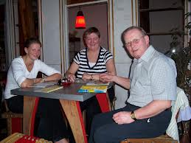
Waiting to be served
You and your group have been waiting to be served for over 30 minutes in a local restaurant.
Compare and contrast American vs Spanish cultures.

Slide 19
U.S. Cultural Values (as viewed by other cultures)
Kohls, (1984).

Slide 20
ABC contributions
Affect: Positive reinterpretation (more time for socializing)
Behavior: adaptation over time (pace of life)
Cognition:
Reframing to fit with Spanish cultural values.
Expanding meaning perspectives to include “slowness” as valuable in some cases.

Slide 21
Conclusions
Acculturation and the ABC’s are a useful framework for thinking about study abroad
Students and faculty differ in life experience and life cycle emphases
Reflective thinking/processing is key to constructing a useful, growthful narrative.
Cognitive identity in the form of culturally based values and beliefs can both help and hinder positive study abroad outcomes.

