Slide 1
Word Level 2 Tutorial
Western Oregon University

Slide 2
At the completion of this tutorial you will be able to.
Use a really cool program to create fake research papers.
Use styles in your document
Add images with descriptions
Add citations to your document
Create a bibliography
Create a table of contents
Fun extras

Slide 3
1.0 We are going to create some text to use with Microsoft Word so you don’t have to type it.

Slide 4
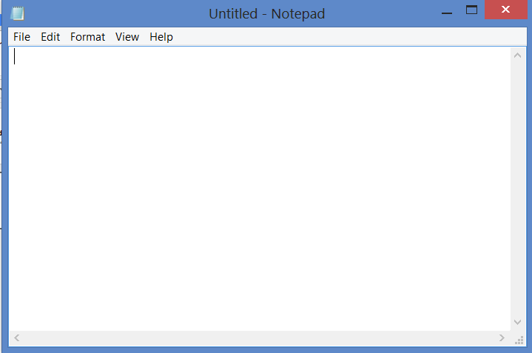
1.1 Open notepad
(you can search for Notebook or type Notebook at the command line).

Slide 5
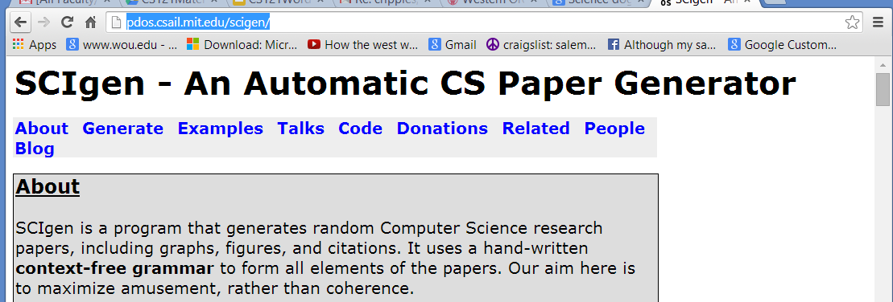
1.2 Go to this site. It creates fake computer science research papers.
http://pdos.csail.mit.edu/scigen/

Slide 6
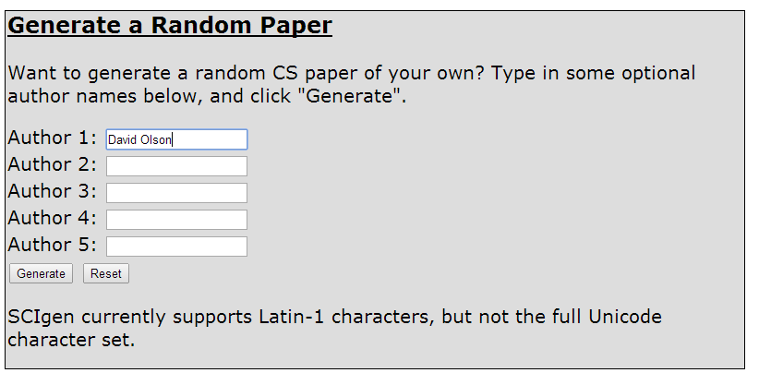
1.3 Create a fake paper with you as the author.

Slide 7
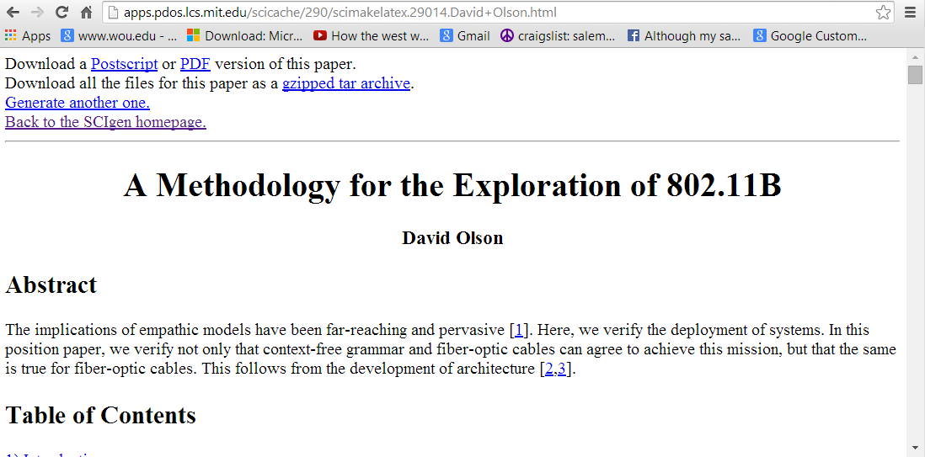
1.4 Your paper will look very different
Select the entire paper (CTRL-A)
Copy the paper to the clipboard (CTRL -C)

Slide 8
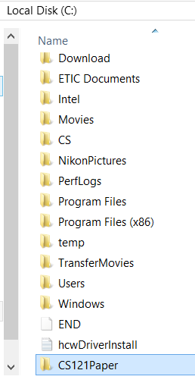
1.5 Create a new directory for the html page you created.
This one was made right off of the CDrive.
Just make it somewhere so that you can find it.

Slide 9
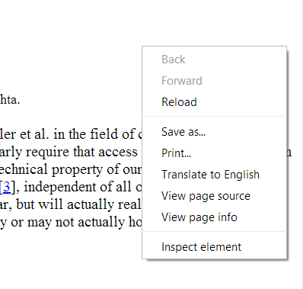
1.6 Right click on the web page and save it in the directory you just created
The image files will be store as well.
We will use them later

Slide 10
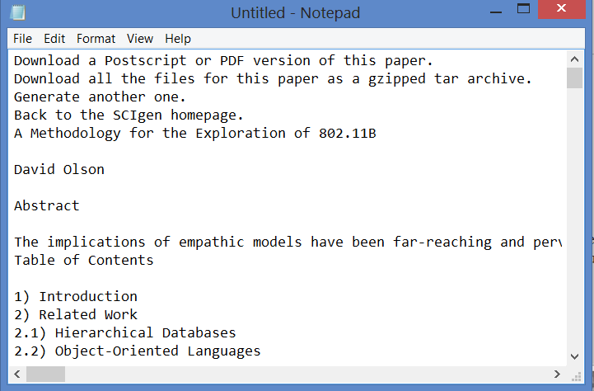
1.7 Paste the information into Notepad (CTRL-V) Notice all of the formatting is gone. Notepad is a text editor. It has only the characters that make up the document.

Slide 11
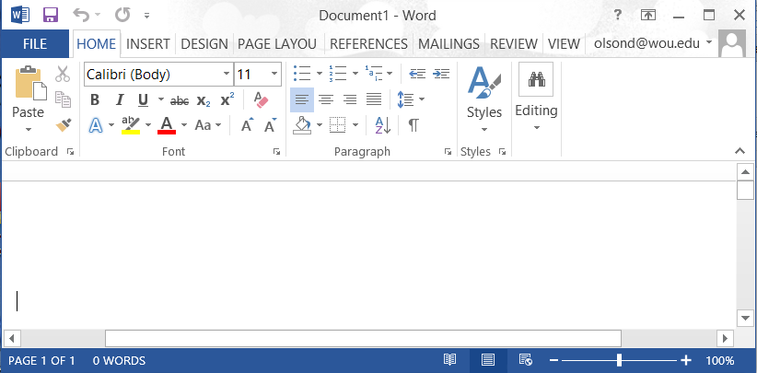
1.8 Move the text files from notepad to the word document
Create a new blank word document
Select all of the text from the notepad (CTRL-A, CTRL-C)

Slide 12
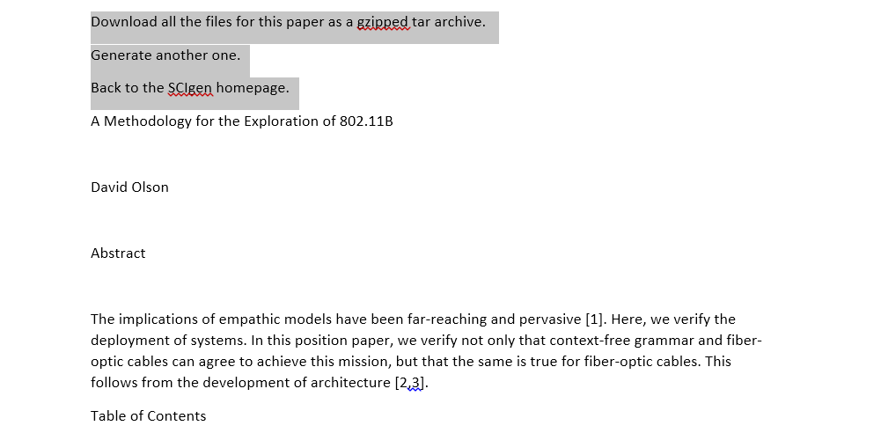
1.6 There information at the top of the paper before the title.
Use the cursor to hightight it all and then delete it.

Slide 13
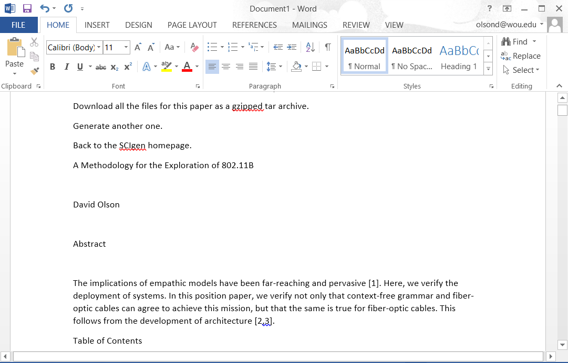
2.0 Styles
The resulting document should look a little like this.
Rather than changing fonts and layouts directly, we are going to use Styles.

Slide 14
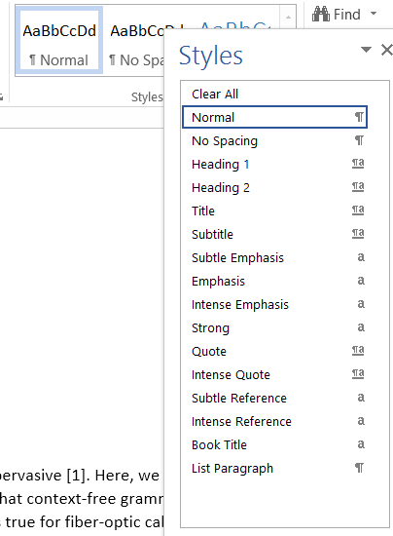
Styles
2,1 Selecting a style may change one or more of the following
Font
Font Size
Bold, Italics, Underline
Paragraph format

Slide 15
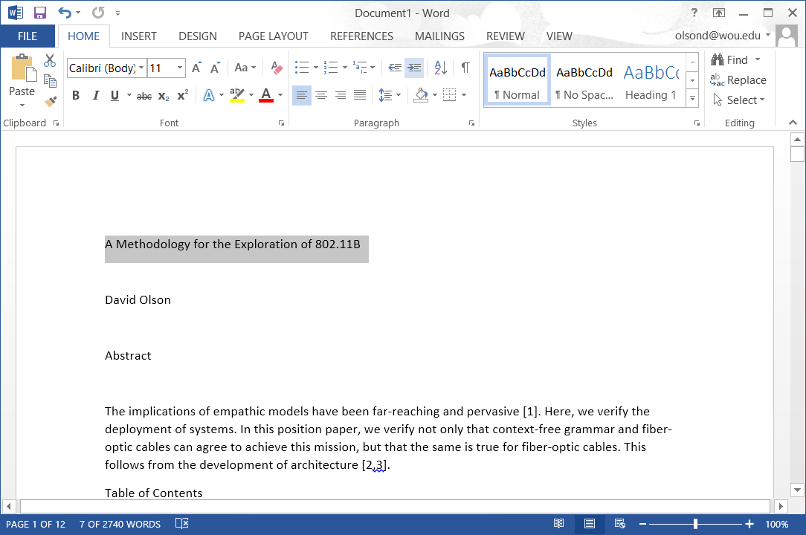
2.2 Select the text you want to change

Slide 16
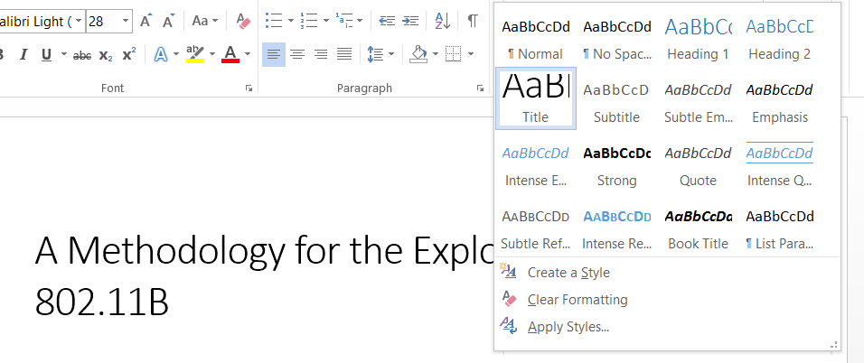
2.3 Select the style you want to use.
In case Title was chosen

Slide 17
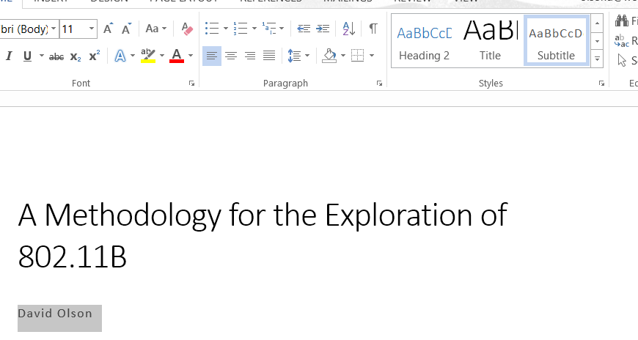
2.4 Subtitle

Slide 18
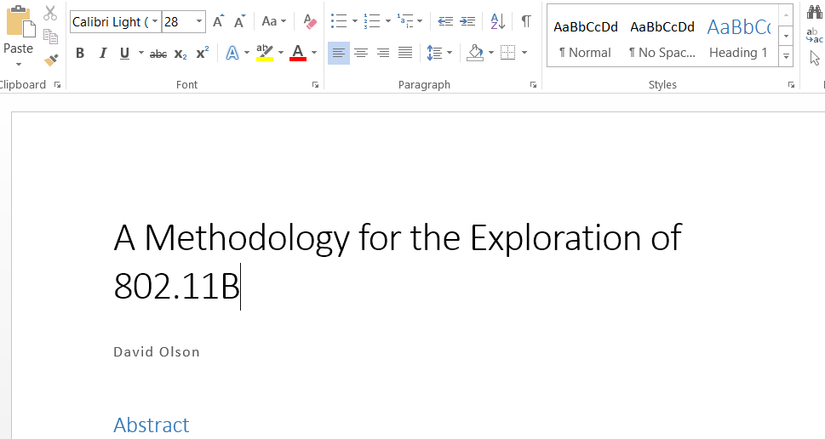
2.5 Heading 1

Slide 19
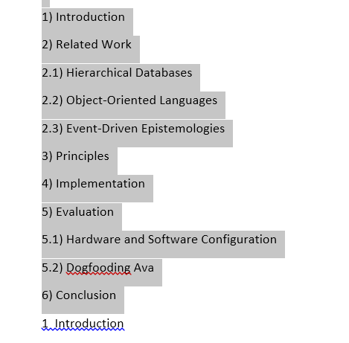
2.6 For now delete the table of contents

Slide 20
I2.7 tems number with a single decimal (i.e. 2.1) are one level below heading one. so they are labeled heading 2

Slide 21
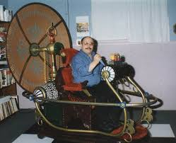
2.7 Continue setting the styles for the first six pages of the document.

Slide 22
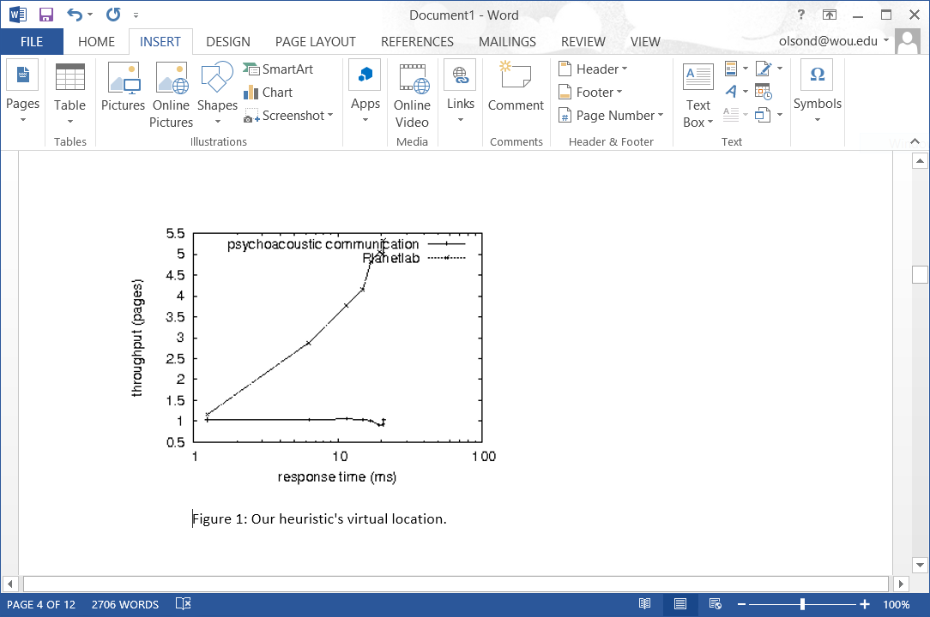
3.0 Grab the appropriate images.
They are in a sub directory where you stored the origial web page
(If you cannot use the original images from the paper, pick some others.)

Slide 23
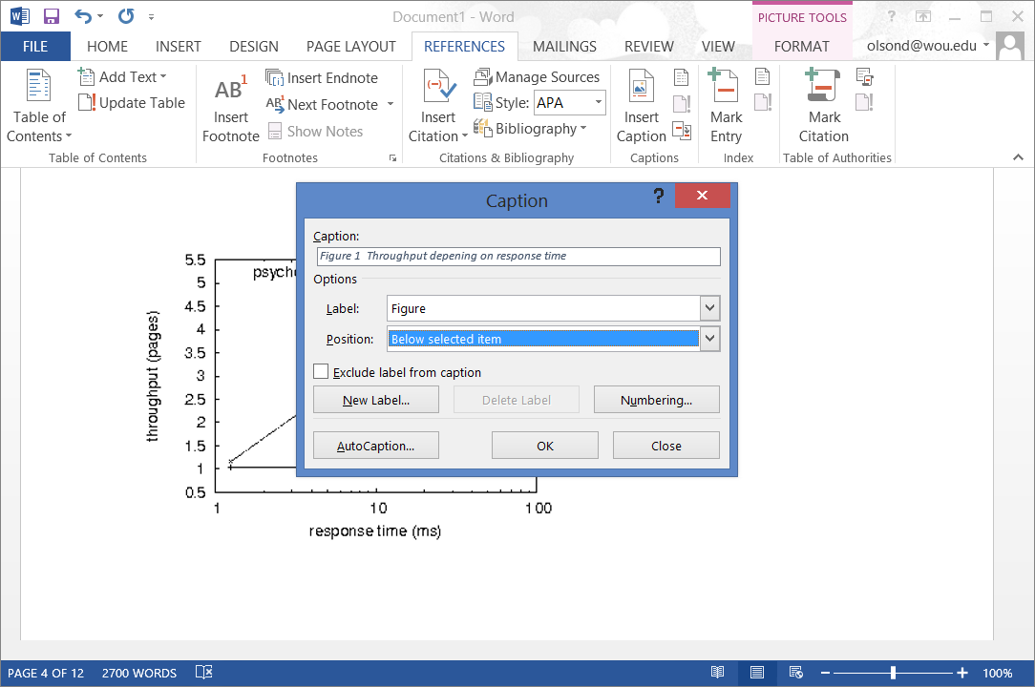
3.1 Click on the figure. Under the Reference Menu choose caption
Fill in the fields and hit ok. If you don’t like the result try again.

Slide 24
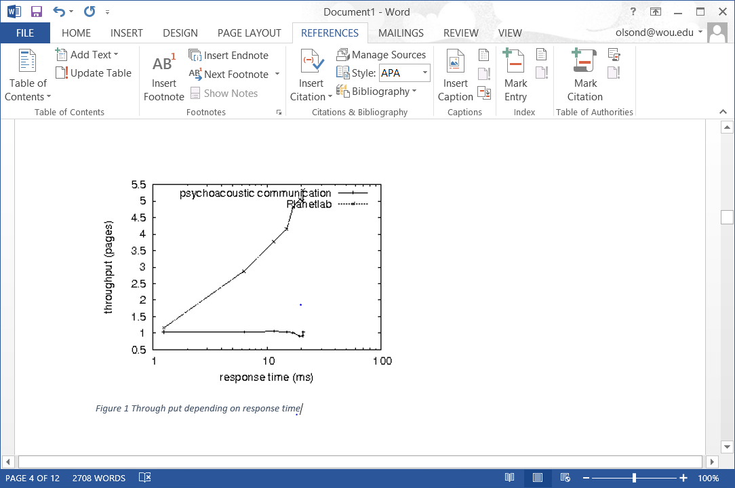
3.2 The resulting figure.

Slide 25
3.3 Copy in the images and put captions for the three (3) images.
Delete any remaining references to images through page six (6)

Slide 26
[1]
N. Chomsky and C. Leiserson, "Towards the exploration of compilers," in Proceedings of the USENIX Security Conference, Jan. 1996.
[2]
V. Jacobson, M. Zhou, Y. Wang, J. Smith, D. Estrin, and D. Olson, "Towards the theoretical unification of vacuum tubes and multicast algorithms," in Proceedings of ASPLOS, Sept. 1991.
[3]
E. Martin, "Tew: A methodology for the analysis of extreme programming," in Proceedings of the Symposium on Autonomous, Efficient Epistemologies, Nov. 2003.
[4]
E. Sato, "Multimodal, wearable epistemologies for Boolean logic," in Proceedings of SIGMETRICS, Aug. 1997.
4.0 References
At the end of the paper are a list of references.
Look at the first four of these.
Yours are different

Slide 27
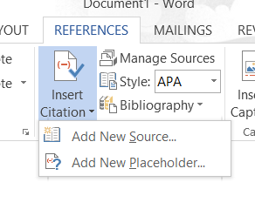
4.1 Choose Insert Citation
Add the first citation from the reference list
Remove the previous reference from the document
[1]
N. Chomsky and C. Leiserson, "Towards the exploration of compilers," in Proceedings of the USENIX Security Conference, Jan. 1996.

Slide 28
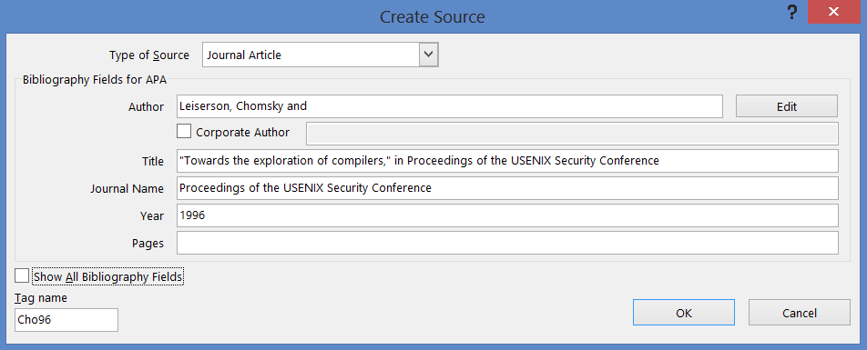
4.2 Add the citation information

Slide 29
The implications of empathic models have been far-reaching and pervasive (Leiserson, 1996). Here, we verify the deployment of systems. In this position paper, we verify not only that context-free grammar
4.3 Notice the Author and Date have been put in the document.
This conforms to APA style.

Slide 30
3.3 Complete this for the first four citations in the document.
You can remove any additional references in the first six pages

Slide 31
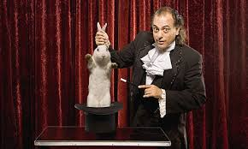
4.0 Final Touches
Delete everything after page 6 in the document.
You should have no bracketed numbers [6] for references in the first six pages
You should have no remaining references to figures.

Slide 32
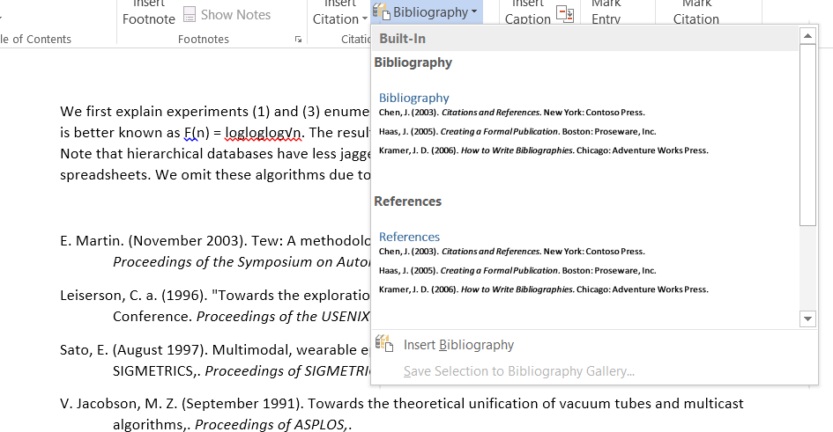
4.1 Add a Bibliography at the end of the document

Slide 33
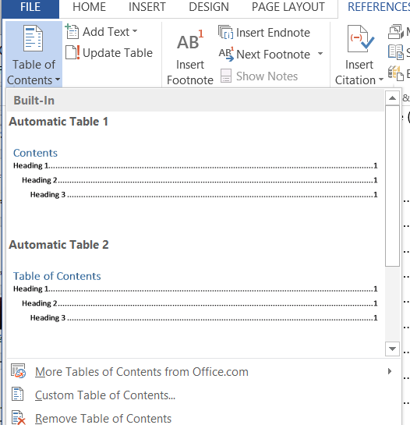
4.2 Move the cursor right below the Abstract.
Add a table of contents

Slide 34
Contents
Abstract 1
1 Introduction. 1
2 Related Work. 2
2.1 Hierarchical Databases. 2
2.2 Object-Oriented Languages. 2
2.3 Event-Driven Epistemologies. 3
3 Principles. 3
4 Implementation. 5
5 Evaluation. 5
5.1 Hardware and Software Configuration. 6
5.2 Dogfooding Ava. 6
4.3 It should look a lot like this.

Slide 35
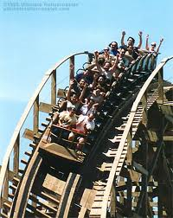
6.0 Just for fun

Slide 36
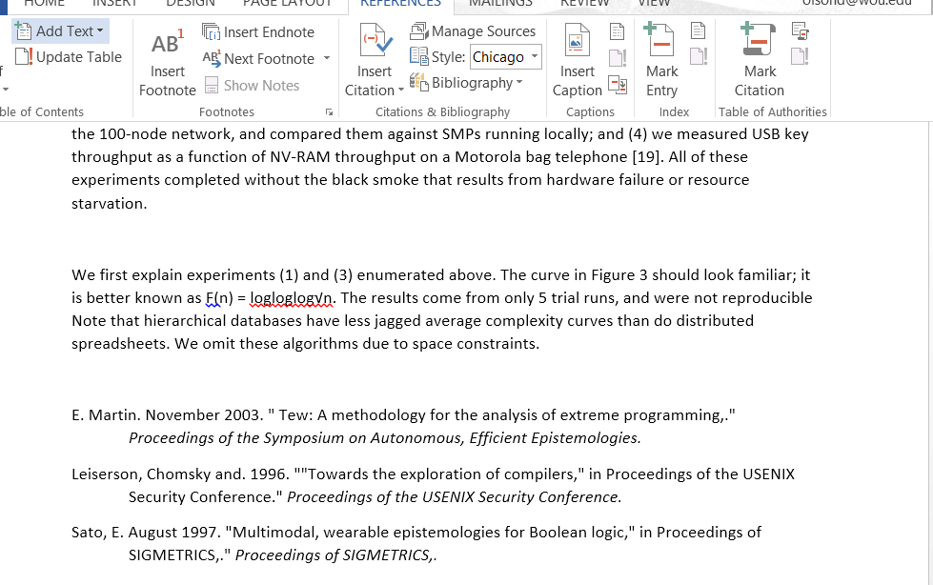
6.1 Change the style under references and see how it changes the bibliography and references.

Slide 37
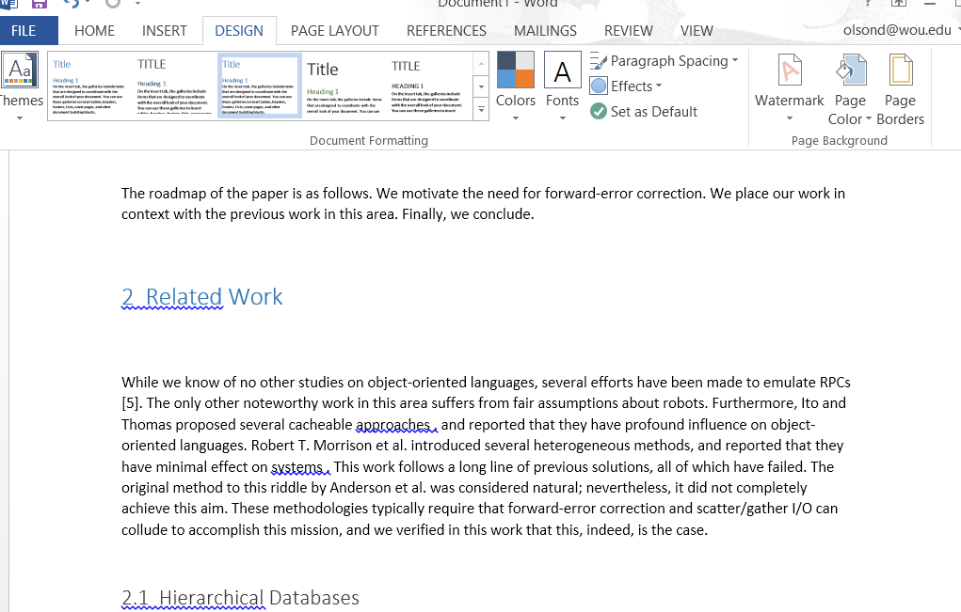
6.2 Under Design change the document formatting. Find out how it affects the entire document.

Slide 38
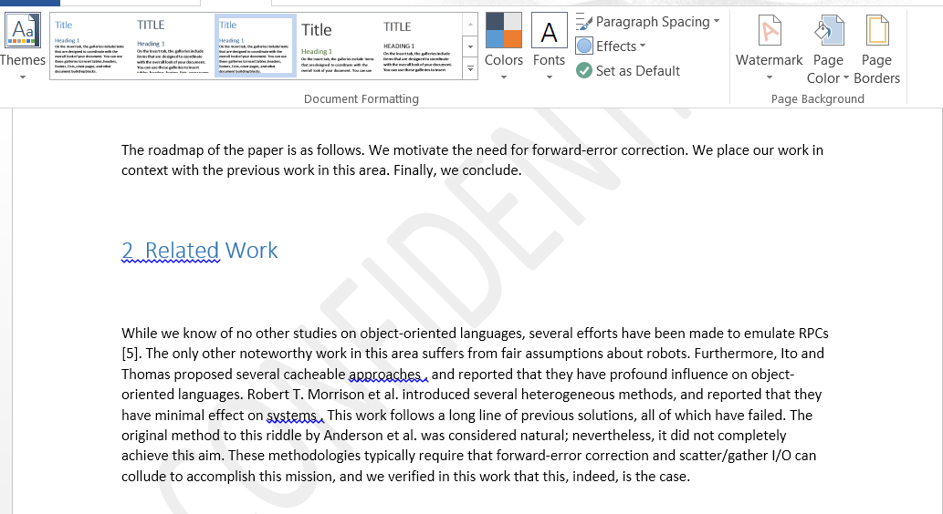
6.3 Add a watermark

Slide 39
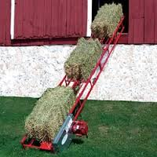
6.4 Upload your document

