Slide 1
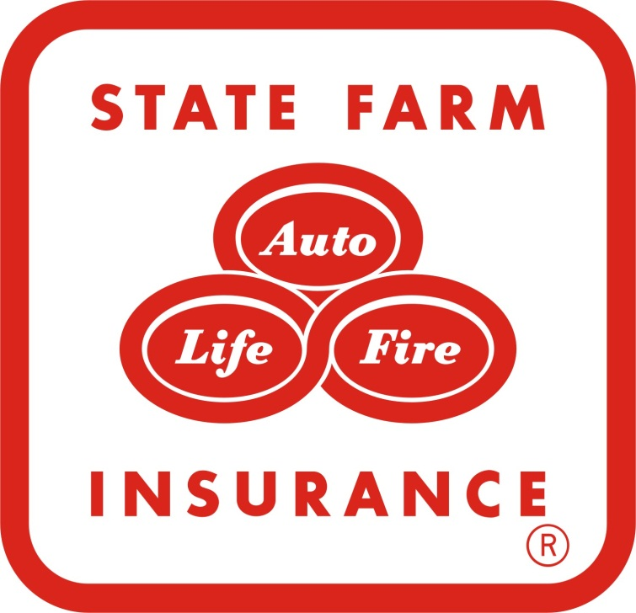
State Farm
“Get to a better state” ad campaign
By: Daryn Palmer & Kaylyn Bloom

Slide 2
About State Farm
State Farm insures more cars and homes than any other insurer in the U.S., the leading insurer of watercrafts, and is also a leading insurer in Canada
Their 17,800 agents and more than 66,000 employees serve 81 million policies and accounts – more than 79 million auto, fire, life and health policies in the United States and Canada, and nearly 2 million bank accounts
State Farm is ranked No. 34 on the Fortune 500 list of largest companies

Slide 3
The Ad Campaign
After experimenting with discount-focused direct-response TV ads last year, State Farm is going back to its service-oriented roots in a new campaign
They planned to "evolve to a bigger message to cover all the needs a customer may have."
The ads do that with a new tagline, urging customers to "Get to a Better State," while spotlighting the company's agents, which State Farm sees as a differentiating point from competitors such as Geico and Progressive

Slide 4
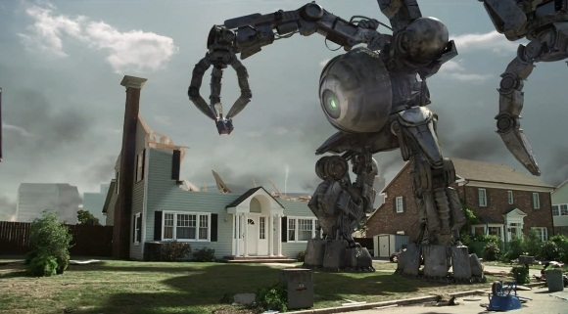
“State of chaos”
Fans can re-create the carnage with their own home through the website chaosinyourtown.com
State Farm Insurance State of Chaos Dwayne 2011 Commercial - YouTube

Slide 5
Marketing Message
State Farm Insurance swears by the motto, “When the unexpected happens, State Farm has you covered”
And while the price message remains, it is now being twinned with discussions of value for money spent
The new effort is intended to deliver the message that there is no better value than State Farm.
In running two campaigns at once, State Farm joins competitors like Allstate, with two campaigns, and Progressive, also with two.

Slide 6
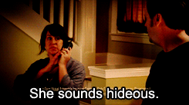
“State of Unrest”
State Farm® Commercial - State of Unrest (Jake) - YouTube

Slide 7
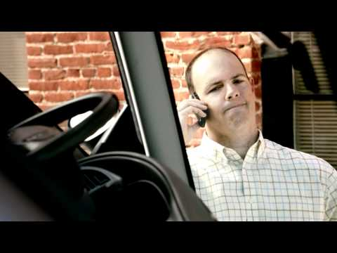
“state of regret”
State Farm: State of Regret - YouTube

Slide 8
Campaign Effectiveness
The campaign remains focused on “what you pay, but now also talks about “what you get, the right coverage as well as the right price.”
The results have been very encouraging. The brand awareness, and brand favorability numbers have been on the rise since the campaign was launched. But even down to the business metrics, the quote volumes, the clicks, and the trends that we want to see are heading in the right direction- Tim Van Hoof (State Farm Marketer)

