Slide 1

Throwing A Football
By: Cory Bean & Caleb Singleton

Slide 2
Phases of Throwing a Football
Throwing a football consists of 4 phases
1. Stance
2. Step/Windup
3. Release
4. Follow Thru

Slide 3
Stance
Wide Base
Support & Balance
Easier to step
Shoulders To Target
Football in pocket position
Comfortably at sternum level

Slide 4
Step & Windup
Make sure the step toward the target is the appropriate length
  Length will differ from person to person
  Over stride and under stride are both detrimental to throw
Foot is pointed towards target
  Will help with accuracy
Weight transfer from back to front foot
  Helps get momentum going forward

Slide 5
Release
Ball goes up past the ear
Proper horizontal alignment found in shoulder
Elbow leads
Fingertips are the last contact point with the ball
Make sure release angle is not too high and not too low
  Too high and the ball will sail
  Too low and the ball will not reach your target before hitting the ground

Slide 6
Follow Thru
Palm of throwing hand finishes downward and out
Throwing arm to be driven into the opposite thigh
Forward shift in motion

Slide 7
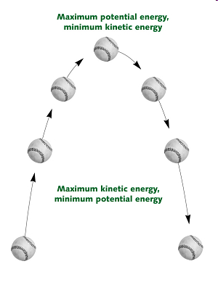
Kinetic and Potential Energy
Kinetic and potential energy work hand in hand when throwing a football.
When the ball is thrown and released from the hand the ball will reach a maximum height determined by how much kinetic energy it has.
The ball reaches its potential energy when it hits its maximum height. (Velocity=0)
As the ball is caught or hits the surface the potential energy is converted to kinetic energy.
(Pretend those baseballs are footballs for this presentation)

Slide 8
Acceleration
-The acceleration throughout the movement gets greater through each interval.
-The motion of the arm accelerates through the movement and since the ball is connected to the arm through the hand, it accelerates as well.

Slide 9
Velocity
The velocity increased gradually through the movement.
1st displacement- 13.16 ft/sec
2nd – 15.15 ft/sec
3rd – 27.78 ft/sec
4th – 38.46
The average velocity through the throwing motion was 19.6 ft/sec

Slide 10
Mass
Mass is the amount of matter in the body
  When throwing an object your mass plays a key role because if effects speed and acceleration
    arm/shoulder
    leg
    Trunk

Slide 11
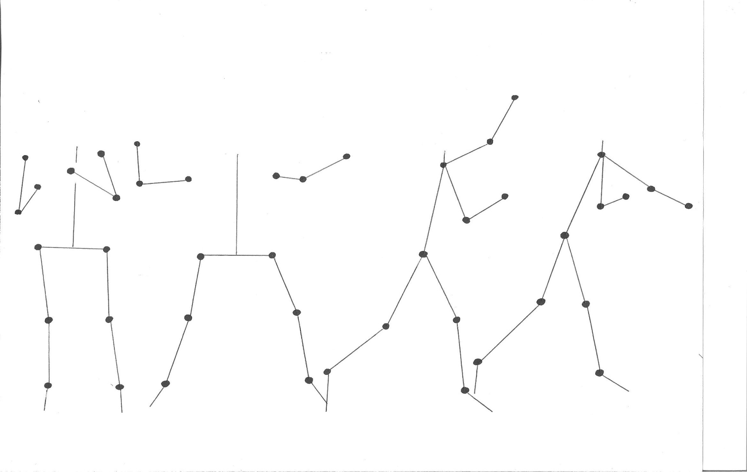
Kinematics
Through our Kinematic analysis we were able to measure the angle of the elbow joint on the subjects throwing arm. As the motion went on the angle increased. Phase 1 the elbow joint measured 51°, 2nd phase 86°, 3rd phase 146°, 4th phase 169°

Slide 12
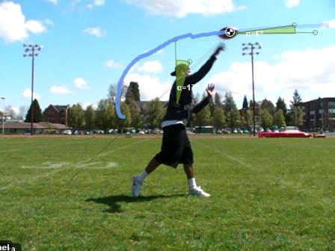
Motion Tracking & Inclination measurements
-You can see the path that the ball takes through the Step and Windup phase, and what the body looks like just as the ball is being released
-The horizontal measurement of the ball when released in 6°
-The vertical measurement of our subject when the ball is thrown is 17°

Slide 13
Conclusion
The way people throw a football might look different, but the overall phases are the same for everyone.
There are many biomechanical concepts that go into throwing a football.
Throwing a football seems like an easy task but each step is critical and lead to the next step. Throwing a football properly and accurately requires the right technique and mechanics in each individual step.

