Slide 1
Welcome to the Werner University center

Slide 2
COME ON IN!

Slide 3
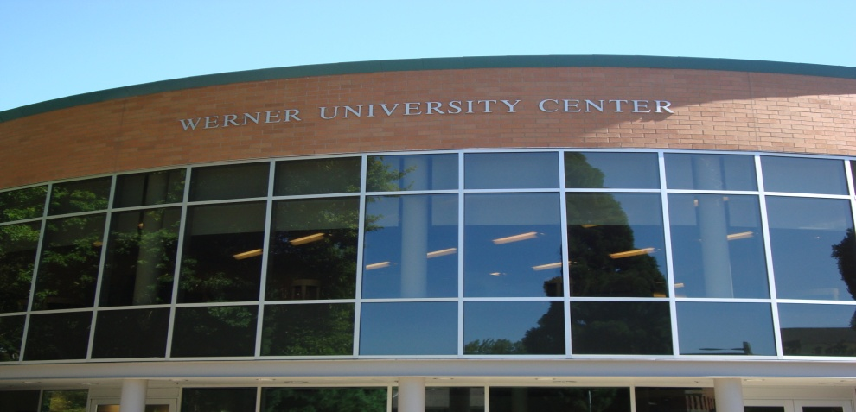
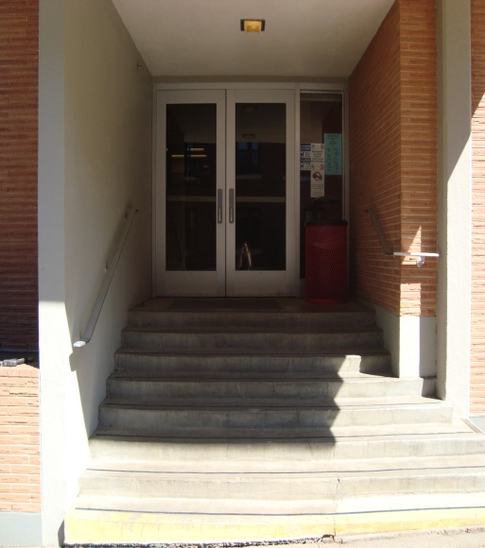
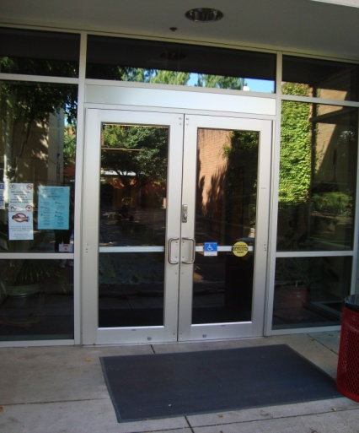
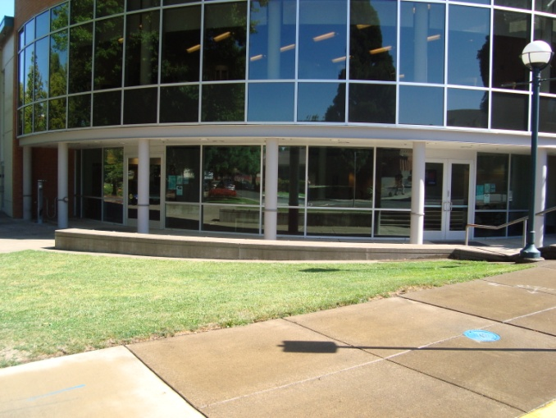
WE HAVE TONS OF ENTRANCES…

Slide 4
The werner university center offers many departments that are here to help you achieve! Let’s check them out!

Slide 5
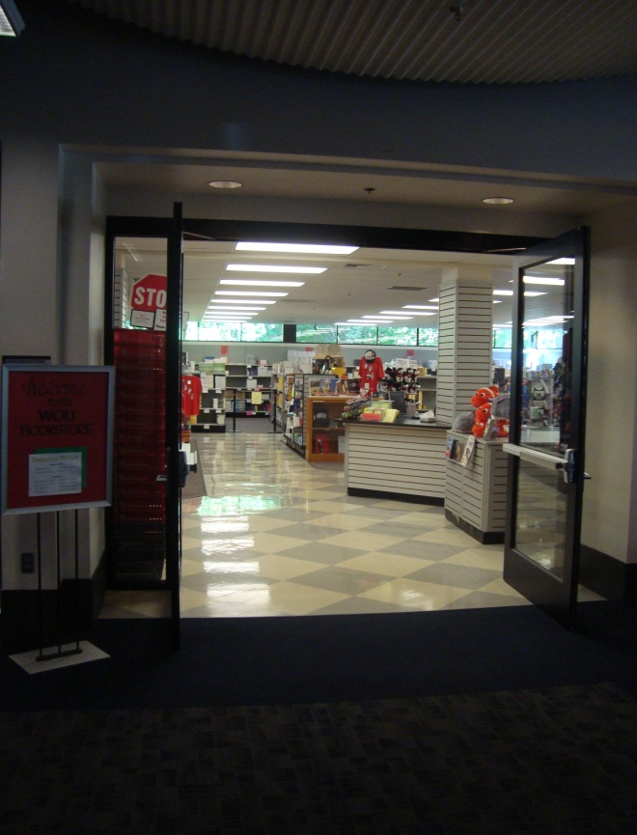
WOU BOOKSTORE: ALL THE WOLF GEAR YOU CAN IMAGINE!
The bookstore has all class textbooks, school and art supplies, and wolf gear for everyone in your family. Get more info at: http://books.wou.edu/home.aspx

Slide 6
STUDENT AFFAIRS OFFICE:
This office is the home of our campus transportation called WOLF RIDE. Wolf Ride gives students transportation throughout Monmouth and Independence.
For more info go to: http://www.wou.edu/student/

Slide 7
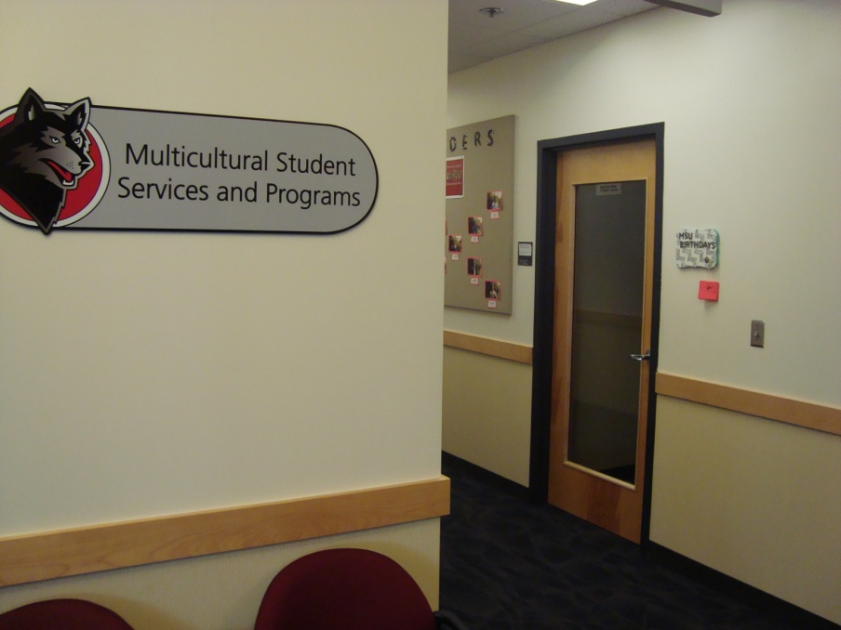
MULTICULTURAL STUDENTS SERVICES AND PROGRAMS:
MSSP offers programs for all different cultures, ethnicities, and backgrounds to ensure an excepting and diverse campus.
http://www.wou.edu/multicultural/

Slide 8
STUDENT ENGAGEMENT INFORAMTION DESK:
The info desk can answer any question you have about campus, classes, programs, departments, and more! They are a friendly group of students who are trained to be able to help you!
For more info go to : www.wou.edu/student-engagement

Slide 9
ABBY’S HOUSE AND STONEWALL CENTER:
Abby’s House is the center on campus for women and families. They stand against violence and harassment and take on a feminist outlook.
Stonewall Center offers support and programs to the LGBTQ community on campus, and also stands against harassment and violence towards everyone.
For more info go to: http://www.wou.edu/abbyshouse/
http://www.wou.edu/student-engagement/programs/stonewall-center/

Slide 10
VETERAN SUCCESS CENTER:
The Veterans Success Center offers support to the Veterans on campus and in our community. Here you can find access to mentors, programs, tutors and events held on campus for Veterans.
For more info go to: http://www.wou.edu/student/veterans-support-services/

Slide 11
STUDENT ACTIVITIES BOARD:
SAB is a group of WOU students who organize and put on activities and events throughout campus. These events encourage all students to join, from comedians or bands to slam poets and magicians, SAB does it all!
For more info go to: http://www.wou.edu/student-engagement/sab/

Slide 12
SERVICE LEARNING AND CAREER DEVELOPMENT:
SLCD is a tool to help students find jobs on or off campus or find an internship. These students and faculty members also help better resumes and applications to make students more confident when interviewing for new positions. For more info go to: http://www.wou.edu/slcd/

Slide 13
NON-TRADITIONAL STUDENT LOUNGE:
The Non-Trad Lounge offers support to Non-Traditional students by giving them a place to study, hang out in between classes, and connect with other non-trad students. For more info go to: http://www.wou.edu/student-engagement/programs/non-traditional-student-services/

Slide 14
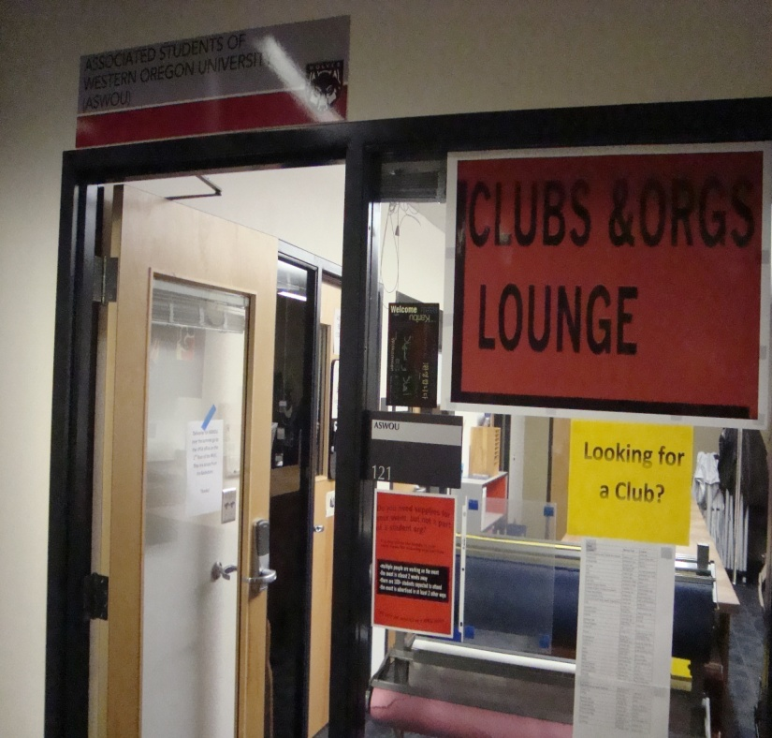
CLUBS AND ORGANIZATIONS LOUNGE:
This lounge gives members of clubs and organization on campus the tools they need to advertise for events and represent their groups.
For more info go to:
http://86465.orgsync.com/org/aswou/clubsandorgs

Slide 15
ASSOCIATED STUDENTS OF WESTERN OREGON UNIVERSITY:
ASWOU is the official student government body of Western Oregon University. This organization advocates for students’ rights while encompassing the entire student body in their efforts.
For more info go to: http://86465.orgsync.com/org/aswou/home

Slide 16
The werner university center also offers places for students to eat, hang out, and study throughout the entire building!

Slide 17
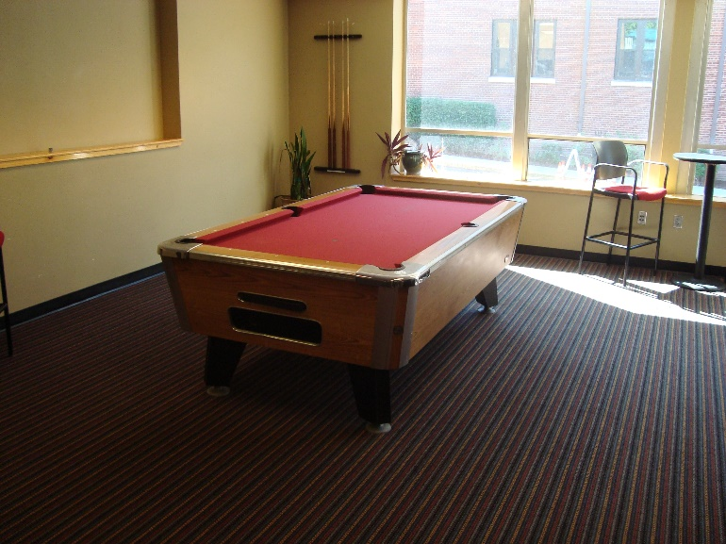
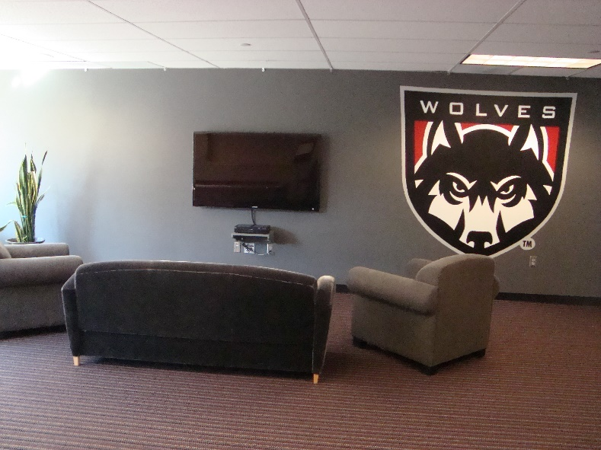
DESCHUTES:
The Deschutes Lounge offers T.V, video games, and pool available to all students and community members. There is also an USB charging station for small electronics

Slide 18
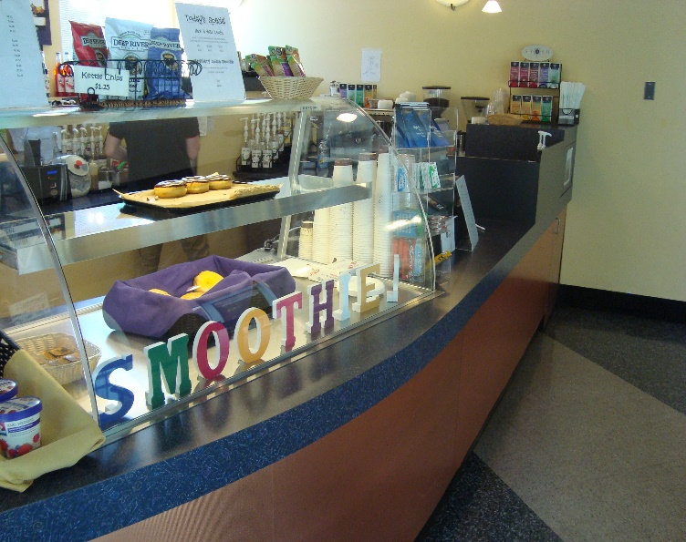
CAFÉ ALLEGRO:
Café Allegro is our on campus café located in the Werner University Center!
http://www.wou.edu/housing/campus-dining/retail-dining/

Slide 19
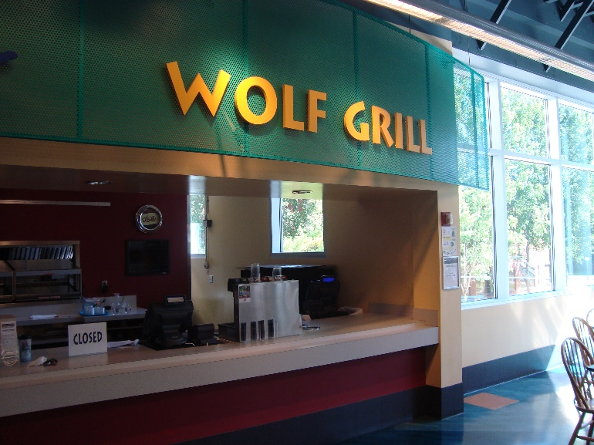
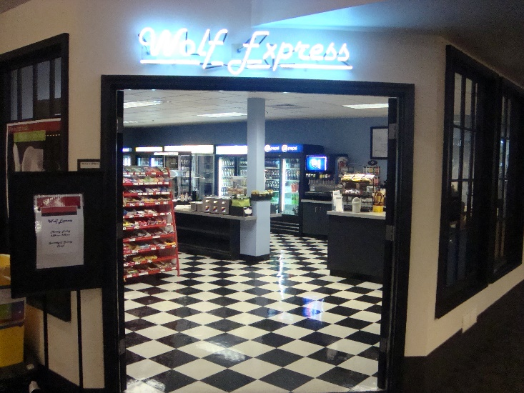
WOLF EXPRESS, WESTERN DELI, AND WOLF GRILL:
The Deli and Grill serve delicious food for students, faculty and community members year-round!
Wolf Express is like our very own mini mart! Stop in and get a snack in between classes!
http://www.wou.edu/housing/campus-dining/retail-dining/

Slide 20
COMPUTER LAB:
The Werner University Center also offers free access to our computer lab available to all WOU students and community members. This is a great tool for all students. There are 2 Mac computers as well as an USB charging station for small electronics

Slide 21
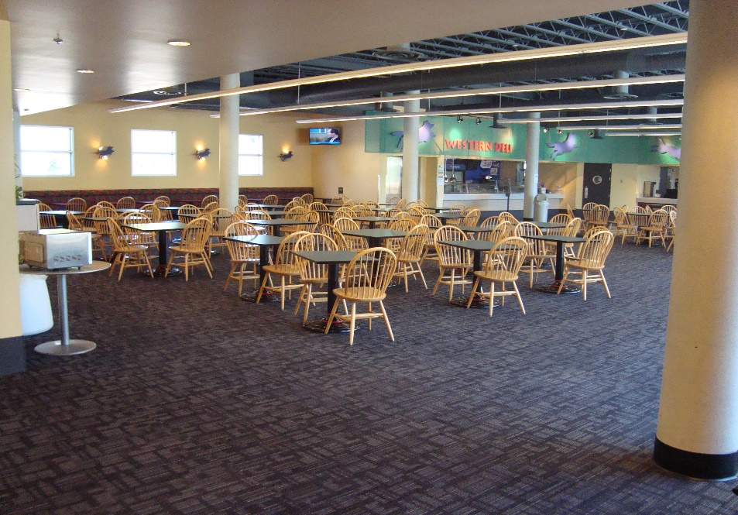
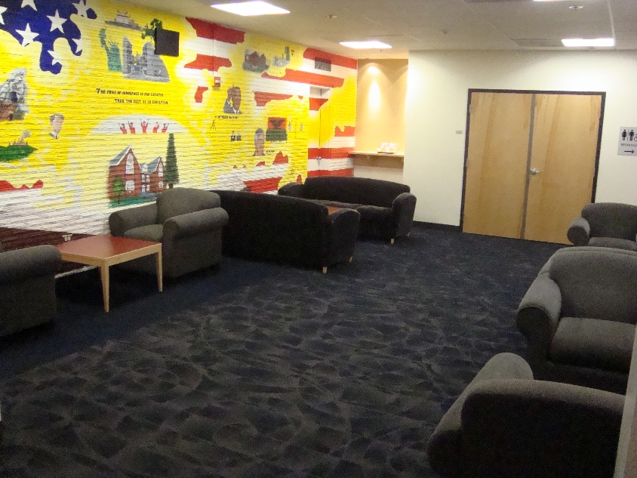
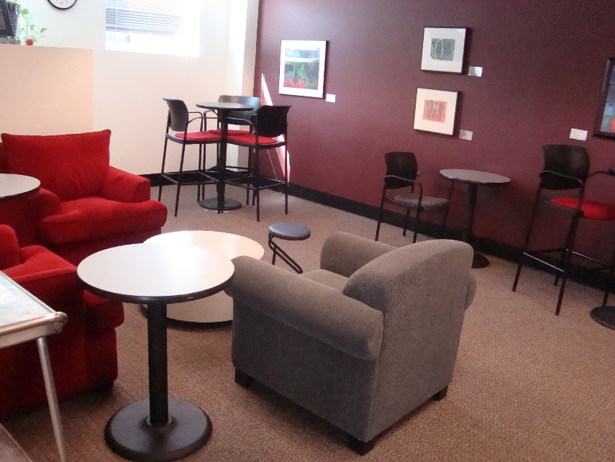
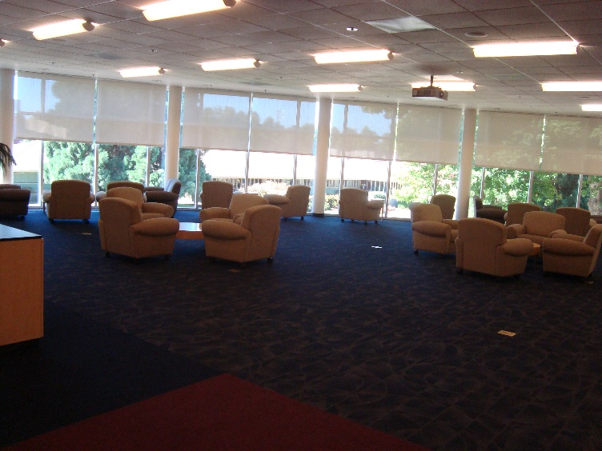
AND THERE ARE SO MANY AREAS TO STUDY!

Slide 22
Come in and check out the building!
Hours
Mon-Fri: 7:30am-midnight
Saturday: 10am-10pm
Sunday: Closed

