Slide 1
Eruption Products and Processes and Posteruptive Geomorphic Evolution
An Article Summary
Kelsii Dana

Slide 2
Overview
Crater Flat, S Nevada
Arid to semiarid climate
Basaltic volcanoes
Red Cone
Black Cone
Little Cones
SW Little Cone
NE Little Cone
Makani
Pleistocene age

Slide 3
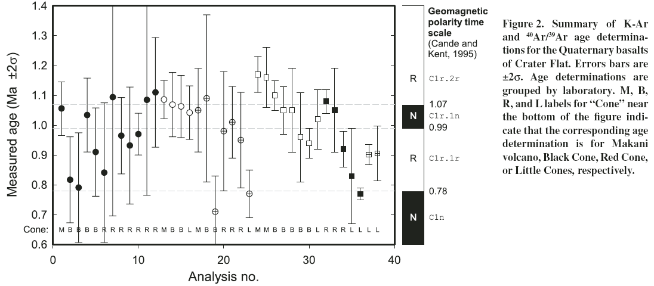
Data Collection

Slide 4
Red Cone

Slide 5
Black Cone

Slide 6
Little Cones

Slide 7
Makani

Slide 8
Growth and Erosion

Slide 9
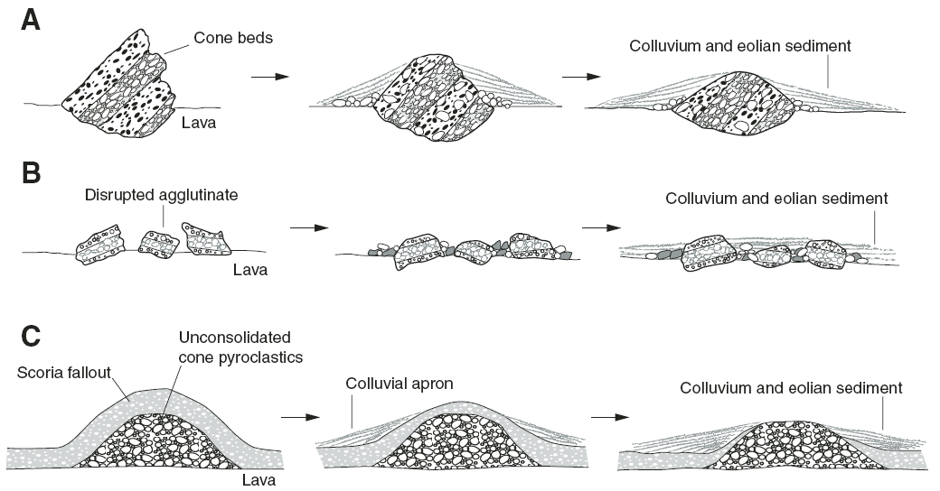
Postemplacement Evolution
Pyroclastic mounds that originate as rafted cone material

Slide 10
Conclusions
Cinder cones formed by explosive processes
Lava fields developed
Thickening by unit stacking and inflation
Lateral expansion based on effusion and topography
Complex histories
Cone growth
Cone failure and deconstruction
Cone healing
Monogenetic
Posteruptive geomorphic evolution
Paleotopography

Slide 11
Thank You!

