Slide 1
Large Wood Treatment on Habitats and Fish Populations of Green River and Crab Creek
Bio-Surveys, LLC 2007
Presented by Esteban Quiles

Slide 2
Overview
Project details
Results Crab Creek
Results Green River
Unified table results
General trends
Recommendations
Conclusion

Slide 3
Project details
Places under study: Crab Creek and Green River (Washington State).
This report describes the effects treatment on channel structure and Coho populations of the treated sections of these streams.
Trees averaged about 120 feet long and ranged in diameter at the large end from 24” - 36" inches.
Crab Creek received 172 trees.
Green River 248 trees.

Slide 4
Project details cont. . .
Primary target for this study was to quantify changes in over-winter survival rates for juvenile Coho associated with the introduction of large amounts of full spanning trees.
A note about Large wood placement:
Until a major high water event occurs, full-spanning wood may exist in a relatively passive state.

Slide 5
Results Crab Creek
These were the first set of changes observed.
Change | Change observed
Pool depth | Modest to undetectable changes have occurred in residual pool depth.
Pool surface area | The number of pools having a residual depth > 1m increased slightly as did their surface area
Spawning Gravel | observed to have a 93% increase, pre-project year to the most recent post-project year.
Habitat formation | Channel roughness was also seen to increase, as a result.

Slide 6
Results Crab Creek cont. . .
Second set of changes observed
Change | Change observed
Habitat area | Side channel habitat has increased post-treatment, providing almost four times the area
Pocket watering | Pocket watering increased from 28 in 2000 to 71 in 2006. ( increased by 43) Total area of these pocket waters increased as well.
Large wood Pre-project + Treatment = 742 Post-project (2006) = 915 | The post-project wood counts of both years exceed the sum of pre-project and treatment wood. With 173 species of Native wood recruited.

Slide 7
Crab Creek results cont.. .(adjustment changes)
Scour pools decreased in number from 143 to 121.
Scour pool surface area also decreased.
Beaver pond abundance decreased.
Rearing capacity of the summer channel progressively decreased by 15,000 from 2000-2006.

Slide 8
Results: Green River
These were some of the changes seen in the Green River project.
Change | Change observed
Main stream habitat | mainstem primary channel habitat units increased from 158 pre-treatment to 202 post- treatment.
Scour Pools | number of scour pools increased from (83 to 119)
Riffle habitats | riffle habitats increased from (63 to 79)
Winter Coho carrying capacity | The winter abundance has exhibited a steady increase with no indication of a ceiling in capacity.

Slide 9
Results Green River: Adjustments
These were some of the adjustments seen in the Green River project
Change | Change observed
Scour pools | average lengths decreased from 56m to 45m, and riffles from 28m to 18m. Scour depth may have decreased slightly overall
Pool Depth | Pool depth and specifically deep, sheltering pools of the Reach 1mainstem primary channel appear to have decreased post-treatment
Summer Coho carrying capacity | Summer carrying capacity has decreased slightly
Dam Pools | Seven dam pools occupying 1,972m2 were recorded in 2000. None were recorded in 2006.

Slide 10
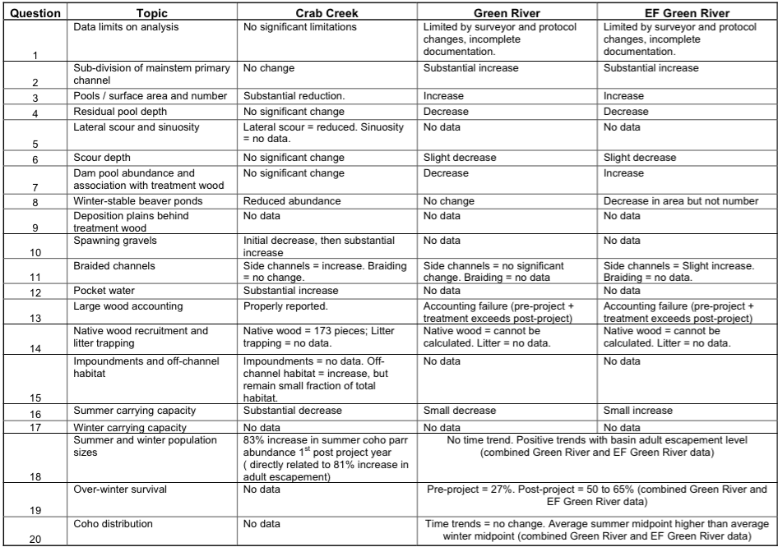
Unified table results

Slide 11
General trends both projects
Coho salmon populations generally saw a decrease in rearing capacity in the six year period of study.
Pools and riffle habitats generally increased in number but lost complexity, and depth as a result.
Channel complexity was not accomplished, during project period.

Slide 12
Recommendations
Authors suggest a longer time period of study, up to 10 years.
More intricate log placement.
Wood treatment structures would be far more effective if composed of open grown trees having complex branching.
Log structures produce varied and sometimes opposing effects involving trapping and deflection.

Slide 13
Conclusion
Crab Creek restoration:
Recruited spawning gravels.
Recruited large native trees.
Rearing capacity decreased over study period.
Green River restoration:
Increased habitat availability.
Reduction in habitat quality.

