Slide 1
Importance of low-flow and high-flow characteristics to restoration of riparian vegetation along rivers in arid south-western United States
Stromberg et al., 2007, Overview of Riparian Vegetation Restoration in Western U.S.

Slide 2
Overview
Rivers in the south west
Low-flow vs. high-flow
Riparian vegetation in the south west
Restoration

Slide 3
Rivers in the South West

Slide 4
Climate
Arid, low precipitation
Flooding
No-flow periods
Varied ground water

Slide 5
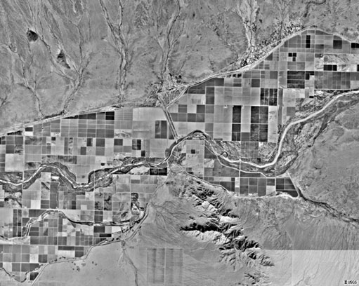
Human Impact
Heavily irrigated

Slide 6
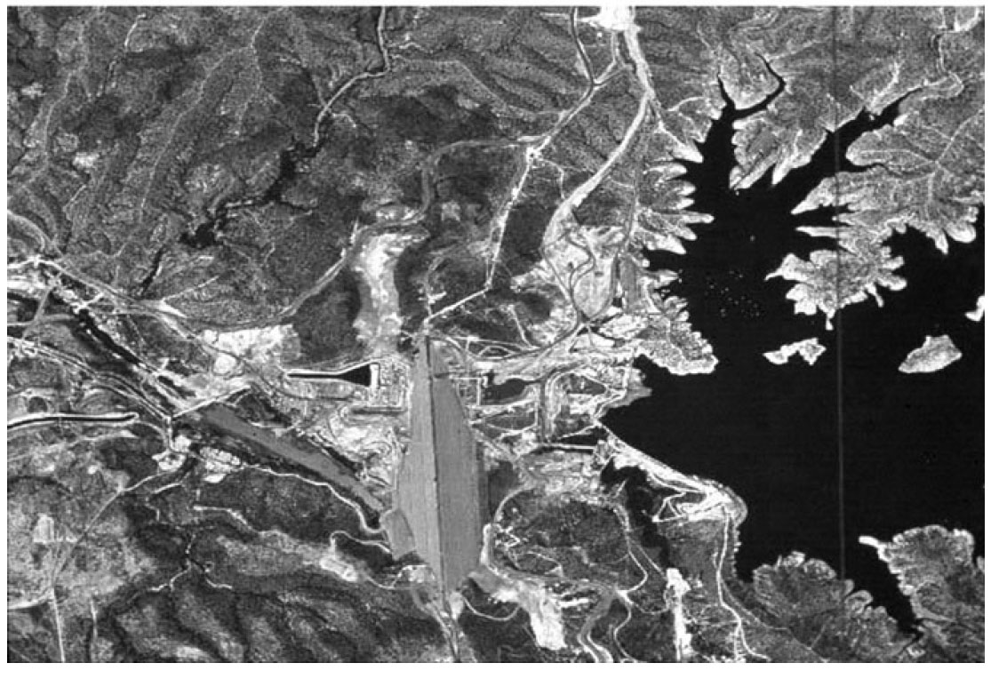
Human Impact
Damming

Slide 7
Compared to the North-west
Far less recharge
No focus on fish
Rivers effect the plants and animals
Riparian vegetation used as indicator

Slide 8
Low-flow vs. High-flow

Slide 9
Low-flow
State of the rivers majority of the time
Natural fluctuations
Flow can be depleted by humans

Slide 10
High-flow
Naturally occurs
Wet periods
Floods
Can be sustained by human intervention

Slide 11
Riparian Vegetation

Slide 12
Indicator of Health
Stream health correlates with vegetation
Vegetation reflects stream health
Analogues with fish in other reigons

Slide 13
Variation
Low-flow
Drought resistant
Salt resistant
Scrub/shrub
Low biomass
Low diversity
High-Flow
Pioneer Wetland species
High biomass
High diversity

Slide 14
Variation
Both are natural
Cant force high-flow
Flooding=variation

Slide 15
Restoration

Slide 16
Restoration
Patch diversity
Encourage flooding
Stay within natural limits
Balance human interaction

Slide 17
Thank You

