Slide 1
Channel Modification and Restoration
Esteban Quiles
Earth and Physical Science Department
Western Oregon University
Monmouth, Oregon
Email: equiles12@wou.edu

Slide 2
Overview
River restoration techniques
In-stream restoration
Channel modification techniques
Large wood placement
Case study Crab Creek/Green River
Summary

Slide 3
RIVER RESTORATION
TECHNIQUES

Slide 4
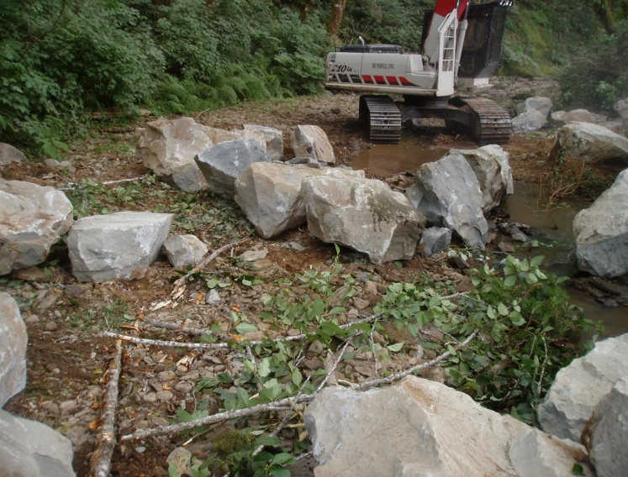
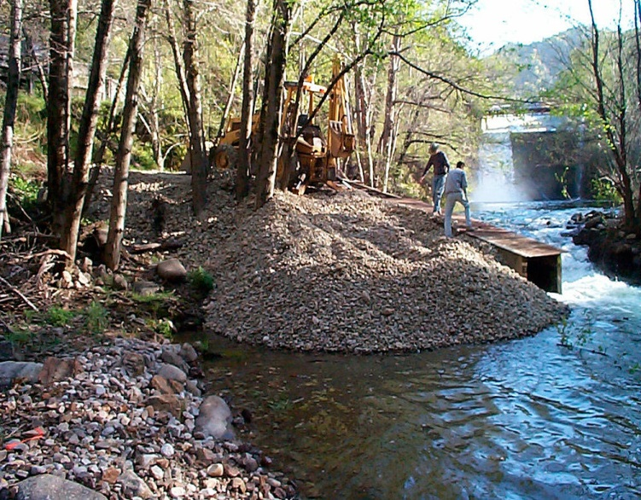
In-Stream Techniques
In stream habitat restoration includes:
Addition of spawning gravels
Boulder placement
Nutrient Enrichment:
Addition of inorganic N and P
Distribution of salmon carcasses

Slide 5
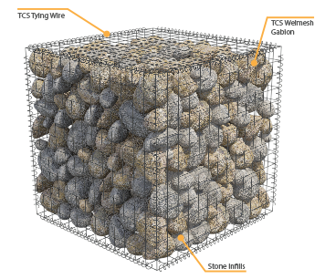
In-Stream Techniques
Artificial Structures
Weirs (bank protection, channel stability)
Wire Gabions (bank stabilization, silt filtration)

Slide 6
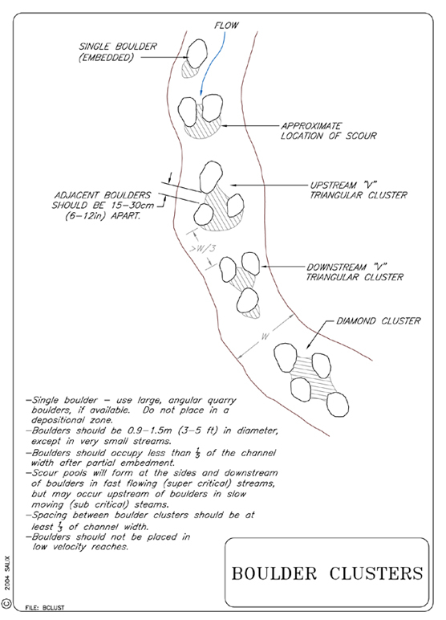
Example of boulder placement to create channel roughness

Slide 7
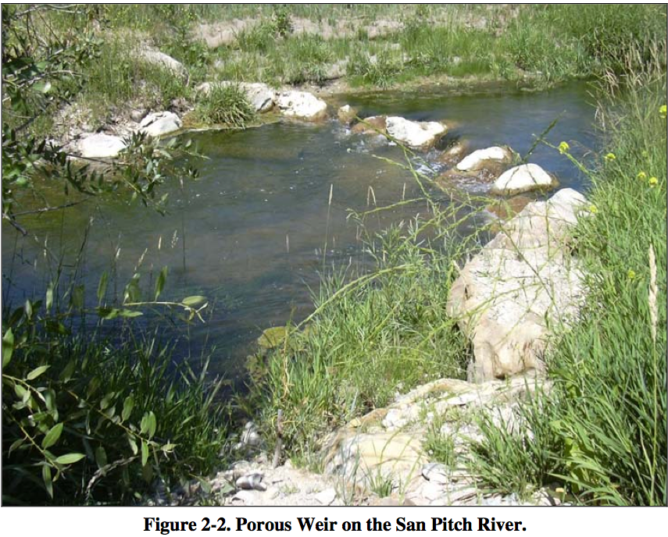
Example artificial structures- porous weir

Slide 8
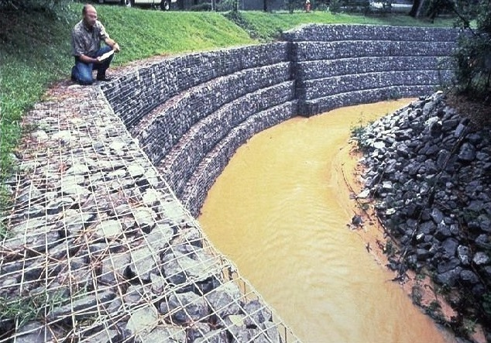
Rip Rap
Example artificial structures- rip rap gabion

Slide 9
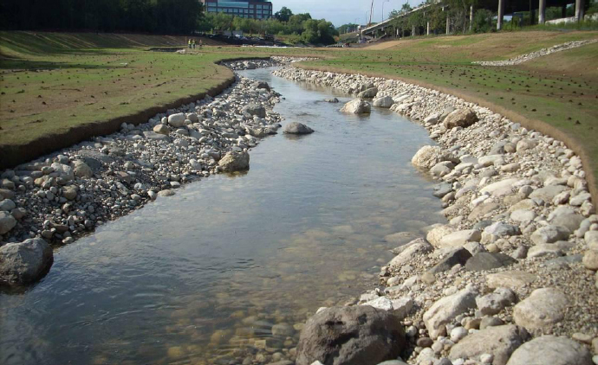
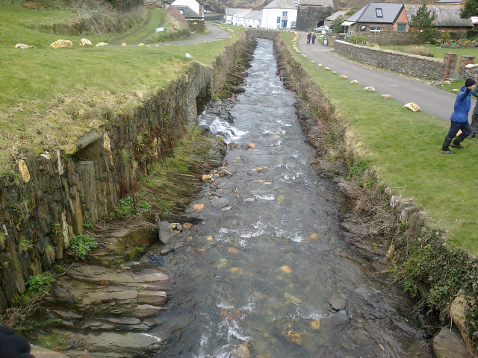
Channel Modification
Techniques
Cross section change
Bank reconstruction
Altering channel profile
Enhancing sediment transport

Slide 10
LARGE WOOD PLACEMENT

Slide 11
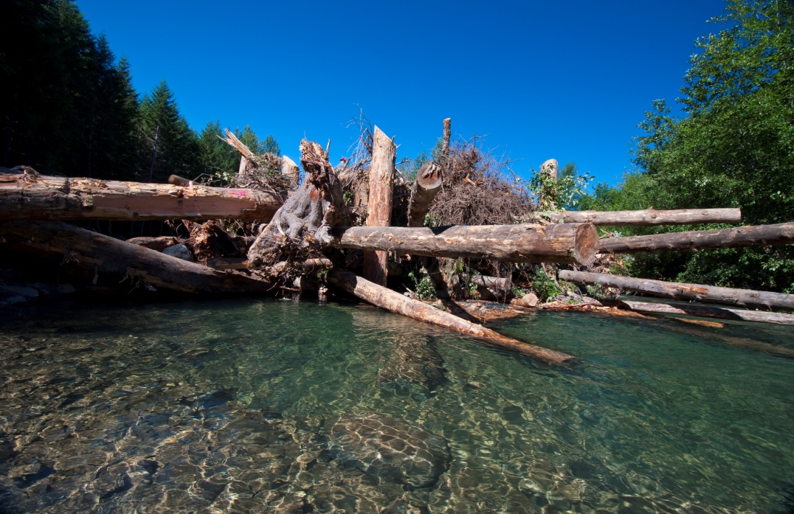
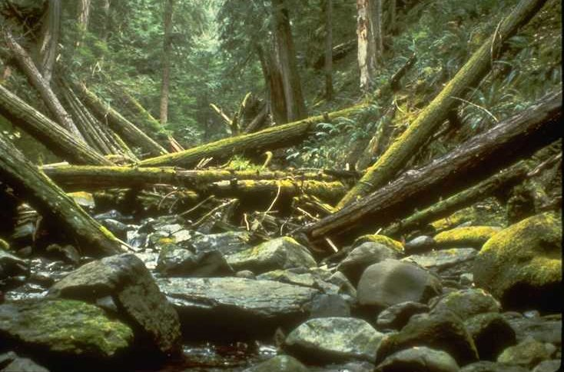
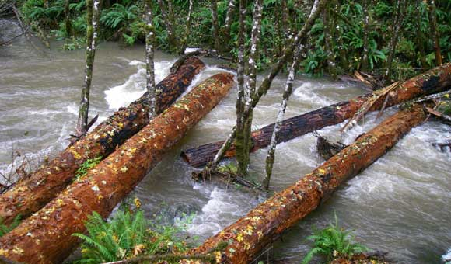
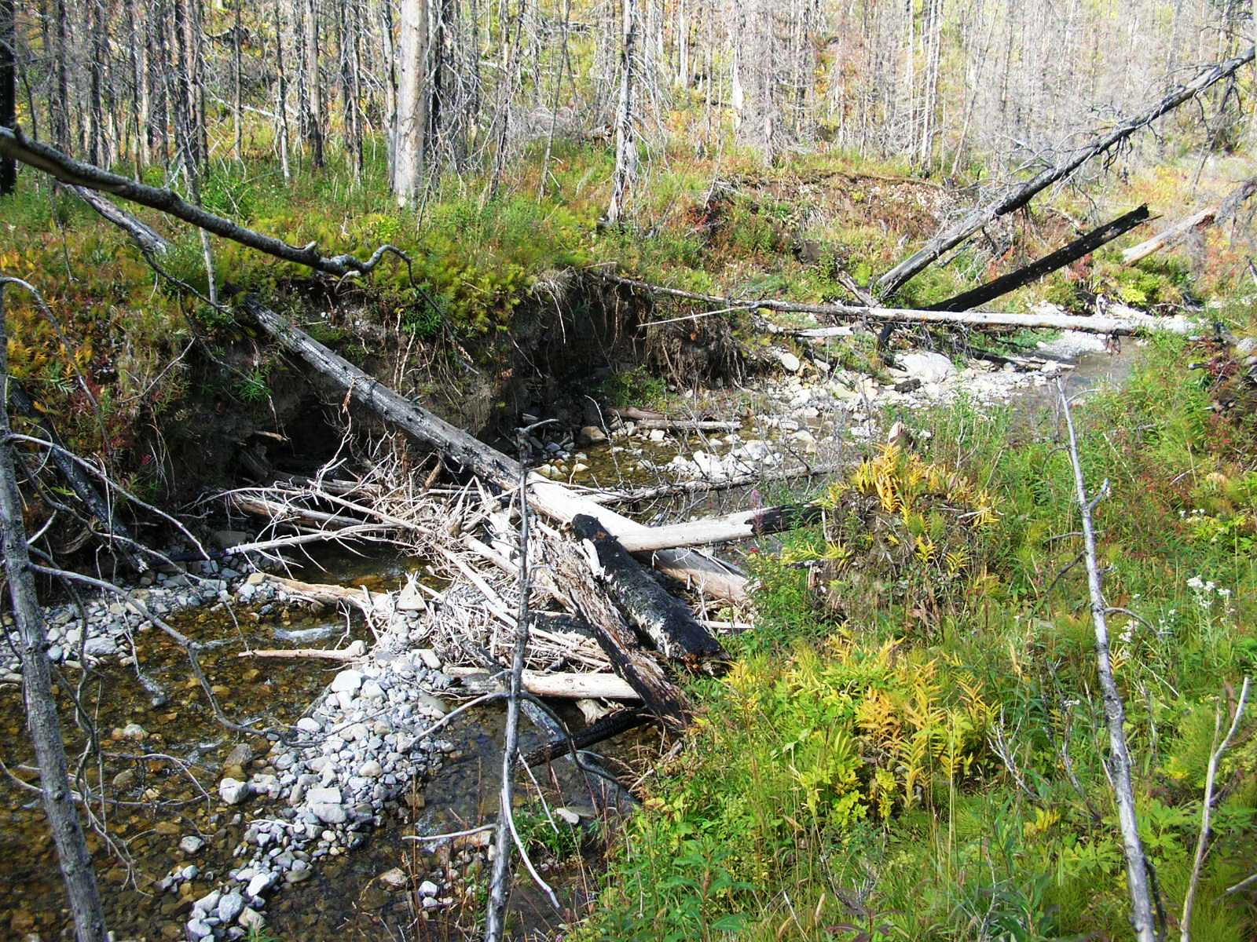
Examples of large wood in channels

Slide 12
Large Wood Placement
Fundamentals
Addresses a deficiency of habitat
Natural channel-forming processes
Short term solution
Provides habitat while natural processes are restored
Promotes channel complexity & roughness

Slide 13
Large Wood Placement
Benefits
Retains organics
Absorbs the force of high flows
Reduces bank erosion
Recruits additional wood
Recruits, sorts, and retains spawning gravel
Provides movement pathways for wildlife

Slide 14
Stage 3
Stage 2
Stage 1
Example of LWD creating channel complexity

Slide 15
PLACED LARGE WOOD

Slide 16
Placed Large Wood
Deliberate placement of wood in streams
Form discrete LW, logjams structures
Create habitat directly
Use natural processes that scour and deposit
Re-establish natural LW loading volumes and distributions

Slide 17
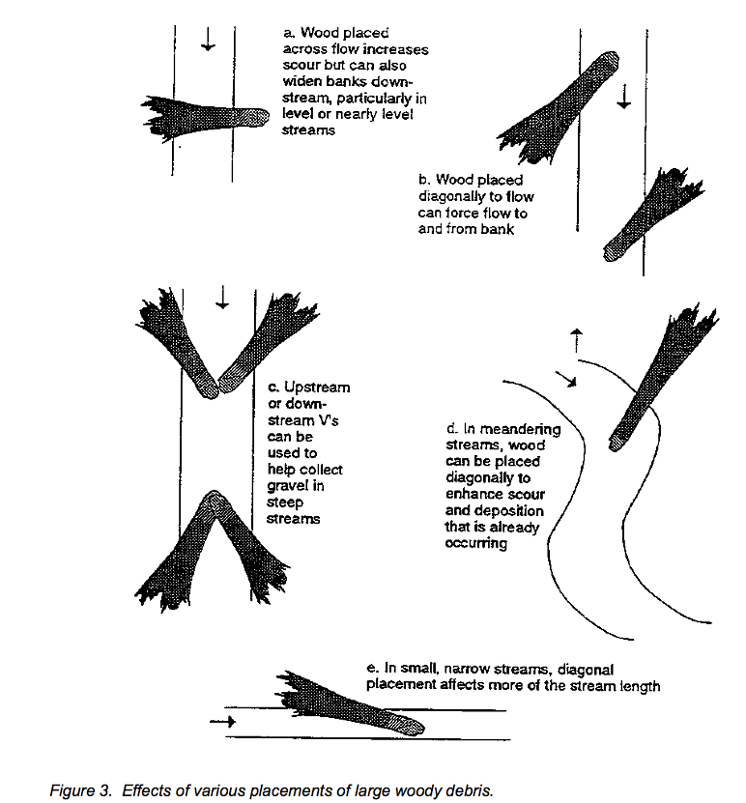
LWD placement techniques

Slide 18
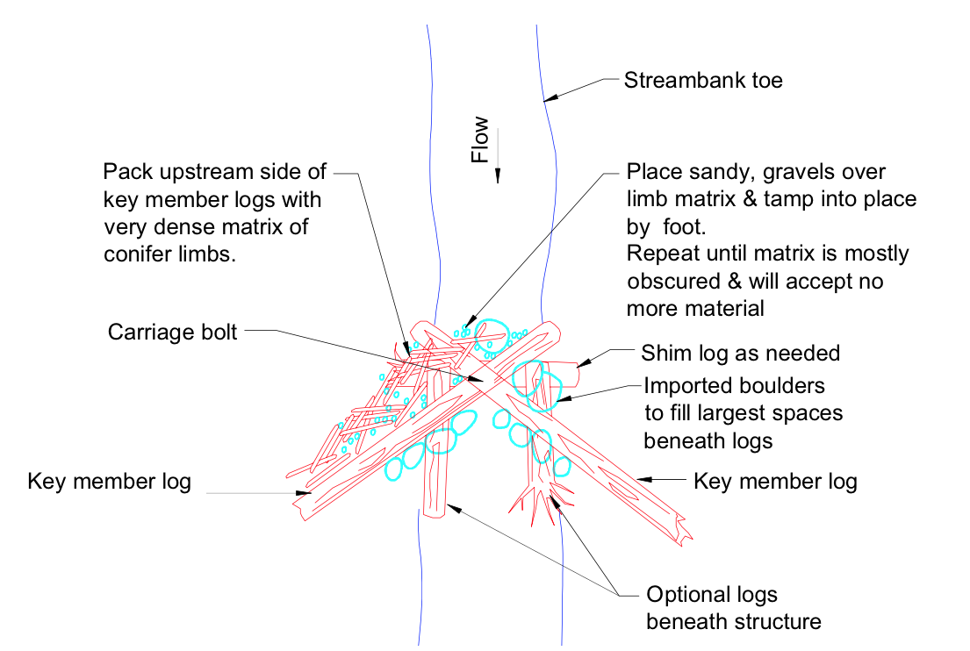
Large wood structure example: Constructed Log Jam

Slide 19
TRAPPING MOBILE WOOD

Slide 20
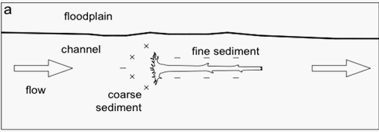
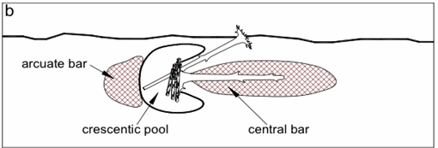
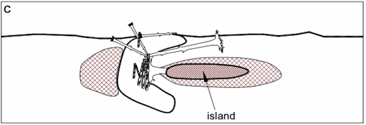
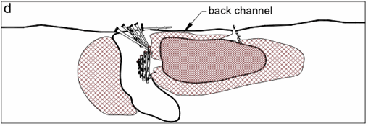
Floodplain
Example of how large wood creates habitat

Slide 21
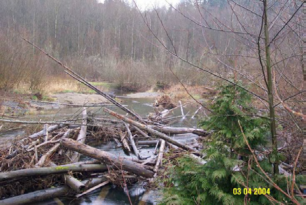
End result of trapping mobile wood

Slide 22
CASE STUDIES:
CRAB CREEK / GREEN RIVER

Slide 23
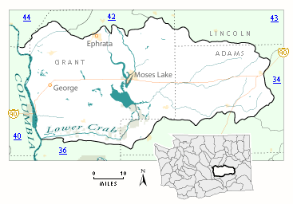
Crab Creek

Slide 24
Project Overview
Project length 2002-2007
Objective: To increase Coho salmon populations
Primary restoration method, LWD
Crab Creek received 172 trees
Green River received 248 trees
Form habitat using wooden debris

Slide 25
Crab Creek Results
Change | Change observed
Pool depth | Modest to undetectable changes have occurred in residual pool depth.
Pool surface area | The number of pools having a residual depth > 1m increased slightly as did their surface area.
Spawning Gravel | observed to have a 93% increase, pre-project year to the most recent post-project year.
Habitat formation | Channel roughness was also seen to increase, as a result.

Slide 26
Crab Creek (Cont.)
Change | Change observed
Habitat area | Side channel habitat has increased post-treatment, providing almost four times in area.
Large wood Pre-project + Treatment = 742 Post-project (2006) = 915 | The post-project wood counts of both years exceed the sum of pre-project and treatment wood. With 173 species of Native wood recruited.

Slide 27
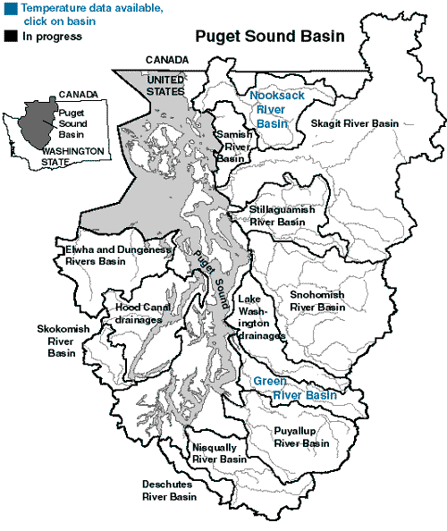
Green River

Slide 28
Green River Results
Change | Change observed
Main stream habitat | mainstem primary channel habitat units increased from 158 pre-treatment to 202 post- treatment.
Scour Pools | number of scour pools increased from (83 to 119)
Riffle habitats | Riffle habitats increased from (63 to 79)
Winter Coho carrying capacity | The winter abundance has exhibited a steady increase with no indication of a ceiling in capacity.

Slide 29
DISCUSSION
Most applied techniques are short term
Outcomes not always certain
Rarely seen to have immediate results
Project may essentially disturb river system

Slide 30
Summary
River restoration techniques
In-stream restoration
Channel modification techniques
Large wood debris (trapped and placed)
Uses natural materials and processes
Habitat forming
Creates channel complexity
River Restoration is “Habit” Forming

