Slide 1
Elk Creek Wood Replacement Phase Two
Oregon Watershed Enhancement Board, 2009
Katie Halvorson

Slide 2
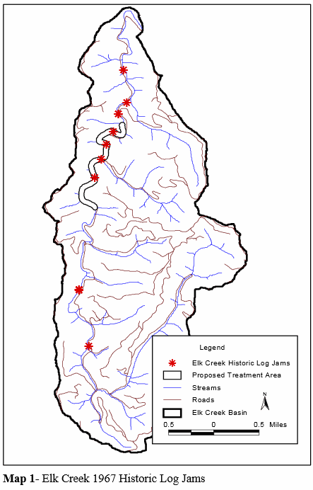
Stream/site data:
1.5mile reach
Stream gradient = 1.2%
Average bankfull = 30-35feet wide
No large log jams
Watershed above project is 5miles squared

Slide 3
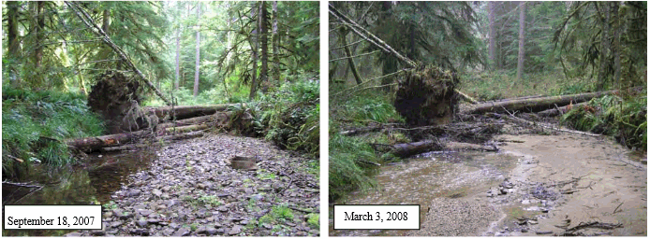
Goals:
Improve stream complexity
Enhance watershed function
Increase number of pools
Increase number of juvenile coho through pools

Slide 4
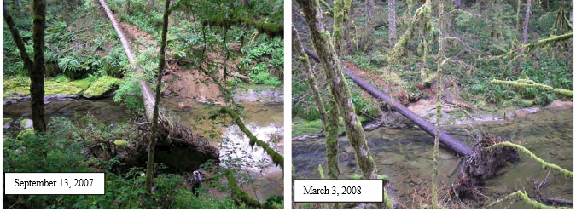
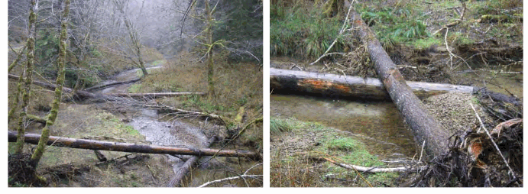

Slide 5
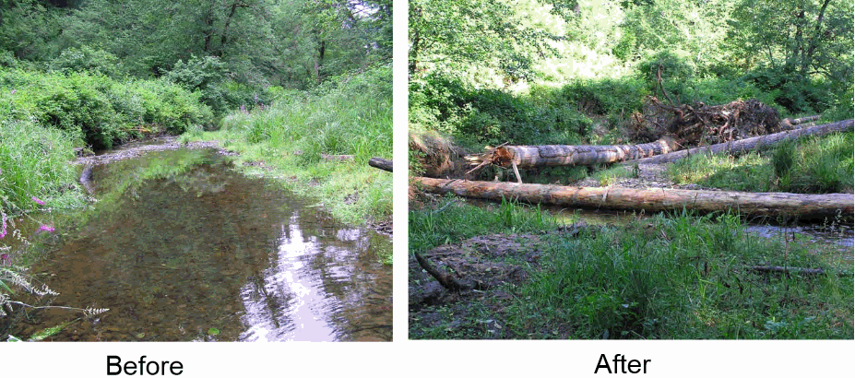
Problems with site:
Lacking large wood conditions
Total volume of wood = 11.5 meters cubed per 100meters
  ODFW says undesirable

Slide 6
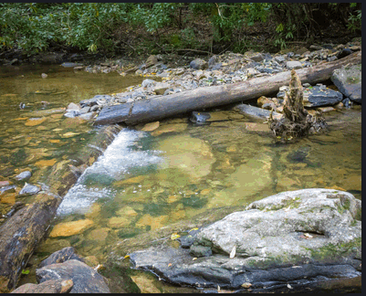
Importance of wood in watershed:
Pool scour
Sediment retention
High-quality spawning habitat
Increases stream elevation to connect channel with floodplain
Nutrient cycle processes

Slide 7
Why no wood at this site now?
Mainly caused by intentional removal
Riparian stands going from mixed to hardwood dominated
Removal of conifers from slide draws

Slide 8
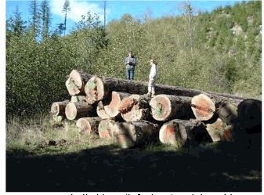
What they did:
Constructed 16 large wood structures
  used 52 trees and logs
Root wads added
  Helps increase habitat complexity
  Aids pool scour
  Acts as anchor
All wood meet standards for permit

Slide 9
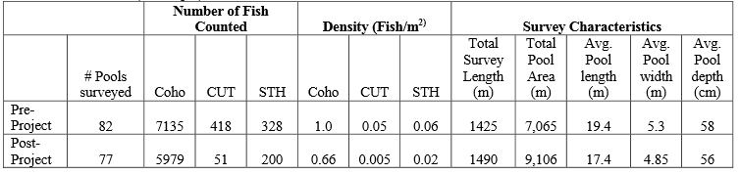
Site conclusions:
Coho, trout, and steelhead dropped
Total length and average pool depth stayed the same
Important to check high water flows

Slide 10
Cowan and Sinko Wetland Restoration Monitoring
Baker and Miranda, 2006

Slide 11
Objectives:
Monitor project effectiveness centered on juvenile salmon habitat use and passage capability.

Slide 12
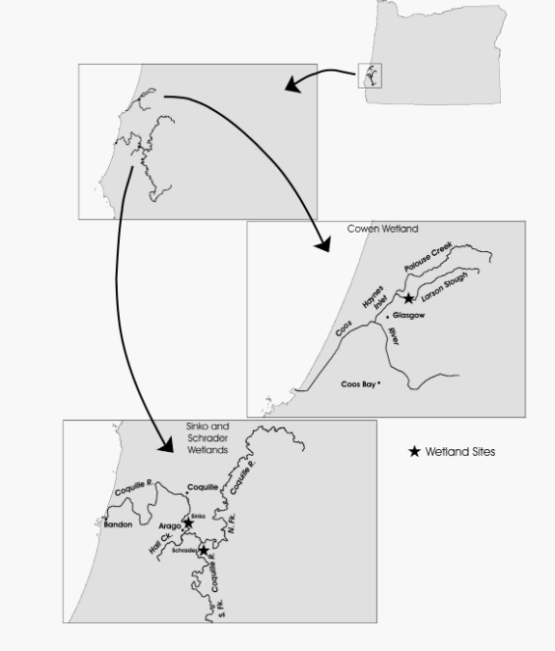
Cowen and Sinko wetlands

Slide 13
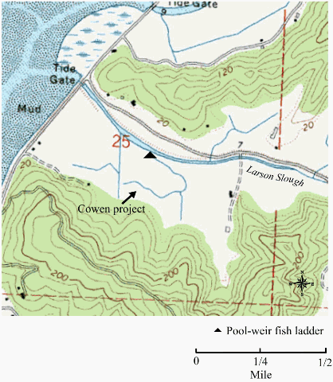
Cowen wetland facts:
Project completed fall of 2002
Restored 80 acres
Mouth of Larson Slough
Chinook, Coho, and steelhead present

Slide 14
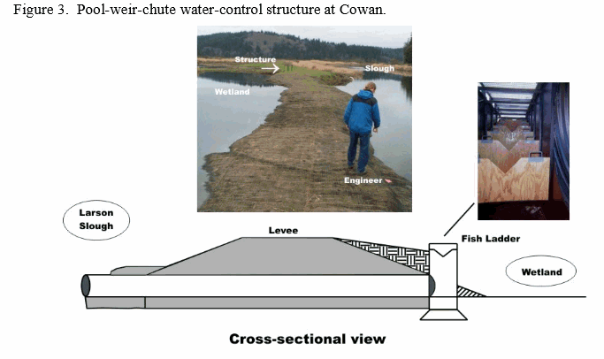
Cowen wetland reconstruction:
Pool-weir-chute ladder installed
Controls water elevation
Allows fish into and out of wetland

Slide 15
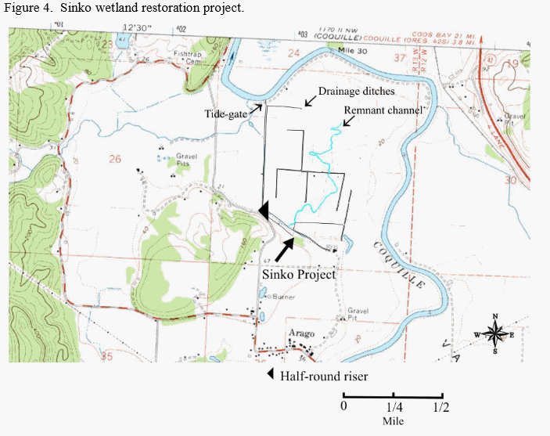
Sinko wetland project:
Completed summer of 2004
Restored 200 acres that was once dairy cattle pasture

Slide 16
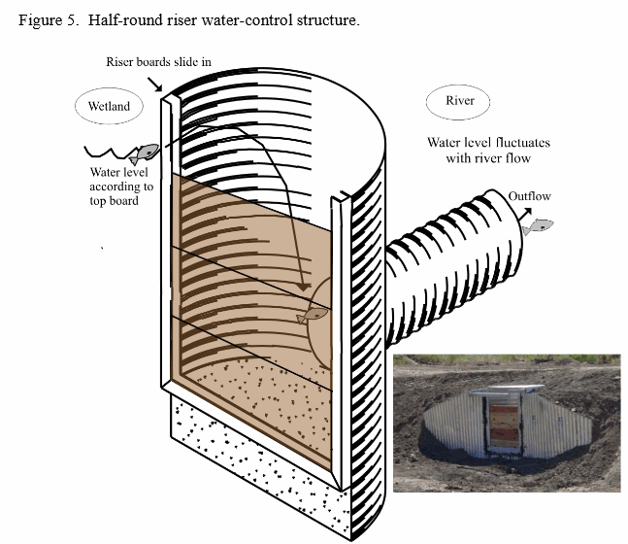
What they did at Sinko:
Filling drainage ditches
Restoring sinuous channels
Plating woody vegetation
Installing half-round riser water control structure

Slide 17
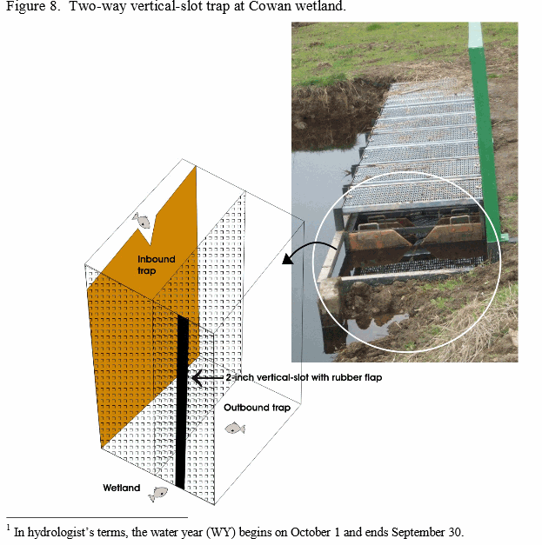
Fish and Cowen
Two-way vertical slot trap was put at the entrance of fish ladder

Slide 18
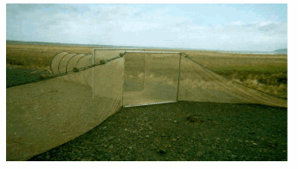
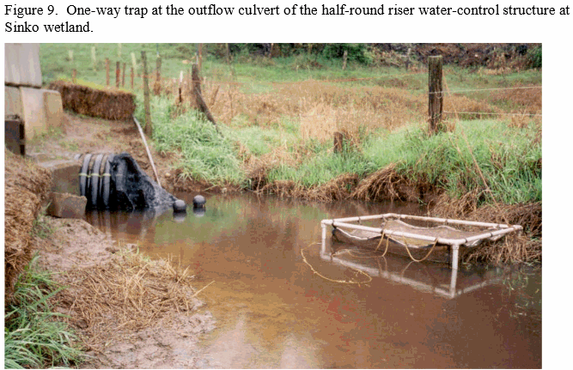
Fish and Sinko
Box trap was used to catch fish that out through water-control structure

Slide 19
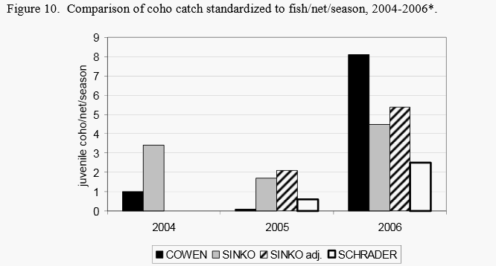
Results:
Juvenile coho were found at both sites after completion.
Coho was greater

Slide 20
In conclusion:
Some projects will get results faster than others. It takes time for the watershed to adjust to the projects.

