Slide 1
Fish Passage and Sediment Control
Washington Department of Forestry, Stream Habitat Restoration Guidelines, 2004
Ryan Johnson

Slide 2
Overview
Fish passage restoration
Spawning gravel cleaning and placement
Instream Sediment Detention Basins

Slide 3
Washington Fish Species
Anadromous
  Steelhead
  Coho, Chinook, Pink, Chum, and Sockeye Salmon
  Cutthroat Trout
  Pacific and River Lamprey
  Green and White Sturgeon
  American Shad
  Dolly Varden/Bull Trout
  Longfin Smelt
  Eulachon

Slide 4
Washington Fish Species
Freshwater
  Juveille Coho, Chinook, and Steelhead
  Kokanee
  Rainbow and Cutthroat Trout
  Brown and Brook Trout
  Bull Trout/Dolly Varden
  Olympic Mudminnow
  Stickleback
  Sculpin
  Pygmy and Mountain Whitefish
  Cyprinids
  Catostomids
  Sturgeon
  Western Brook Lamprey

Slide 5
Fish Passage
All listed fish require unimpeded access up and downstream
  Safe, effective passage between reproduction, feeding, and refuge habitats
Passage timing, frequency, and duration varies with each species
Passage not limited to mainstream
  Lateral movement

Slide 6
Blockage of Passage
2,256 road crossings of fish bearing streams
  1,036 identified as barriers
  Potential for >33,000 salmonid blockages
Coincides with blockage of downstream transport of habitat elements
  Sediment, water, wood

Slide 7
Fish Passage Restoration
Potential for greatest return on value
  As simple as retrofitting a culvert
Can restore fish population, and habitats downstream
Best used in vertically and laterally stable streams
  Passage structures can become buried

Slide 8
Risk & Uncertainty
Risk to resident fish
  Can create competition with established species
  Can introduce species historically not ever present
Structures can fill with sediment
  If not maintained, possible catastrophic failure of road fill
With relevant data and proper analysis, uncertainty is minimal

Slide 9
Spawning Gravel Cleaning and Placement

Slide 10
Salmonid Spawning Habitat
Controlling factors
  Size, permeability, and compaction of substrate
  Velocity, depth, direction, and dissolved oxygen content of flow
  Proximity to cover and rearing habitat

Slide 11
Excessive Fine Sediment
Buries spawning gravel
Reduces availability of dissolved oxygen to eggs
Reduces removal rate of metabolic wastes from the redd
Displaces aquatic invertebrates from gravel pore spaces
  Primary source of food for juvenile salmonids

Slide 12
Gravel Cleaning
Mechanized removal of fine material
  Occasionally hydraulic removal
Temporary if source of fines not tended to
Should only be used where excessive fines are the limiting factor for salmonids

Slide 13
Gravel Placement
Spawning gravel added to replace identified loss of gravel
Construction of discrete spawning pads
  Typically created by channel constriction or streambed control structures
Must be careful with placement
  High flows can wash away eggs
Appropriate if stream’s capacity to retain gravel is restored
May be used in fines-dominated stream if there is no continuing source of fines

Slide 14
Sediment Size
Optimal sediment size for most salmonid species
  80% of 10-50 mm gravel
  20% up to 100 mm gravel
  Trace coarse sand (2-5 mm)
No angular or crushed gravel

Slide 15
Risk & Uncertainty
Relatively low risk for both methods
  Temporary destabilization of habitat
  Targeting benefits toward one species may hurt other species
  Placing gravel may cause aggradation in unwanted places
Significant uncertainty
  Stream-specific and species-specific
  Observation and evaluation important

Slide 16
Data and Assessment
Must understand requirements of involved species and habitat
Gravel cleaning questions (lots of fines):
  Single event or chronic source of sediment?
  Fines increased by land use?
    If yes, watershed and riparian restoration viable?
Gravel placement questions (no gravel):
  Gravel recruitment problem?
  Limits by transport conditions?
  Anthropogenic or natural?
    If natural, should the habitat be altered?
    If human, can the source be addressed?

Slide 17
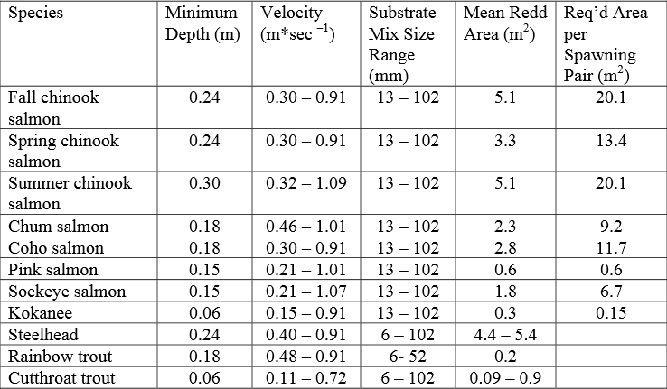
Variation
Variation in redd creation from different species
  Substrate size, water depth, and water velocity

Slide 18
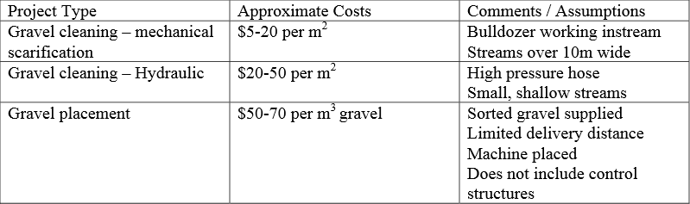
Cost
Can be costly and vary from project to project, depending on specific needs

Slide 19
Maintenance
Gravel cleaning should require no maintenance
Gravel placement should be monitored regularly
  Gravel moves slowly downstream
  Periodic replenishment

Slide 20
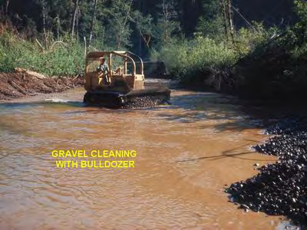

Slide 21
Instream Sediment Detention Basins

Slide 22
Gravel Traps
Pools built to capture and store sediment for removal
Useful for curbing excessive aggradation in a pinch
  Treats only the symptom, not the source
Should only be used after developing a full understanding of sediment source(s) and patterns of deposition
  Must allow appropriate types of sediment to continue

Slide 23
Considerations
Building structures of this nature disrupt the habitat on a local scale
Causes discontinuity in sediment and debris flows
Can interfere with organism survival requirements
All-in-all, very invasive

Slide 24
Goal
Short-term solution for removal of excess sediment
Used before long-term measures can be implemented or before they become effective
Most effective for gravels, cobbles, and boulders

Slide 25
Risks & Uncertainty
Impedance of fish passage up and downstream
May strand fish during low or no-flow periods
Cleanout requires fish relocation
  High stress, injury, or death
If unmonitored, lateral channel migration can occur
Can increase flood levels
High natural variability causes high uncertainty in efficacy of trap and size of particle trapped

Slide 26
Planning
Make sure there is no alternative
Is mitigation necessary? Is the obligation worth it?
Starvation of downstream spawning habitats of gravel?
Downstream incision or scour?
How often will inspection, maintenance, and cleanout be necessary?
Where will the sediment be dumped?
How will the trap be decommissioned?

Slide 27
Location
Should be placed at a natural grade break or constriction
  Low velocity
  Increase natural tendency for sediment to accumulate

Slide 28
Construction
Two major components
  Excavation of the basin
  Construction of the flow control structures
Off-site assembly reduces time stream is impacted

Slide 29
Flow Control Structures
Weirs
  Controlled by shape, elevation, and length of weir crest
  Flow passes over weir crest
Slots
  Configured in vertical orientation
  Flow passes through slot
Flashboard risers and gates
  Allows isolation of active working area

Slide 30
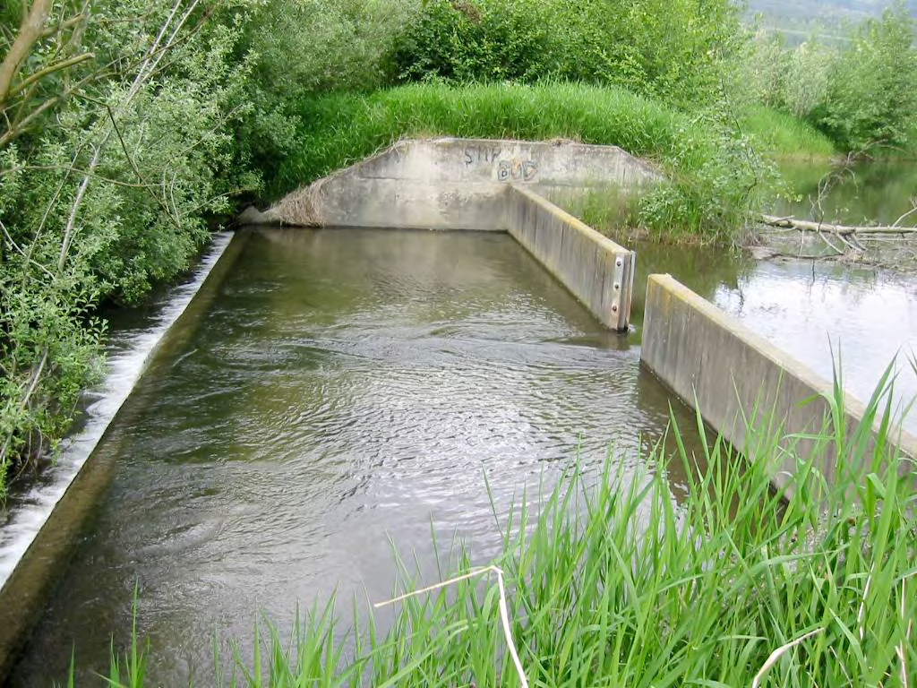
Slot & Weir

Slide 31
Sediment Removal
Basin design should include bypass ditch or pipe
  Diverts stream flow while removal occurs

Slide 32
Cost and Maintenance
Includes excavation and hauling, and construction of structures, including
  Flow control devices and bypass channels
Maintenance costs for sediment removal
Frequent monitoring important
  Sediment removal can be initiated near operating capacity
  Should be checked after each flood

Slide 33
Decommissioning
Short-term project
Should be as simple as removing the flow control devices

Slide 34
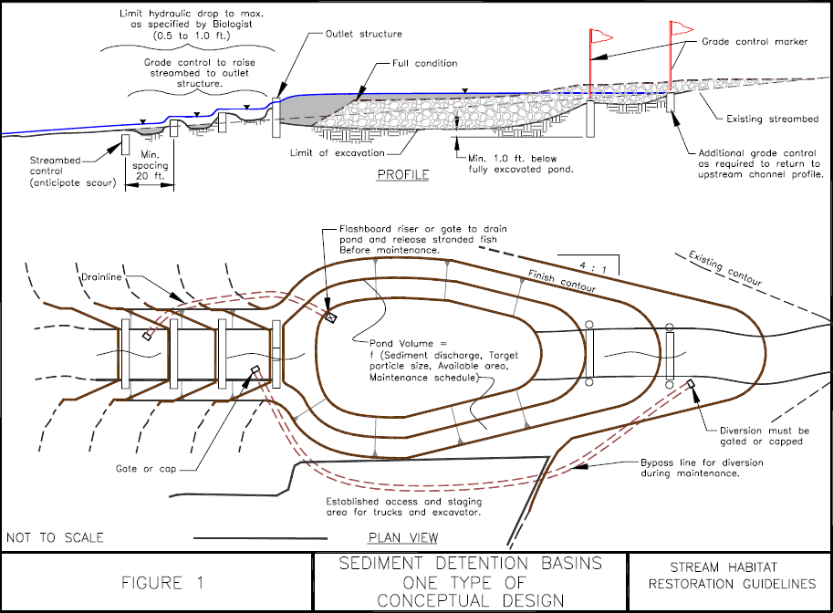

Slide 35
Summary
Fish passage restoration
  Simple and cost-effective
  Must consider needs of different species
Gravel cleaning
  Removal of fines, which can negatively impact salmon spawning
Gravel placement
  Creation of spawning pads where gravel deposition is minimal
Gravel traps
  Short-term solution to excessive sediment transportation

