Slide 1
Salmonid Habitat as a Guiding Principle in River Restoration
Dylan Castle
Earth and Physical Science Department
Western Oregon University
Monmouth, Oregon
Email: dcastle11@wou.edu

Slide 2
Outline
Introduction
Terminology
Salmon as Restoration Indicators
Constitution of Healthy Habitat
River System Benefits
Summary

Slide 3
INTRODUCTION

Slide 4
Terminology
Anadromous: Fish that are born in fresh water, spends most of its life in the sea and returns to fresh water to spawn
Salmon and Steelhead
Salmonid: Various fishes of the family Salmonidae, which include salmon, trout, grayling, and whitefish
Chinook, Coho, Steelhead, and Chum

Slide 5
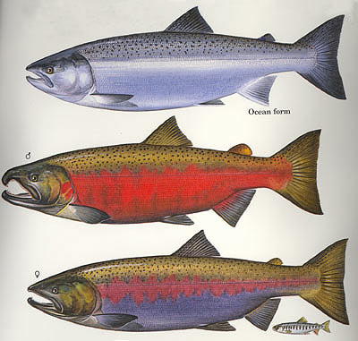
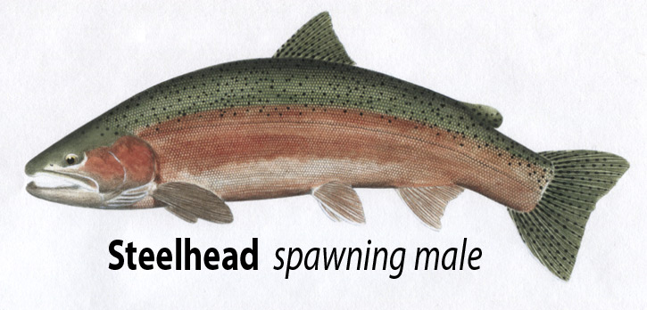
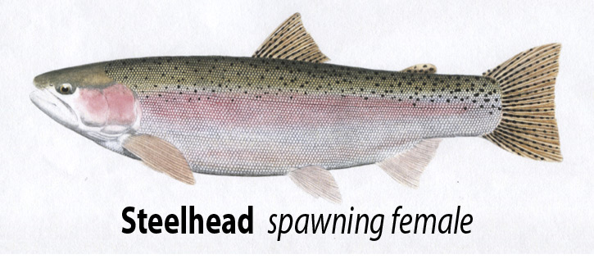
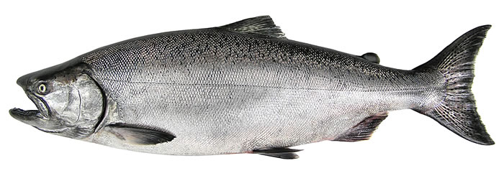
Coho Salmon
Steelhead
Chinook (king) Salmon

Slide 6
SALMON AS INDICATORS FOR RESTORATION

Slide 7
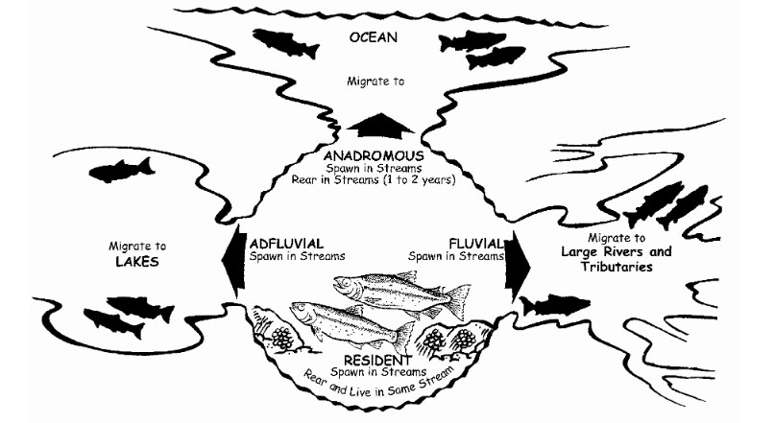
Why Use Salmon?
Easy to monitor
Fish counts
Adults and fry
Sensitive to changes
Vegetation, temperature, and gravel conditions

Slide 8
HEALTHY SALMONID HABITAT

Slide 9
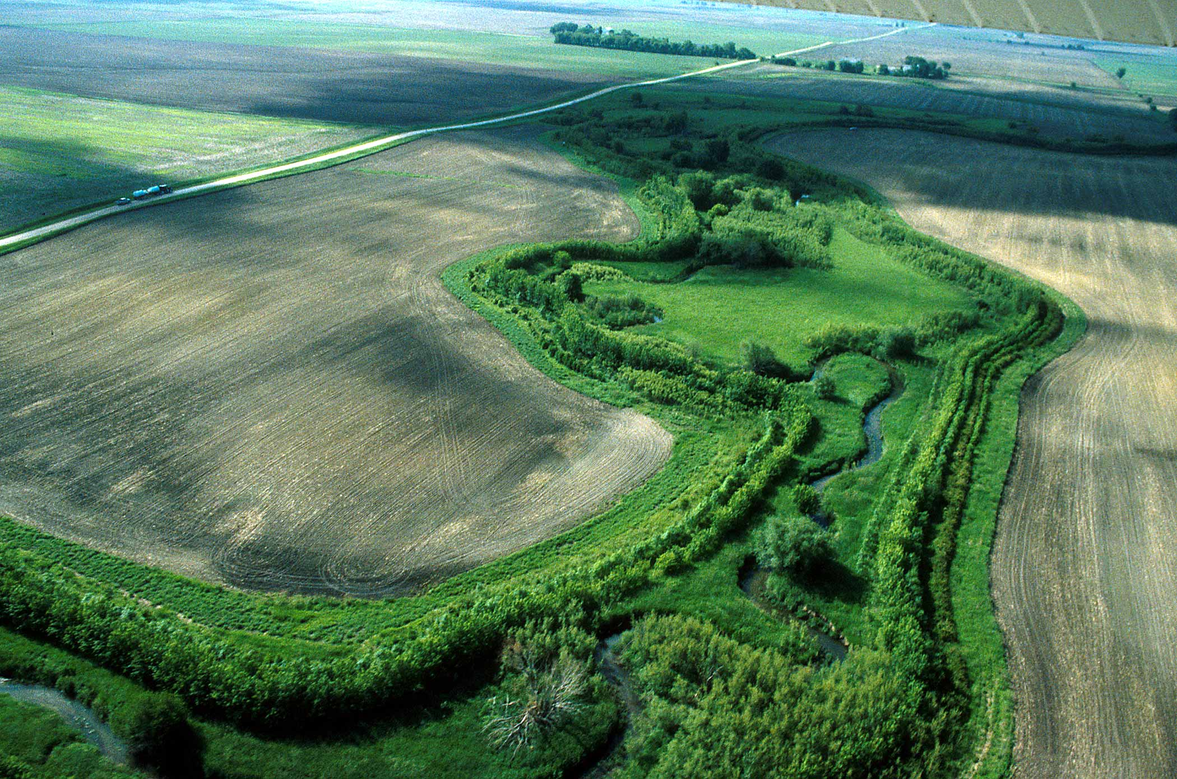
Riparian Vegetation:
Area between land and a river or stream
Water temperature
Sediment and groundwater delivery
Filter toxins and decrease erosion
Food/shelter for living organisms
Provides large woody debris

Slide 10
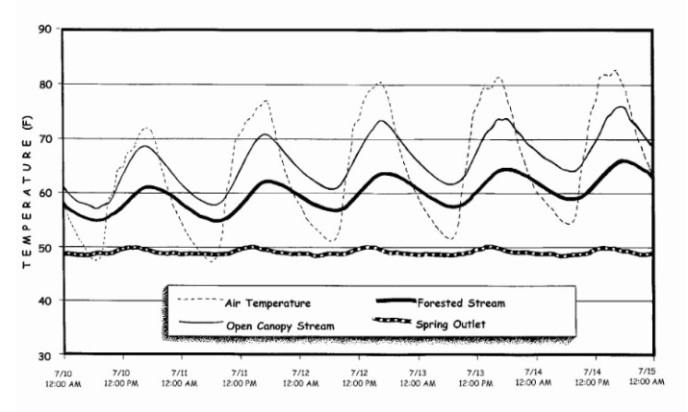
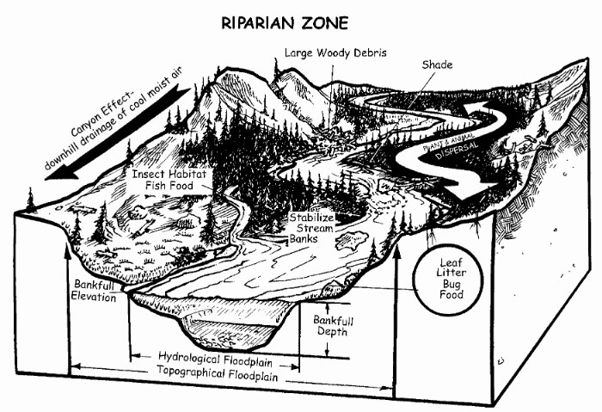

Slide 11
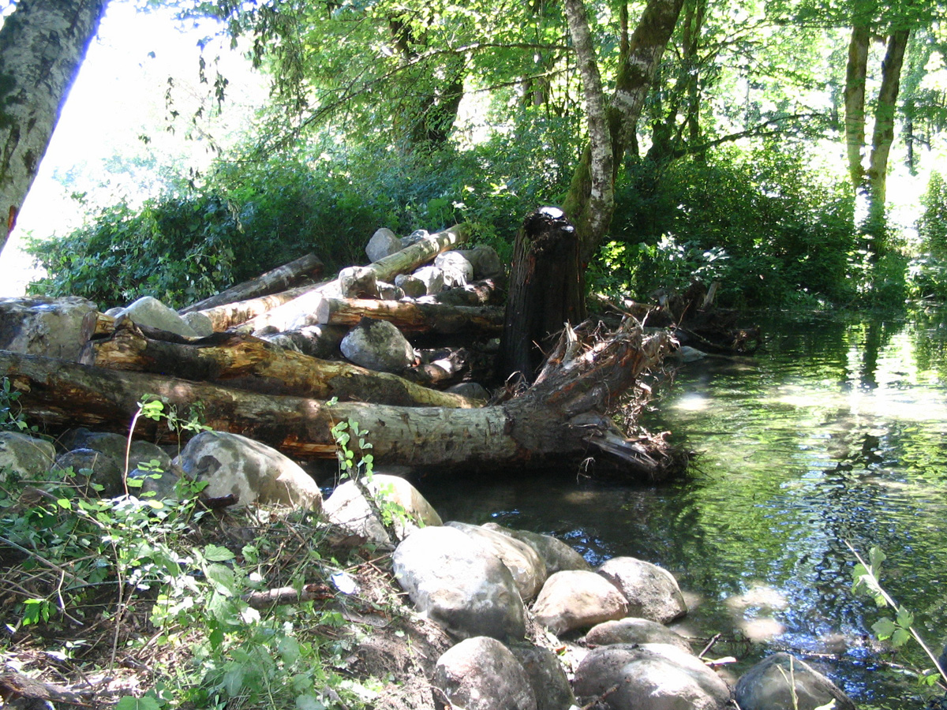
Vegetation (Cont.)
Source of large woody debris (LWD)
Increase channel roughness
Provide refuges and covers during high flows
Retain gravel

Slide 12
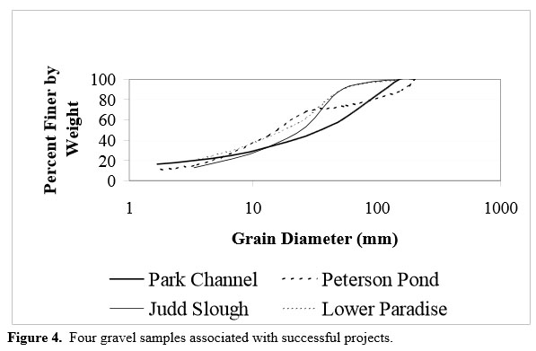
Vegetation (Cont.)
Vegetation helps to limit sediment loading of rivers
Clouds water
Covers spawning gravels

Slide 13
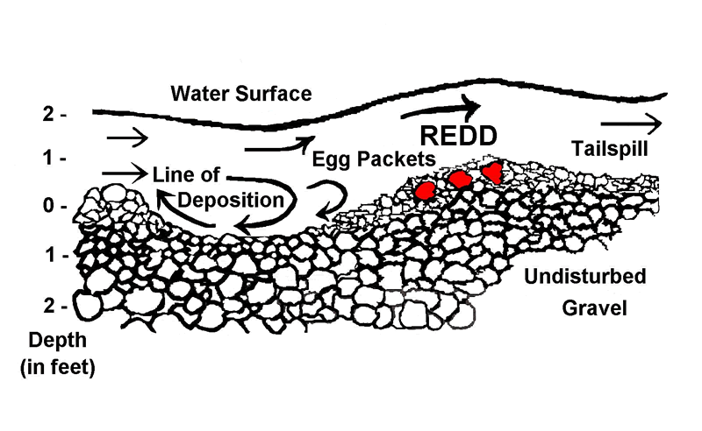
Gravel and Sediment:
Specific gravel for spawning
Redds (nests) are formed from gravel

Slide 14
Gravel and Sediment (Cont.)
Fine sediments cover spawning gravels
Large sediment does not allow for spawning

Slide 15
Soil Erosion and Sedimentation
Humans have little control over natural sedimentation
Organisms adapt to local sedimentation rates
Can only control human-induced sedimentation
Some sources of Sediment
Road/Slope instability
Surface erosion from crop, range, and urban use

Slide 16
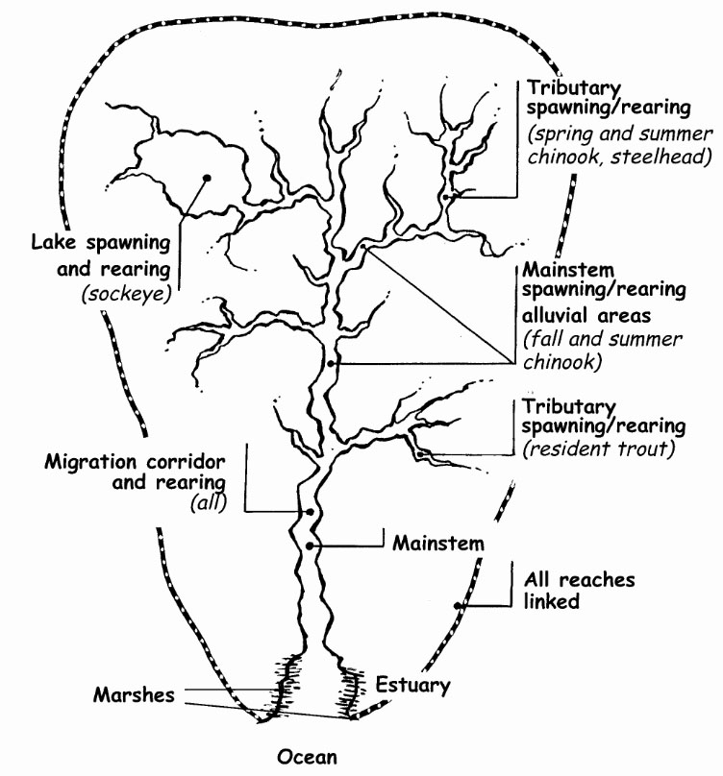
Side Channels:
Chinook (King)
Spawn in large main channels
Coho
Spawn in small, low-gradient tributaries
Sockeye
Spawn in lakes
Steelhead and Trout
Spawn in tributaries

Slide 17
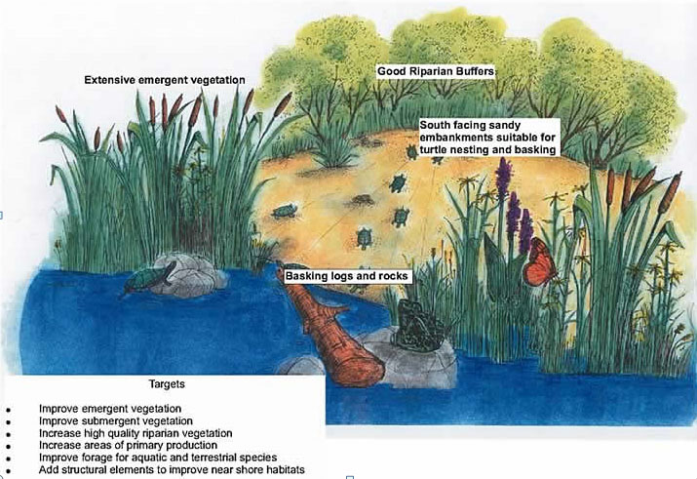
Side Channels (Cont.)
Vegetation Diversity
Insect Reproduction
Amphibian Habitat
Bird reproduction and foraging

Slide 18
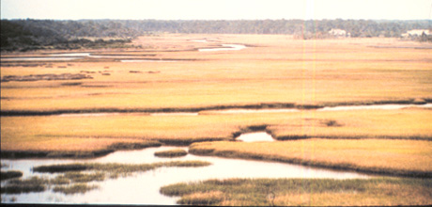
Wetlands:
Provide variety of important functions
Water quality improvement
Assimilate nutrients and filter toxins
Flood attenuation and desynchronization
Store water and delays runoff
Groundwater recharge and discharge
Recharge aquifers
Fish and wildlife
Provide food and habitat

Slide 19
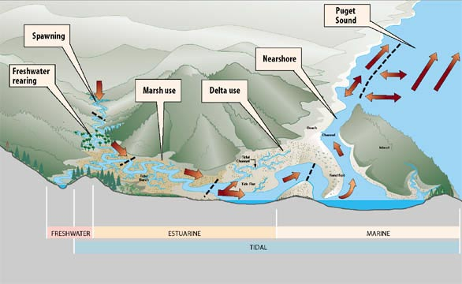

Slide 20
RIVER SYSTEM BENEFITS

Slide 21
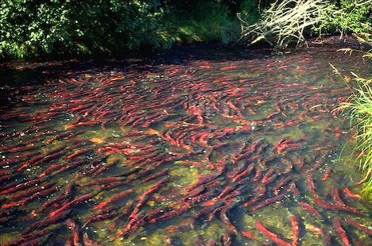
Nutrient Enrichment:
Salmon carcasses enrich the waters for juvenile salmon production
Addition of inorganic nitrogen and phosphorous

Slide 22
Benefits (Cont.)
Average length (inches) of coho and chinook, respectively
Unfertilized river: 30.38 and 41.25
Unfertilized Pond: 46.38 and 56.61
Fertilized Pond: 49.60 and 66.52
61% length increase for coho and 62% for chinook

Slide 23
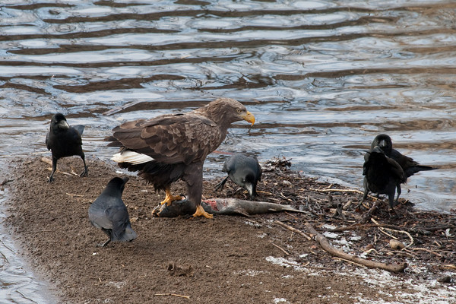
Benefits (Cont.)
Provides for other organisms
Insects
Bears
Birds

Slide 24
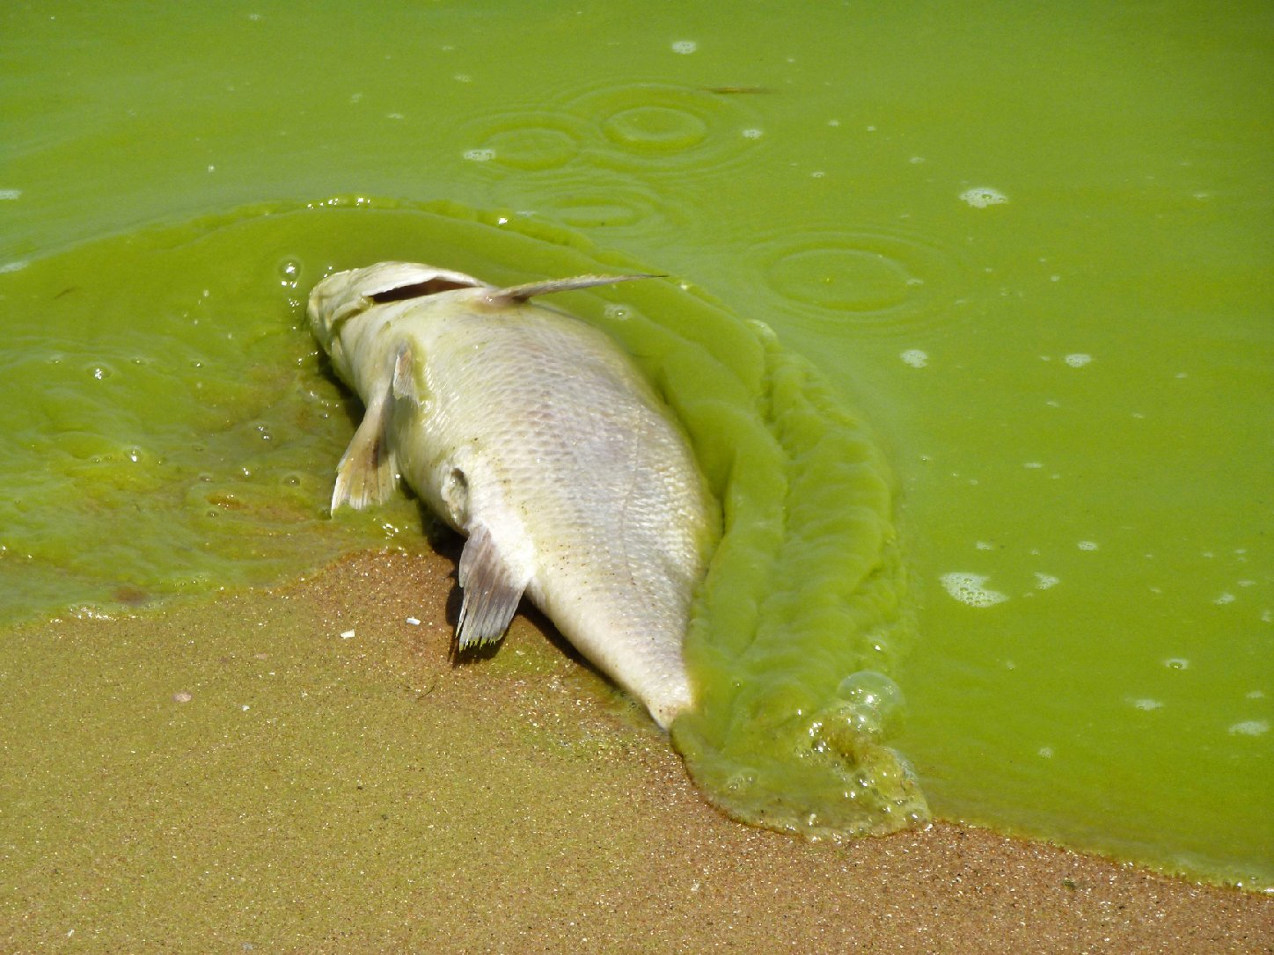
Excessive Nutrient Loading (N, P)
Caused by Runoff
Agricultural
Residential
Industry

Slide 25
SUMMARY
Salmonids are excellent indicators for restoration projects:
Responsive to subtle system changes
Healthy habitat includes:
Riparian vegetation
Range of sediment sizes
Side channels and estuaries
Salmon carcasses provide nutrients:
Salmon fry, insects, vegetation, other animals

Slide 26
Five-Minute River Interlude
https://www.youtube.com/watch?v=8Jq1U8JyHW4
Youtube - Salmon Spawning

