Slide 1
Suggested Guidelines for Geomorphic aspects of Anadromous Salmonid Habitat Restoration proposals
G. Mathias Kondolf

Slide 2
Some Information basics
What is Anadromous?
anadromous fish, are born in fresh water, spends most of its life in the sea and returns to fresh water to spawn.
What is Reach?
A reach is any length of a stream between any two points.
What is a Salmonid?
Any of various fishes of the family Salmonidae, which includes the salmon, trout, grayling, and whitefish

Slide 3
Purpose of publication
This publication reviews some of the common factors of failure seen in river restoration projects.
Suggests guidelines for preparation and evaluation of salmonid habitat restoration.
These guidelines are based around geomorphic aspects that are not normally taken into account.

Slide 4
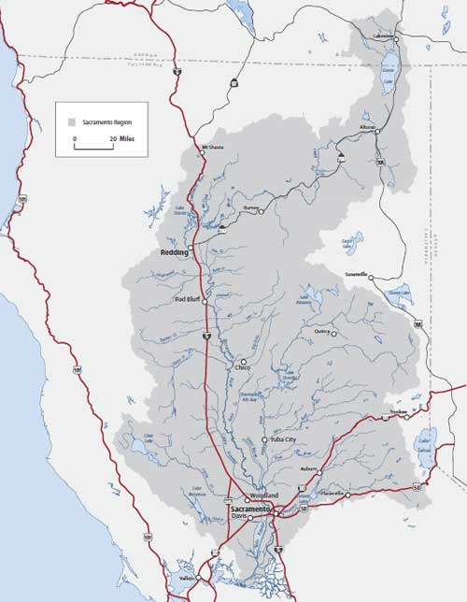
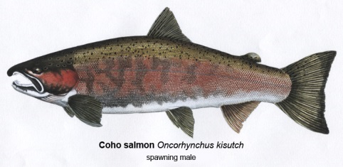
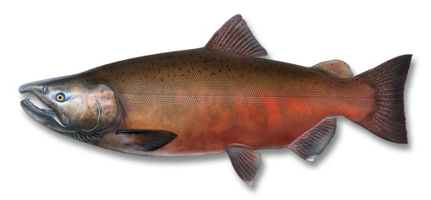
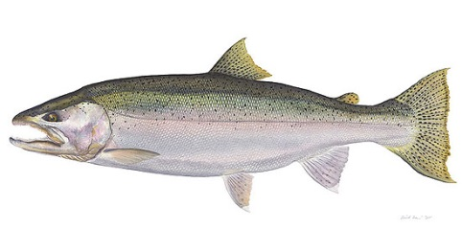
Area and aspects of the study
Sacramento- San Joaquin River System
Fish habitat under consideration
Coho Salmon
Chinook Salmon
Steel head trout
Sacramento River Basin

Slide 5
Geomorphic aspects not typically considered in River restoration
Geomorphic setting (Most Important)
Watershed, and reach scale
Historical alterations of in flow
Sediment supply and transport
Gravel supply and intragravel flow, as spawning habitat material.
Vegetation, and large woody debris within the reach of the project.

Slide 6
Geomorphic aspects cont..
Why is Geomorphic setting so important?
Without geomorphic setting knowledge local conditions may be attributed to local influences. Which lead project planners to believe these issues can be fixed with localized fixes.
Knowledge of geomorphic setting permits a broader picture, that can incorporate channel changes influenced by mass waste, large floods dams, and timber harvest.

Slide 7
Other restoration guidelines Water shed maps
Watershed maps: Project should show upstream influences, especially where dams have hydrologically isolated the project area from up stream influences.
Should also indicate information on areas with:
high erosion rates
Pollution sources
Land use changes which have possible altered runoff or sediment supply.

Slide 8
Other restoration guidelines Water Flow Regime
Documented historical hydrologic changes, resulting for land use change or reservoir construction.
Flood frequency analysis
Pre and post dam conditions
This information can be used to analyze the impact of low summer flows on riparian and vegetation conditions.

Slide 9
Sediment budgets
Information on runoff and sediment produced by local geomorphic processes.
Temporal and spatial patterns of deposition in reach area of the restoration project.
Estimates of gravel supply, for salmonid spawning habitat.
Transport rates under pre and post-dam flow regimes.

Slide 10
Channel form
A clear plan detailing the following:
Channel form dimensions and proposed depth.
Whether the proposed channel will be flat or undulating.

Slide 11
Gravel considerations
Spawning gravel quality, that is whether the existing channel gravel is appropriate for salmonid spawning needs. (including information on frame work size and compaction)
Gravel permeability, which influences inflows of oxygenated water into and out of the bed.

Slide 12
Large woody debris (LWD)
Large woody debris are known for increasing channel roughness.
They also provide high flow refuges, and covers for fish.
They also help retain gravel in high flow streams. Which inheritably provide much of the instream habitat for fish.
One consideration for LWD’s is wither they should be incorporated into the system artificially or wither riparian trees should be encouraged to topple into the stream on their own.

Slide 13
Last considerations
A clear statement of restoration objectives. This implies a specific set of objectives that can be measured, to accurately gauge restoration success.
Wishy washy objectives are not useful in this regard.
Post restoration evaluation funding, is strongly encouraged. This allows for the recording of channel evolution, adding to the historical data on these sites.

Slide 14
Conclusion
Stream restoration projects need to have a clear statement of objectives. Which can be measured.
Stream restoration projects need to incorporate geomorphic setting information as in the planning of restoration projects.
Gravel quality (compaction, and framework size need to be taken into account.
The incorporation of large woody debris (LWD) should be considered. Also the sourcing for these LWD should be also be considered. Whether local or foreign.

