Slide 1
Fundamentals of River Restoration and Salmonid Fisheries OWEB, 1999, Fundamentals of River Restoration and Salmonid Fisheries
Dylan Castle

Slide 2
Overview
What is a Watershed?
Patterns in Watershed Conditions
Water Dynamics
Soil and Sediments
Vegetation
Wetlands
Water Quality
Fisheries Resources
Conclusion

Slide 3
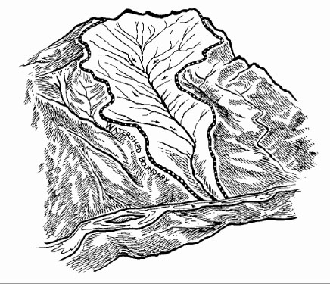
What is a Watershed
“Area of land that drains downslope to the lowest point”- OWEB
Drainage pathways can be surficial or underground
Assessments should occur at the watershed level due to connectivity
Activity affecting the watershed at one location will affect the watershed downstream

Slide 4
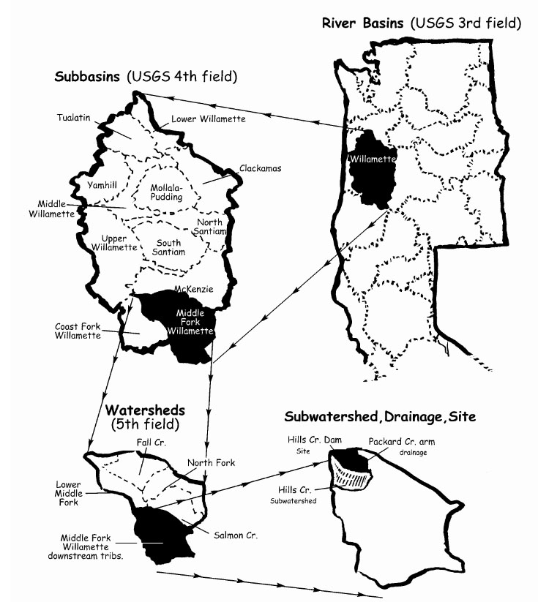
What is a Watershed Cont.
Watersheds are broken into categories
River Basins
Sub-basins
Watershed
Sub-watershed
Drainage
Site

Slide 5
Regional Patterns in Watershed Conditions
Watersheds determined by geology, climate, and disturbances
Geology: uplifting can influence slope and orientation of bedrock
Climate: elevation, precipitation, and vegetation
Disturbances: large or small scale
Small Scale: trees blown into a stream
Large Scale: fire or flood
Natural part of watershed evolution
Human activities can increase timing and intensity
i.e. roads creating impervious surfaces

Slide 6
Water Dynamics
Water Cycle
Precipitation uses three pathways on Earth’s surface
Intercepted by vegetation and evaporated or transpired back to atmosphere
Move downslope on surface or through soil to stream system
Stored in snowpack, groundwater, ponds, or wetlands for a period of time

Slide 7
Water Dynamics Cont.
Precipitation is generally less than infiltration rates
Little surface runoff or overland flows occur
Decreases in infiltration rates can cause larger peak flows
Reduce water storage and result in low flows

Slide 8
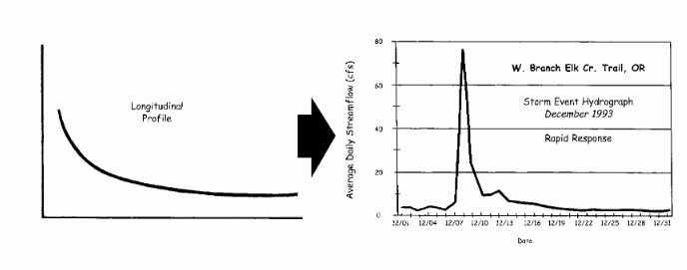
Hydrologic Data
Steep slopes and/or thin soil move water relatively quickly
Larger watersheds, deep soils, and extensive storage sites tend to move water slower

Slide 9
Soil Erosion and Sediment in Streams
Sediment Derived from
Erosion of upland areas
Lateral movement of stream channels
Downcutting of stream beds
Sediment balance is important
Fine sediment can blanket spawning gravel and cover rock surfaces for insects
Suspended sediments can cloud water

Slide 10
Soil Erosion and Sediment in Streams Cont.
Humans have little control over natural sedimentation
Organisms have adapted to local sedimentation rates
Can only control human-induced sedimentation
Some sources of Sediment
Slope instability
Urban runoff
Surface erosion from crop, range, and burned land.
Road instability

Slide 11
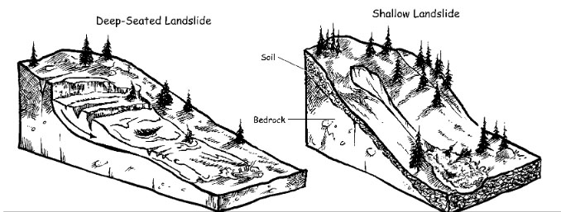
Soil Erosion
Number of mechanisms can move soil downhill or into streams
Raindrop Splash: splattered soil grain from raindrops, can accumulate downhill
Ravel: movement of soil downhill from gravity
Surface rilling: soil carried by overland flow.
Landslides

Slide 12
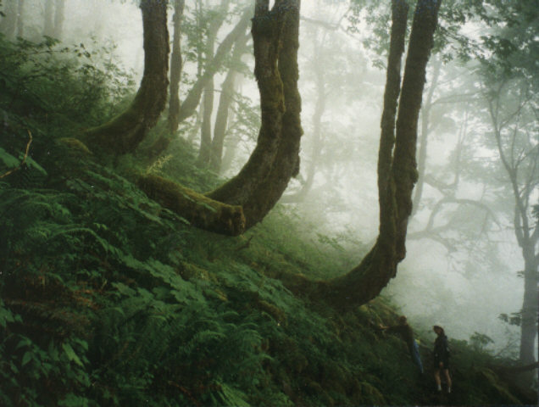
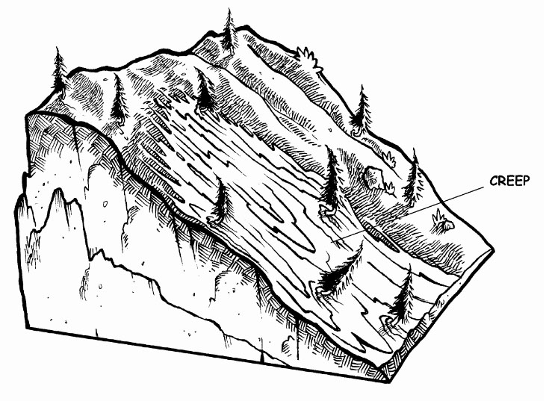
Soil Erosion
Mass Wasting (creeps and flows): gravity moves soil downhill

Slide 13
Vegetation
Factors of Vegetation
Water temperature
Sediment delivery
Reduces soil compaction
Amount and timing of runoff
Filters Toxins
Food and shelter for living organisms
Large woody debris
Decrease erosion

Slide 14
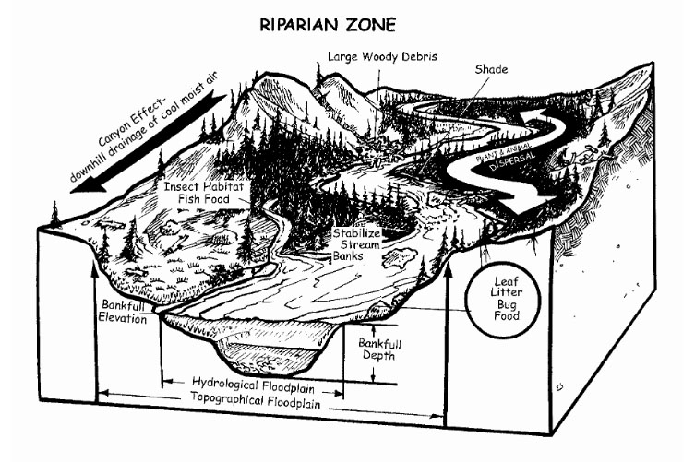
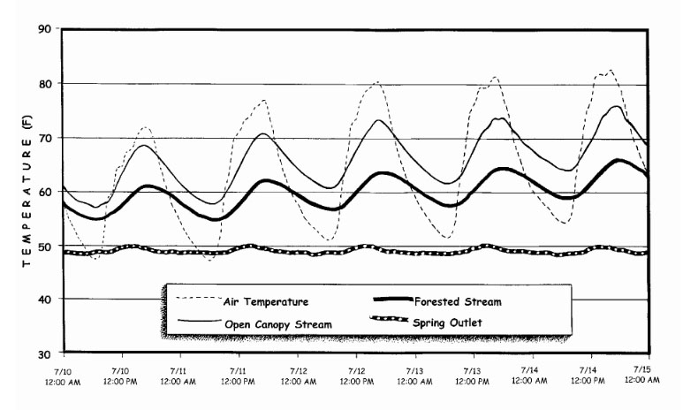
Riparian Zones
Vegetation decreases fluctuation of water temperatures

Slide 15
Wetlands
Provide Variety of important functions
Water quality improvement
Assimilate nutrients and filter toxins
Flood attenuation and desynchronization
Alleviate flooding by storing water or delaying runoff
Groundwater recharge and discharge
Recharge aquifers by storing water
Fish and wildlife
Provide food and habitat

Slide 16
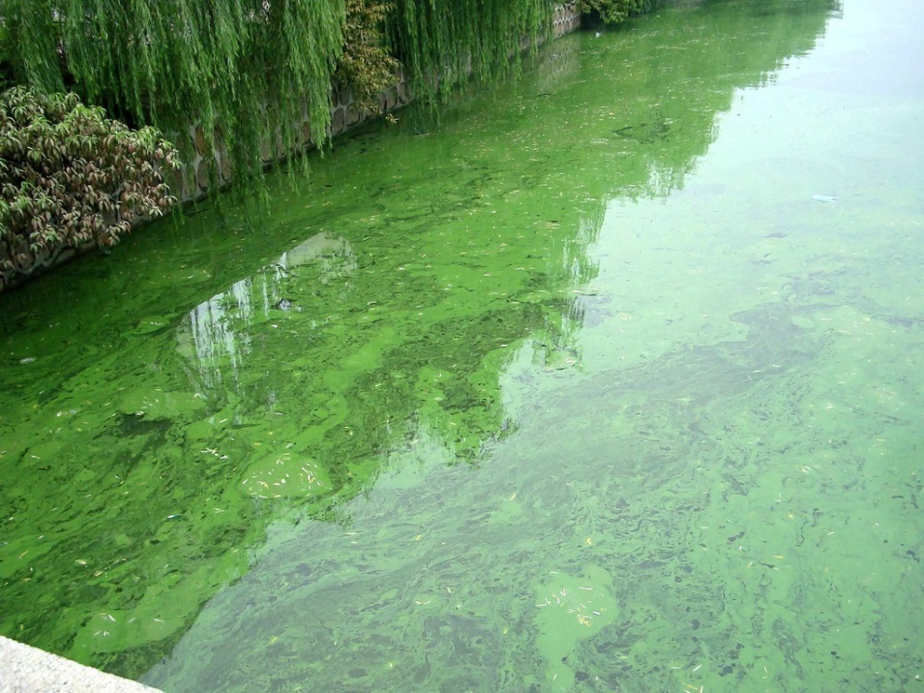
Water Quality
Nutrients
Stimulate growth of algae and plants
Produce food for aquatic insects which are eaten by fish
Excessive growth (blooms) can cause oxygen deficiencies
Phosphorous and nitrogen are controlling nutrients and are monitored most
Bacteria
Used to test water quality for drinking
Indicate contamination by sewage, feedlots, grazing, and urban runoff

Slide 17
Water Quality Cont.
Cool Temperatures and dissolved oxygen
Essential for salmonids and aquatic community
64ºF established as basis of sub-lethal for salmonids
Toxic Contaminants
Runoff from pesticides or herbicides
Urban runoff

Slide 18
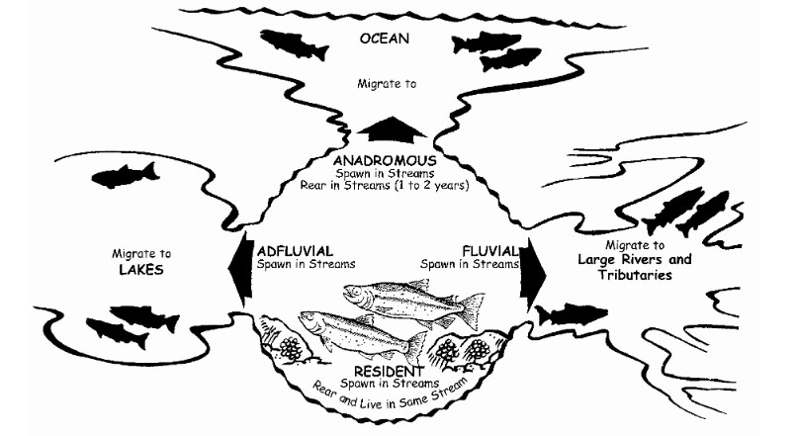
Fisheries Resource
Best indicator of watershed health

Slide 19
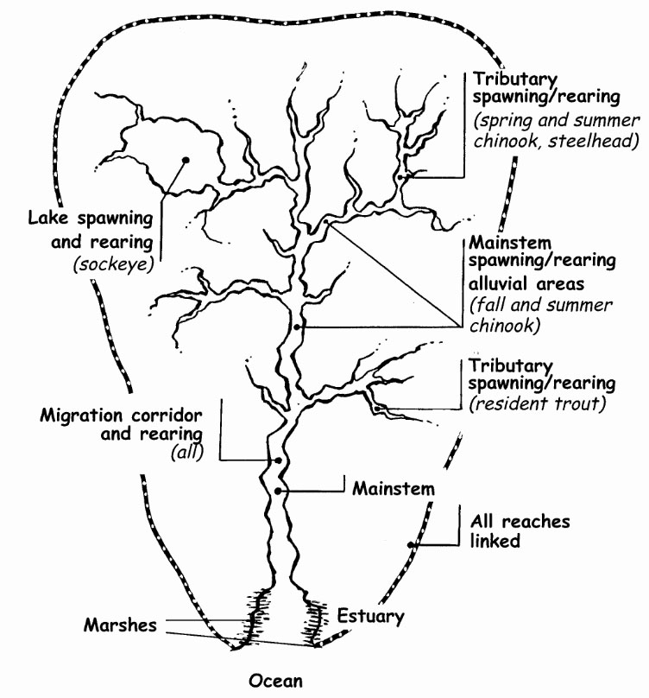
Fisheries Resource
Chinook (king)
Spawn in large main channels
Coho
Spawn in small, low-gradient tributaries
Sockeye
Spawn in lakes
Steelhead and Trout
Spawn in tributaries

Slide 20
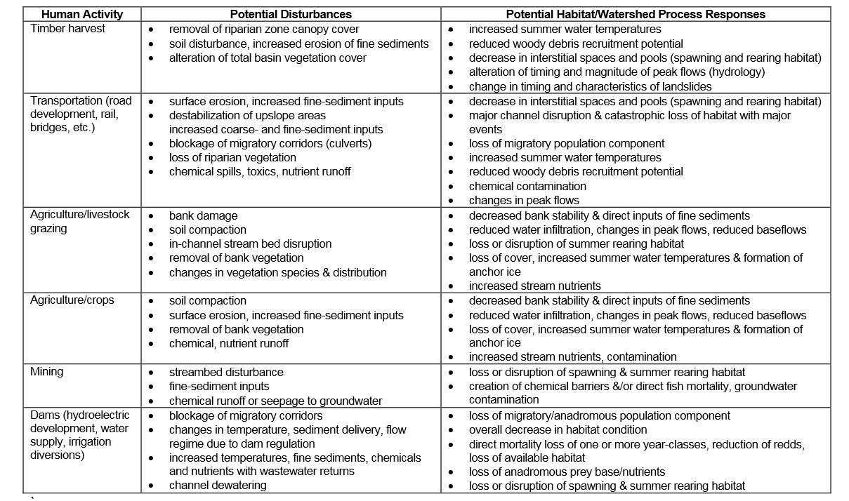
Human Impacts

Slide 21
Human Impacts Cont.

Slide 22
Conclusion
Watershed: area of land that drains downslope to the lowest point
Watersheds determined by geology, climate, and disturbances
Can only control human-induced sedimentation
Vegetation is critical in healthy watersheds
Water quality is vital for living organisms

