Slide 1
Perspectives on River Restoration
ES407 Senior Seminar Working Group
Earth and Physical Science Department
Western Oregon University
Monmouth, Oregon

Slide 2
River Restoration
Restoration Defined:
Improving hydrologic, geomorphic, and ecological processes
Replacing lost or damaged elements of the natural system
Oregon Plan for Salmon and Watersheds:
Restoring fish populations and aquatic systems
OWEB: 1997 Legislation (Lottery Fund)

Slide 3
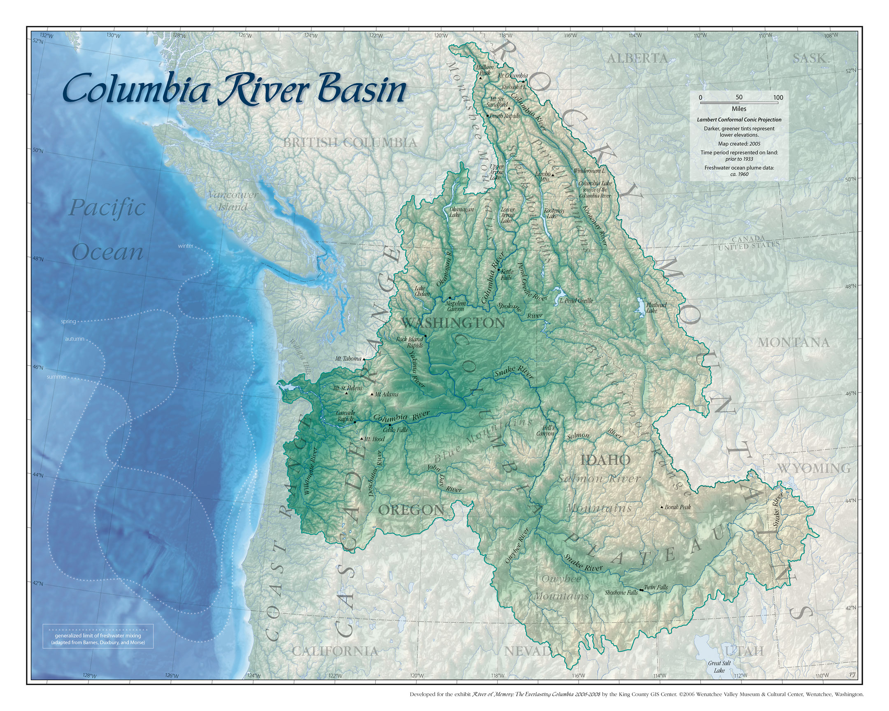

Slide 4
Historical Framework
Lewis and Clark Expedition ca. 1805
Hudson’s Bay Co. Trappers ca. 1830-1840
Willamette Valley Settlement ca. 1840-1880
Logging and Timber Industry
Agricultural Development
Columbia Basin Dam Projects ca. 1930-1950’s
Urbanization of Puget-Willamette Lowland
Moral of Story: 150 – 200 years of intensive management

Slide 5
Most Common Remedial Actions
Riparian Vegetation / Planting:
Tree cover for stream channels
Invasive plant mitigation
Large Woody Debris Replenishment:
LWD placement and recruitment
Erosion Mitigation
Fish Passage:
Culverts and dams

Slide 6
Session Overview
Katie Halvorson:
“Watershed Assessment and River Restoration Strategies”
Dylan Castle:
“Salmonid Habitat as a Guiding Principle in River Restoration”
Ryan Johnson:
“Fluvial Hydrology, Fish Passage, and Sedimentation”
Ian McBride:
“Riparian Vegetation, Land Use and Habitat Restoration”
Esteban Quiles:
“Channel Modification and Restoration”

Slide 7
Five-Minute River Interlude
https://www.youtube.com/watch?v=8Jq1U8JyHW4
Youtube - Salmon Spawning

