Slide 1
Fluvial Processes in Puget Sound Rivers and the Pacific Northwest
John M. Buffington, Richard D. Woodsmith, Derek B. Booth, and David R. Montgomery
2003
Ian McBride

Slide 2
Overview
Introduction/Background
Aspects of Pacific N.W. streams
Restoration in the Pacific N.W.
Conclusion

Slide 3
Introduction

Slide 4
Stream Restoration
Expensive: $44 million in 5 years, Columbia
Often unmonitored and uncontrolled
Projects beginning in the Puget sound region
Focus on salmon recovery

Slide 5
Stream Restoration
Difficult to assess
Hard to inform future projects
Three problems:
Incomplete understanding of fluvial processes
Designs inappropriate for specific channel
Small scope

Slide 6
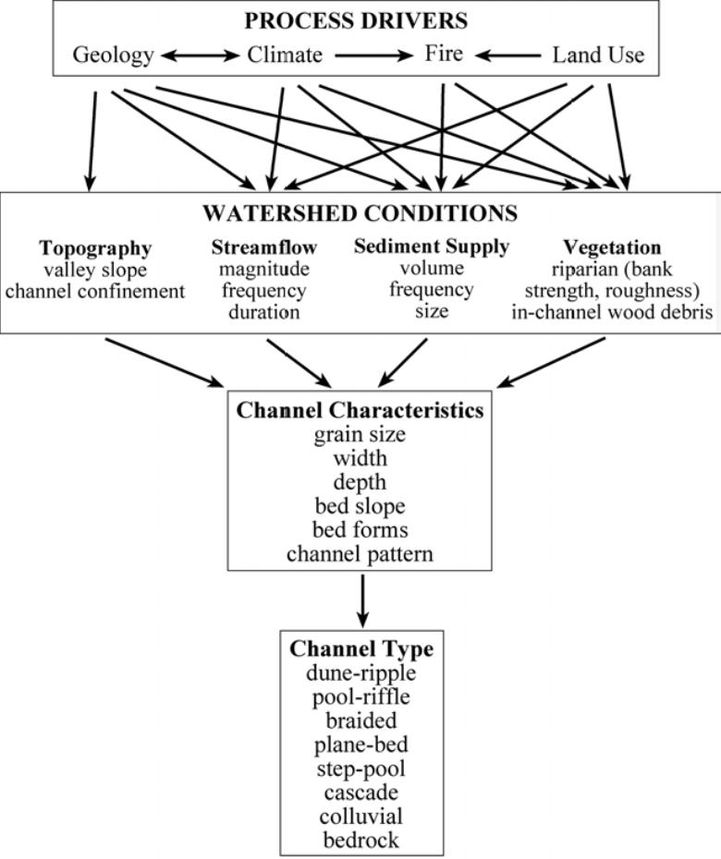
Stream
Restoration
Complex
Interconnected
All factors need to be considered

Slide 7
Pacific Northwest Streams
Diverse
What is ideal for one stream, is not ideal for all

Slide 8
Aspects of N.W. Streams

Slide 9
Morphology
Controlled by:
Geology
Climate
Land use
Fire
Resulting in:
Topography
Streamflow
Sediment supply
Vegetation

Slide 10
Channel Characteristics
Watersheds are often ignored
Watershed conditions influence:
Grain Size
Width
Depth
Bed Forms
Channel patterns

Slide 11
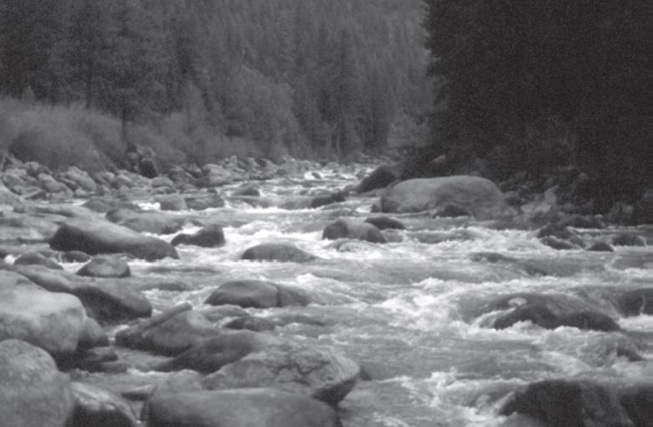
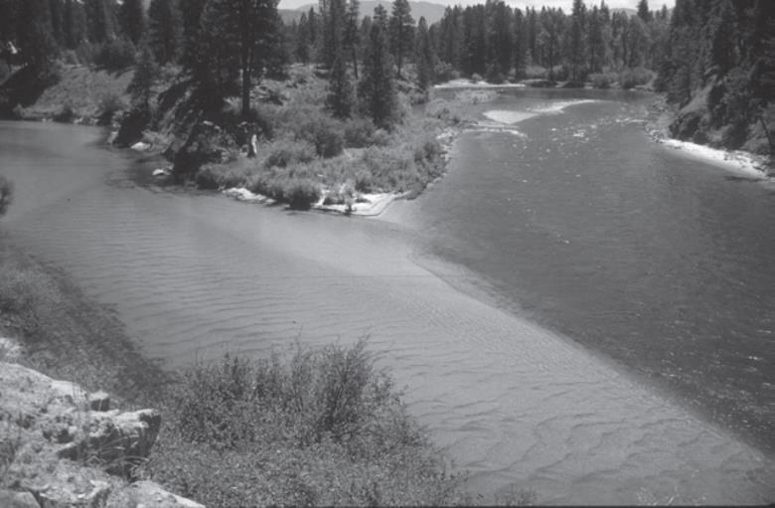
Stream Types
Boulder dominated
Limited sediment
High grade
Confined
Sand/gravel dominated
Sediment laden
Low grade
unconfined

Slide 12
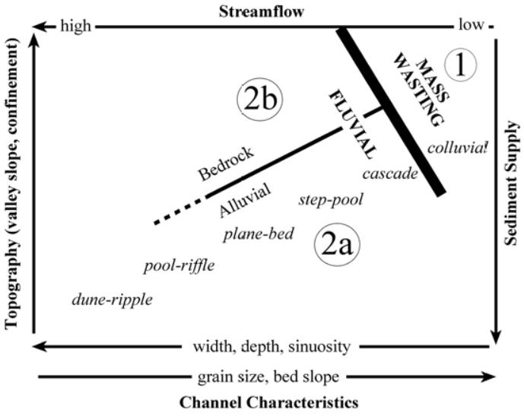
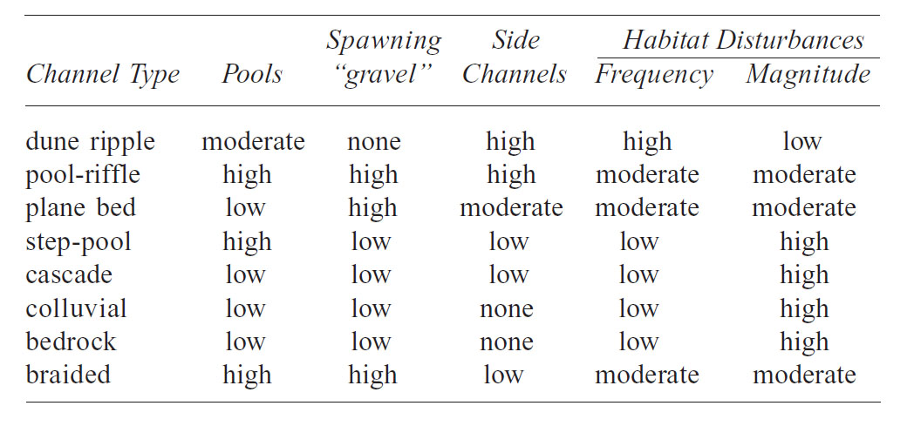
Classifying Channels
Topography
Streamflow
Sediment supply
Channel characteristics

Slide 13
Restoration in the N.W.

Slide 14
Proper Restoration
Recognizing differences is crucial
Classification
Restoration outside of the norm can result in:
Loss of self maintenance
Instability

Slide 15
Puget Sound Rivers
Highly populated areas
Urbanized
Social and economic limitations
Restoration limited

Slide 16
Pacific N.W. Restoration
Three components to develop programs:
Understanding of physical settings and potential
Knowledge of history of river and watershed
Clear policy objectives

Slide 17
Conclusion

Slide 18
Conclusion
One size does not fit all
Understand entire river system + watershed
History of the area
A lot must be done before beginning restoration

Slide 19
Thank You!

