Slide 1
Process-based Principles for Restoring River Ecosystems
T. Beechie, D. Sear, J. Olden, G. Pess, J. Buffington,
H. Moir, P. Roni, M. Pollock
2010, BioScience, v. 60

Slide 2
Purpose of the Paper
River and land management causing decline of river health
Exponential rise in stress on ecosystem
Constant increase in human demand for water and land
Need to synthesize restoration concepts and practice
Guiding principles for sustainable river restoration
Explanation of process-based restoration and its advantages

Slide 3
Overview
What is process-based restoration?
Advantages of process-based restoration
Four principles of process-based restoration
Classes of restoration

Slide 4
What is process-based restoration?
Restoration of normative rates and magnitudes of processes
Physical
Chemical
Biological
Focus on correcting anthropogenic disruptions
Minimal corrective intervention

Slide 5
Advantages
Control vs. Restore
Popular methods
Tend to follow legal mandates
Restore narrowly-defined aspects of river ecosystems
Creates habitats that conform to a standard
“Good” habitat
Controls processes to create habitat
Results in artificial and unnaturally static habitats

Slide 6
Process-based Method
Works with sediment and discharge regimes
Identifies driving processes of stream degradation
Restores processes to promote self-restoration of stream

Slide 7
The Principles
Four guidelines
Target the root causes of habitat and ecosystem change
Tailor restoration actions to local potential
Match the scale of restoration to the scale of physical and biological processes
Be explicit about expected outcomes, including recovery time

Slide 8
1st Principle - Target
Don’t deal with symptoms; deal with the cause(s)
A “good” habitat may have unaddressed system drivers
Designed to correct human alterations

Slide 9
2nd Principle - Tailor
Each reach is unique
Relatively narrow range of channel and riparian conditions
Restoration should follow unique conditions
Identify natural potential
Historical analysis
Assessment of disruptions to primary driving processes

Slide 10
3rd Principle - Scale
Actions must affect entirety of afflicted area
On both a physical scale and biological scale
Most restoration projects at reach scale or smaller
Most processes at reach scale or larger
Most restoration projects at headwaters or small tributaries
Most severe habitat changes at lowland floodplains and deltas

Slide 11
4th Principle - Predict
Use quantitative predictions
Helps set appropriate expectations of project
Provide general range of possible outcomes
Often difficult to predict outcome, but helps provide expectations as well

Slide 12
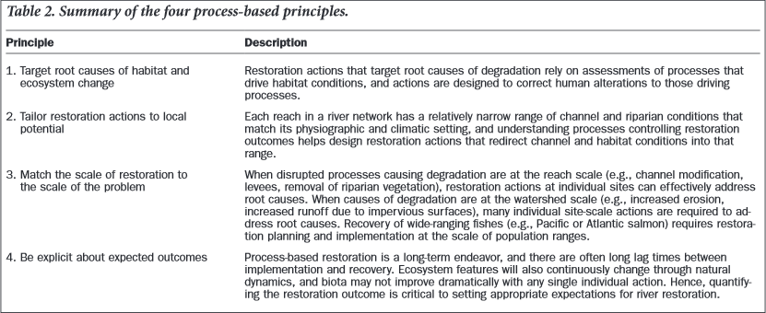

Slide 13
Applying Principles
Need to put the right projects in the right places
Provide the greatest ecosystem benefit at the least cost
Set appropriate expectations for ecosystem response
Planning based on two questions:
How have changes in riverine habitats affected biota?
What are the ultimate causes of changes in riverine habitats?

Slide 14
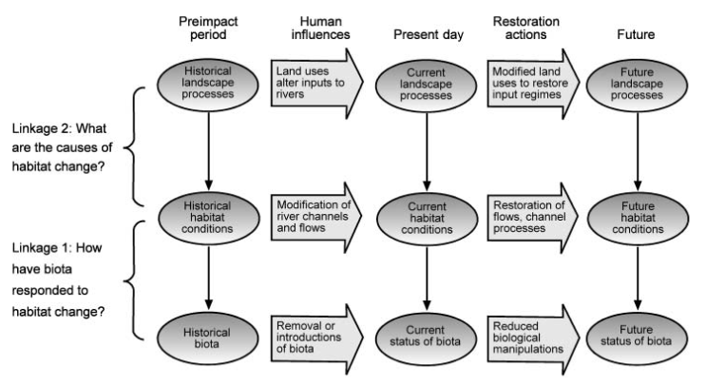

Slide 15
Classes
Three restoration classes
Full restoration
Preferred
Partial restoration
Normally best achievable goal, but still good
Habitat creation
Last resort

Slide 16
Full Restoration
Return river to natural regime
Restore all natural processes
Sustainment of habitats and biota
Examples
Blocking drainage channels
Increases flooding
Adding wood structures at natural jam points
Forms pools and overbank flooding
Removing nonnative trees
Restore nature riparian vegitation

Slide 17
Partial Restoration
Restore select processes
Mimic essential components of natural hydrograph
Most common class
Optimal for areas with limitations from land use or other human activity
Example
Managing flow regime in a dammed river
Improves ecosystem health

Slide 18
Habitat Creation
Treatment of symptoms, but not causes
Not process-based
Sometimes only option in urbanized and heavy land use areas
Results in a static imitation of a habitat that could naturally exist
Example
Reintroduction of wood into river system
Treats loss of wood but not cause of wood loss

Slide 19
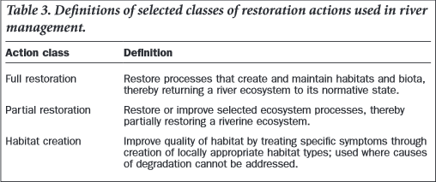
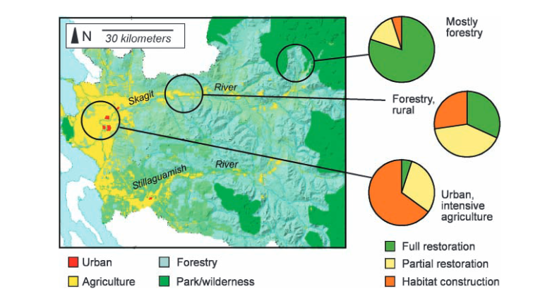

Slide 20
Conclusion
Process-based restoration
Treats causes of degradation, not just symptoms
Restoration of natural river regime
Principles
Provides guidelines for sustainable restoration efforts
Target, Tailor, Scale, Predict
Restoration classes
Determined by type and magnitude of land use

