Slide 1
WOU Board of Trustees
FINANCE & ADMINISTRATION COMMITTEE ~ June 3, 2019

Slide 2
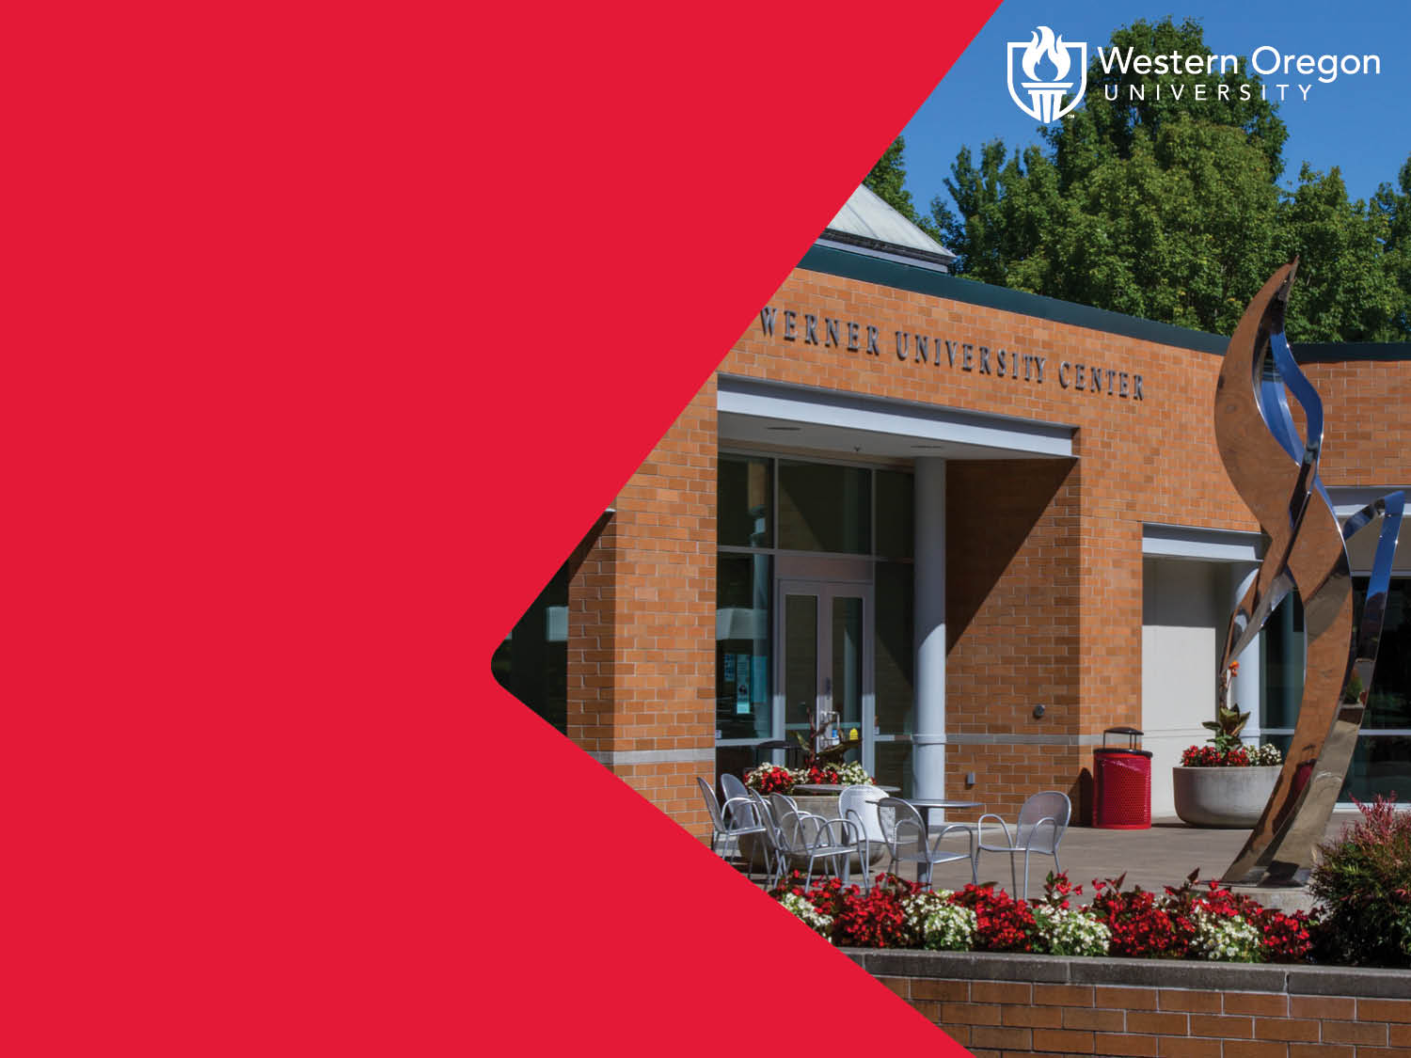
WOU Facilities Services
2019 Summer Projects

Slide 3
WOU SUMMER PROJECTS 2019
Capital Improvements & Deferred Maintenance
Notes:
Combination of improvements and addressing deferred maintenance.
Highest percentage is Asphalt and sidewalk work and that is all deferred maintenance. Includes some work around OMA which offsets some of the potential construction costs for this project.
Second highest is roof work and these are basically “have to” projects since all the roofs getting work have serious leaks.
Third is Print / Mailroom relocation between ITC and OMA.

Slide 4
Totals By Project
CIR-Cap Repairs XI-Q 2017A & XI-2019A
Non-related ITC or OMA Cap Repairs Spending:
Admin HVAC Efficiencies | $ (210,000.00)
Asphalt & Concrete ADA Improvements | $ (750,000.00)
Boiler Modifications | $ (212,000.00)
Cottage Roof Improvements | $ (150,000.00)
Elevator Upgrades | $ (120,000.00)
Fire Alarm Panel Upgrades | $ (300,000.00)
Rice Lighting Efficiencies | $ (327,000.00)
OMA Sidewlks | $ (103,000.00)
Other Sidewalks | $ (147,000.00)
Natural Science Roof replacement | $ (375,000.00)
OMA/ITC Print / Mailroom relocation | $ (425,000.00)
Todd Hall Renovation | $ (190,000.00)
Total | $ (3,309,000.00)
Notes:
Note that HVAC is the largest need. Our HVAC systems are dated and inefficient so there is opportunity to greatly improve energy costs.
ADA needs continues to be a need and is consistently being addressed.
Electrical refers to project involving building infrastructure.
Energy mostly includes energy savings through improving insulation or replacing windows on buildings to reduce energy loss.

