Slide 1
Modernizing Accounting & Business Services

Slide 2
Division of Finance & Administration
Mission
The Division of Finance & Administration supports WOU by providing a culture of leadership, innovative solutions, and efficiency through transparency, collaboration, and integrity.
Vision
To be the partner of choice.
Finance & Planning Goal
Provide transparent and sustainable operations through modernization.

Slide 3
All Objectives – Finance & Planning
Improve quality of receivables
Improve process efficiencies & establish best practices for all financial functions
Educate campus on accounting & budgeting processes
Increase financial reporting and processes self-sufficiency

Slide 4
Objective:
Improve Quality of Receivables
Extend 1st payment due date by one month beginning Fall 2019
Establish collections policy that reflects best practices
All AR over 10 years are reviewed on ongoing basis
Develop a dashboard to evaluate the quality of receivables on a monthly basis
Electronic Billing
Action Items FY 2019-2020

Slide 5
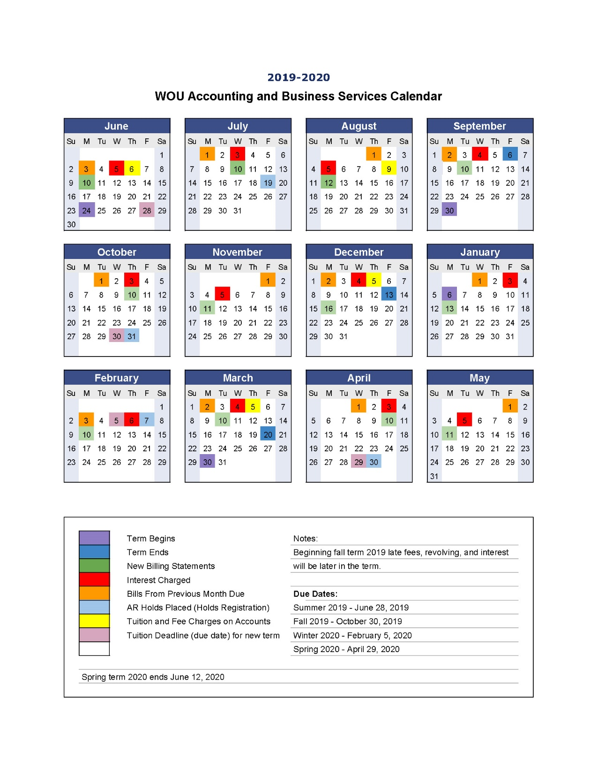

Slide 6
Objective:
Improve process efficiencies & establish best practices for all financial functions
Drafted travel policy that simplifies travel reimbursement for both WOU and employees
Implementing document management system for AP invoices, Journal Vouchers, P-Card reports and receipts
Implementing credit card terminals for Cashiers, AR Accountant, and Collection Accountant
Creating Desk Manuals for each position
Action Items FY 2019-2020

Slide 7
Objective:
Educate campus on accounting & budget processes
Produce Banner 9 Accounting related user self-study training videos (Director of Accounting & FA Accountant)
Produce Banner 9 Budget related user self-study training videos (Budget Manager)
P-Card training videos (P-Card & Procurement Accountant)
Document management system training (TBD)
Action Items FY 2019-2020

Slide 8
Objective:
Increase financial reporting and process self-sufficiency
FYE 6/30/19 – produce audited FY19 financial statements in tandem with USSE
Utilize GASB Reporting Function in Banner to generate quarterly & annual financial statements
Implement bank reconciliations and cash flow projections in-house (Treasurer)
Action Items FY 2019-2020

