Slide 1
University Technology Advisory Committee (UTAC)
June 2019

Slide 2
DUO UPDATE
What is DUO?
Multifactor authentication
Why use multifactor authentication
Credentials are easily compromised through social engineering
Where will it be used?
Portal login (phase 1)
Account lookup (phase 2)
Rollout plan
Phase 1 - Begins: May 2019 Complete: October 2019
All of UCS – completed
Banner users – started
Non-Banner staff
Non-Banner faculty
Students – opt-in

Slide 3
Learning Management System
LMS Review Committee, subcommittee of UTAC
Review outcome
Stay with our current LMS – active since 2008
Make a change to a new LMS
Make recommendations on better ways to support our LMS
The process
http://www.wou.edu/wp/lms-review/project-overview/
If there is a new LMS, full implementation would begin Fall 2020
Old LMS would be supported for a designated period of time

Slide 4
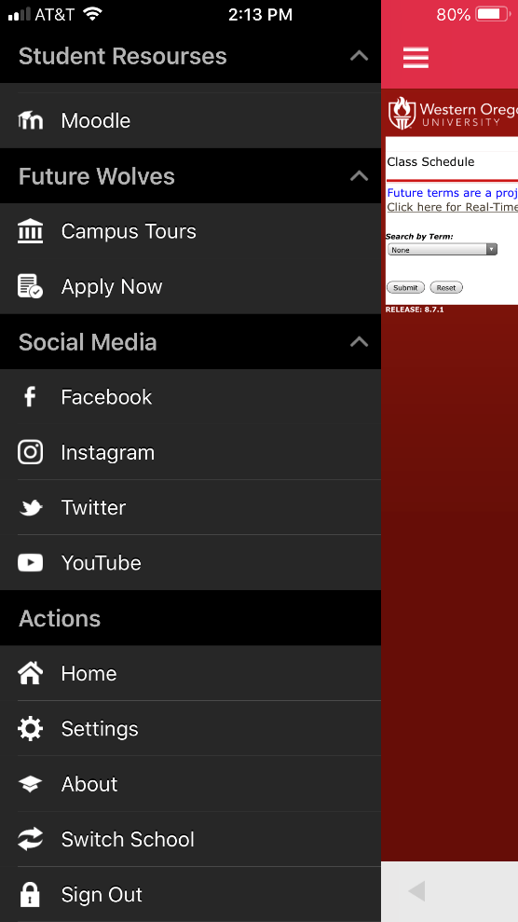
Ellucian Mobile
Currently in production
Additional functionality will be added, when available
College Scheduler
…and others

Slide 5
Technology Plan
Subcommittee formed
Technology plan will be directly related to each section of the University Strategic Plan
Expect a draft outline related to student success by the June UTAC meeting
Completion goal: Spring 2020

