Slide 1
The Four Freedoms, 1943 & The Problem We All Live With, 1964
Paintings by
Norman Rockwell

Slide 2
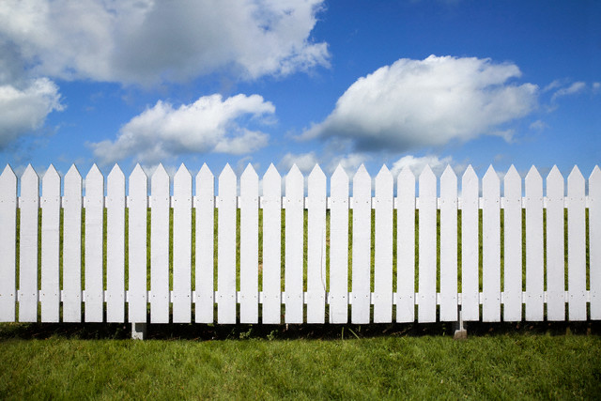

Slide 3
Freedom to Worship, 1943

Slide 4
“The Great American Pastime” by Megan Clark “The American Dream: Opportunity” by Brianda Gutierrez “The Fundamental Flaw of the American Dream: A Formula in Flux” by Taylor Schnell “Waking Up from the American Dream” by Brandy Balas “Putting the American Dream on Trial” by Danielle Hannan

Slide 5
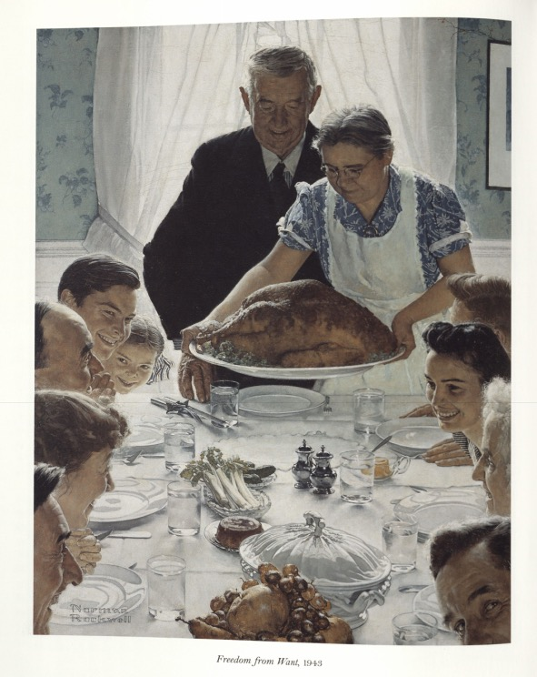
Freedom from Want, 1943

Slide 6
“The Great American Pastime” by Megan Clark “The American Dream: Opportunity” by Brianda Gutierrez “The Fundamental Flaw of the American Dream: A Formula in Flux” by Taylor Schnell “Waking Up from the American Dream” by Brandy Balas “Putting the American Dream on Trial” by Danielle Hannan

Slide 7
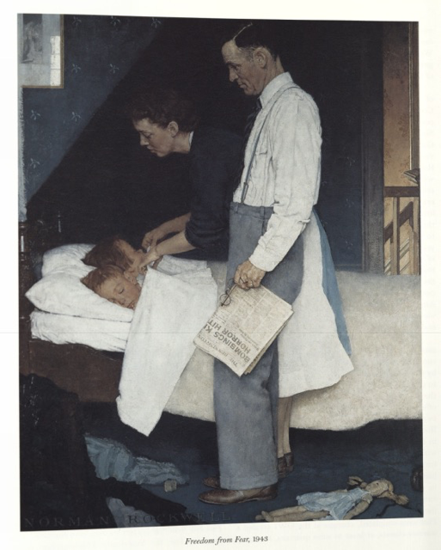
Freedom from Fear, 1943

Slide 8
“The Great American Pastime” by Megan Clark “The American Dream: Opportunity” by Brianda Gutierrez “The Fundamental Flaw of the American Dream: A Formula in Flux” by Taylor Schnell “Waking Up from the American Dream” by Brandy Balas “Putting the American Dream on Trial” by Danielle Hannan

Slide 9
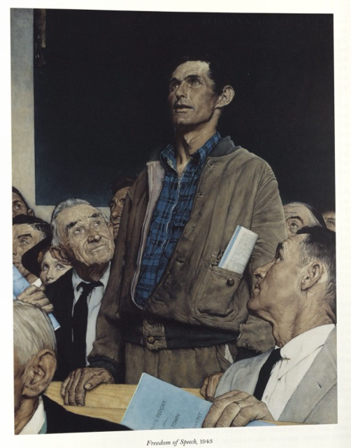
Freedom of Speech, 1943

Slide 10
“The Great American Pastime” by Megan Clark “The American Dream: Opportunity” by Brianda Gutierrez “The Fundamental Flaw of the American Dream: A Formula in Flux” by Taylor Schnell “Waking Up from the American Dream” by Brandy Balas “Putting the American Dream on Trial” by Danielle Hannan

Slide 11
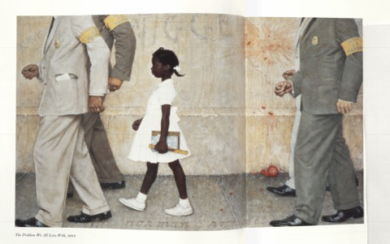
The Problem We All Live With, 1964

Slide 12
“The Great American Pastime” by Megan Clark “The American Dream: Opportunity” by Brianda Gutierrez “The Fundamental Flaw of the American Dream: A Formula in Flux” by Taylor Schnell “Waking Up from the American Dream” by Brandy Balas “Putting the American Dream on Trial” by Danielle Hannan

Slide 13
Freedom to Worship, 1943

Slide 14
“The Great American Pastime” by Megan Clark “The American Dream: Opportunity” by Brianda Gutierrez “The Fundamental Flaw of the American Dream: A Formula in Flux” by Taylor Schnell “Waking Up from the American Dream” by Brandy Balas “Putting the American Dream on Trial” by Danielle Hannan

Slide 15
Freedom from Want, 1943

Slide 16
“The Great American Pastime” by Megan Clark “The American Dream: Opportunity” by Brianda Gutierrez “The Fundamental Flaw of the American Dream: A Formula in Flux” by Taylor Schnell “Waking Up from the American Dream” by Brandy Balas “Putting the American Dream on Trial” by Danielle Hannan

Slide 17
Freedom from Fear, 1943

Slide 18
“The Great American Pastime” by Megan Clark “The American Dream: Opportunity” by Brianda Gutierrez “The Fundamental Flaw of the American Dream: A Formula in Flux” by Taylor Schnell “Waking Up from the American Dream” by Brandy Balas “Putting the American Dream on Trial” by Danielle Hannan

Slide 19
Freedom of Speech, 1943

Slide 20
“The Great American Pastime” by Megan Clark “The American Dream: Opportunity” by Brianda Gutierrez “The Fundamental Flaw of the American Dream: A Formula in Flux” by Taylor Schnell “Waking Up from the American Dream” by Brandy Balas “Putting the American Dream on Trial” by Danielle Hannan

Slide 21
The Problem We All Live With, 1964

Slide 22
“The Great American Pastime” by Megan Clark “The American Dream: Opportunity” by Brianda Gutierrez “The Fundamental Flaw of the American Dream: A Formula in Flux” by Taylor Schnell “Waking Up from the American Dream” by Brandy Balas “Putting the American Dream on Trial” by Danielle Hannan

Slide 23
Freedom to Worship, 1943

Slide 24
“The Great American Pastime” by Megan Clark “The American Dream: Opportunity” by Brianda Gutierrez “The Fundamental Flaw of the American Dream: A Formula in Flux” by Taylor Schnell “Waking Up from the American Dream” by Brandy Balas “Putting the American Dream on Trial” by Danielle Hannan

Slide 25
Freedom from Want, 1943

Slide 26
“The Great American Pastime” by Megan Clark “The American Dream: Opportunity” by Brianda Gutierrez “The Fundamental Flaw of the American Dream: A Formula in Flux” by Taylor Schnell “Waking Up from the American Dream” by Brandy Balas “Putting the American Dream on Trial” by Danielle Hannan

Slide 27
Freedom from Fear, 1943

Slide 28
“The Great American Pastime” by Megan Clark “The American Dream: Opportunity” by Brianda Gutierrez “The Fundamental Flaw of the American Dream: A Formula in Flux” by Taylor Schnell “Waking Up from the American Dream” by Brandy Balas “Putting the American Dream on Trial” by Danielle Hannan

Slide 29
Freedom of Speech, 1943

Slide 30
“The Great American Pastime” by Megan Clark “The American Dream: Opportunity” by Brianda Gutierrez “The Fundamental Flaw of the American Dream: A Formula in Flux” by Taylor Schnell “Waking Up from the American Dream” by Brandy Balas “Putting the American Dream on Trial” by Danielle Hannan

Slide 31
The Problem We All Live With, 1964

Slide 32
“The Great American Pastime” by Megan Clark “The American Dream: Opportunity” by Brianda Gutierrez “The Fundamental Flaw of the American Dream: A Formula in Flux” by Taylor Schnell “Waking Up from the American Dream” by Brandy Balas “Putting the American Dream on Trial” by Danielle Hannan

Slide 33
Freedom to Worship, 1943

Slide 34
“The Great American Pastime” by Megan Clark “The American Dream: Opportunity” by Brianda Gutierrez “The Fundamental Flaw of the American Dream: A Formula in Flux” by Taylor Schnell “Waking Up from the American Dream” by Brandy Balas “Putting the American Dream on Trial” by Danielle Hannan

Slide 35
Freedom from Want, 1943

Slide 36
“The Great American Pastime” by Megan Clark “The American Dream: Opportunity” by Brianda Gutierrez “The Fundamental Flaw of the American Dream: A Formula in Flux” by Taylor Schnell “Waking Up from the American Dream” by Brandy Balas “Putting the American Dream on Trial” by Danielle Hannan

Slide 37
Freedom from Fear, 1943

Slide 38
“The Great American Pastime” by Megan Clark “The American Dream: Opportunity” by Brianda Gutierrez “The Fundamental Flaw of the American Dream: A Formula in Flux” by Taylor Schnell “Waking Up from the American Dream” by Brandy Balas “Putting the American Dream on Trial” by Danielle Hannan

Slide 39
Freedom of Speech, 1943

Slide 40
“The Great American Pastime” by Megan Clark “The American Dream: Opportunity” by Brianda Gutierrez “The Fundamental Flaw of the American Dream: A Formula in Flux” by Taylor Schnell “Waking Up from the American Dream” by Brandy Balas “Putting the American Dream on Trial” by Danielle Hannan

Slide 41
The Problem We All Live With, 1964

Slide 42
“The Great American Pastime” by Megan Clark “The American Dream: Opportunity” by Brianda Gutierrez “The Fundamental Flaw of the American Dream: A Formula in Flux” by Taylor Schnell “Waking Up from the American Dream” by Brandy Balas “Putting the American Dream on Trial” by Danielle Hannan

Slide 43
Freedom to Worship, 1943

Slide 44
“The Great American Pastime” by Megan Clark “The American Dream: Opportunity” by Brianda Gutierrez “The Fundamental Flaw of the American Dream: A Formula in Flux” by Taylor Schnell “Waking Up from the American Dream” by Brandy Balas “Putting the American Dream on Trial” by Danielle Hannan

Slide 45
Freedom from Want, 1943

Slide 46
“The Great American Pastime” by Megan Clark “The American Dream: Opportunity” by Brianda Gutierrez “The Fundamental Flaw of the American Dream: A Formula in Flux” by Taylor Schnell “Waking Up from the American Dream” by Brandy Balas “Putting the American Dream on Trial” by Danielle Hannan

Slide 47
Freedom from Fear, 1943

Slide 48
“The Great American Pastime” by Megan Clark “The American Dream: Opportunity” by Brianda Gutierrez “The Fundamental Flaw of the American Dream: A Formula in Flux” by Taylor Schnell “Waking Up from the American Dream” by Brandy Balas “Putting the American Dream on Trial” by Danielle Hannan

Slide 49
Freedom of Speech, 1943

Slide 50
“The Great American Pastime” by Megan Clark “The American Dream: Opportunity” by Brianda Gutierrez “The Fundamental Flaw of the American Dream: A Formula in Flux” by Taylor Schnell “Waking Up from the American Dream” by Brandy Balas “Putting the American Dream on Trial” by Danielle Hannan

Slide 51
The Problem We All Live With, 1964

Slide 52
“The Great American Pastime” by Megan Clark “The American Dream: Opportunity” by Brianda Gutierrez “The Fundamental Flaw of the American Dream: A Formula in Flux” by Taylor Schnell “Waking Up from the American Dream” by Brandy Balas “Putting the American Dream on Trial” by Danielle Hannan

